Slide 1
A Primer on Quantile Regression for Epidemiologists
Aayush Khadka, Jilly Hebert, Amanda Irish, and Anusha M. Vable
Department of Family and Community Medicine University of California, San Francisco

Slide 2
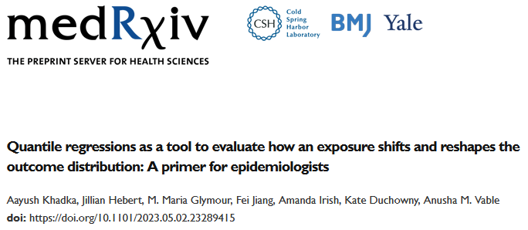


Slide 3
Funding and acknowledgements
Funding: National Institute on Aging (R01 AG069092, PI Vable).
Many thanks to:
VabLab team
Maria Glymour’s research team
Dr. Catherine Duarte

Slide 4
Overall learning aims
Theory | Practice
What is quantile regression and why do we care about it? | How do we run quantile regression analyses in R?
How does quantile regression differ from mean regression? | How can we visualize quantile regression coefficients?
How do estimators targeted at quantiles of the conditional vs. unconditional outcome distributions differ from one another?

Slide 5
Overall learning aims
Theory | Practice
What is quantile regression and why do we care about it? | How do we run quantile regression analyses in R?
How does quantile regression differ from mean regression? | How can we visualize quantile regression coefficients?
How do estimators targeted at quantiles of the conditional vs. unconditional outcome distributions differ from one another?

Slide 6
Overall learning aims
Theory | Practice
What is quantile regression and why do we care about it? | How do we run quantile regression analyses in R?
How does quantile regression differ from mean regression? | How can we visualize quantile regression coefficients?
How do estimators targeted at quantiles of the conditional vs. unconditional outcome distributions differ from one another?

Slide 7
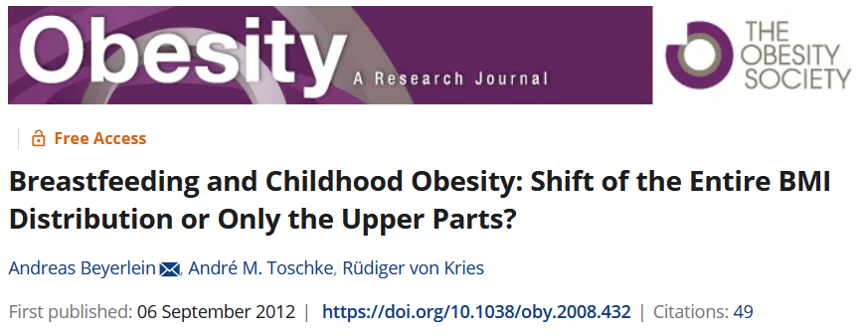
Quantile regressions at work

Slide 8
Breastfeeding and childhood obesity Beyerlein et. al. (2012)
Meta-analyses present inconsistent findings
Protective effect of breastfeeding on being overweight in later-life
Unclear association of breastfeeding with body mass index (BMI)
Hypothesis: breastfeeding affects upper percentiles of BMI
Methods:
Data on height, weight, socio-demographics from a school-entry health examination in Bavaria, Germany (N = 14,412)
Exposure: breastfed (yes/no)
Outcome: BMI
Methods: linear regression (BMI), logistic regression (obesity), quantile regressions (BMI)

Slide 9
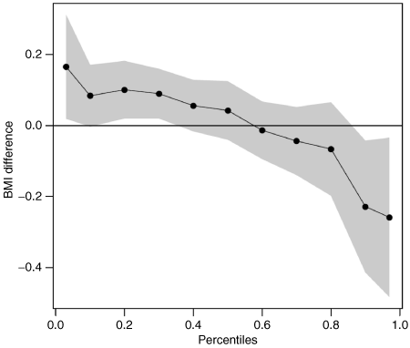
Breastfeeding reduced BMI values at high levels and increased BMI values at low levels

Slide 10
Linear regression results suggest no association between breastfeeding and BMI

Slide 11
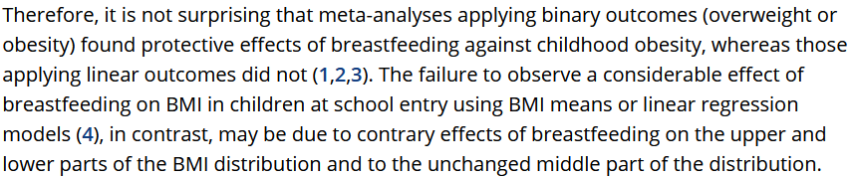
A potential resolution of the inconsistency in the meta-analysis results

Slide 12
Previewing our practical example
We will investigate the relationship between educational attainment and systolic blood pressure (SBP) in later-life
Education has a strong, inverse relationship with average SBP levels
There may be a non-linear relationship between later-life SBP and risk of coronary heart disease and stroke
Motivates the need to investigate if educational attainment affects the distribution of blood pressure

Slide 13
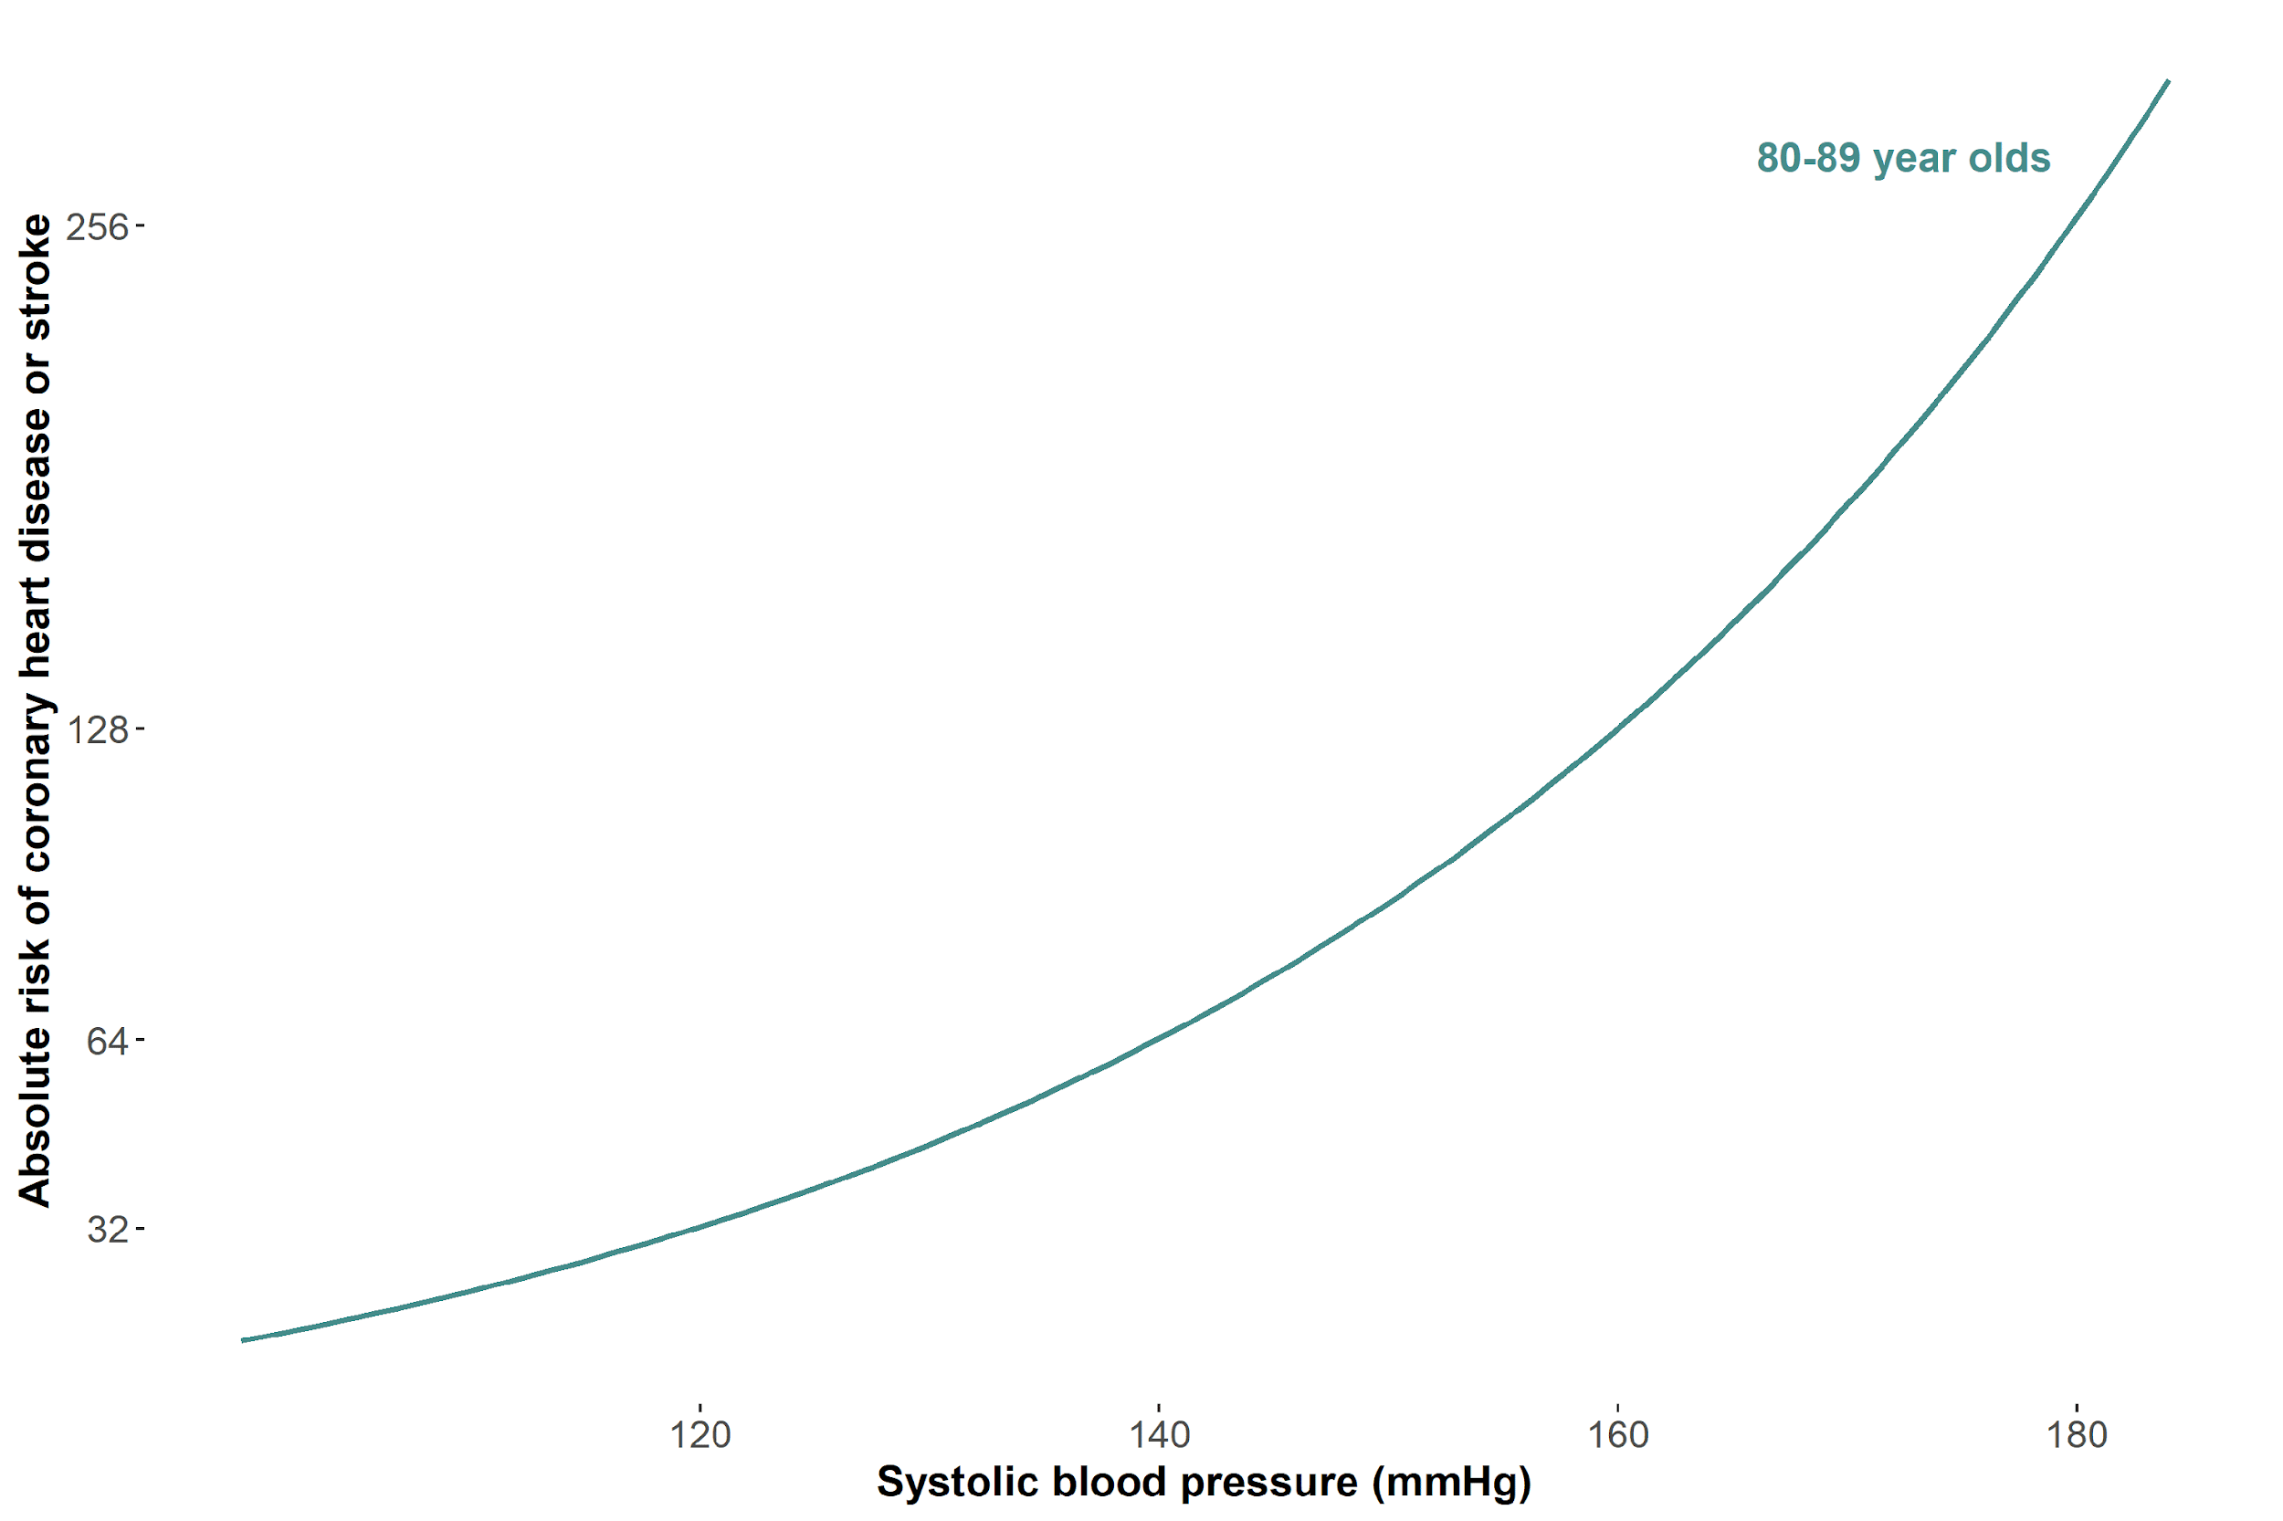
The tails matter too: case of blood pressure
This figure is a recreation of a figure from Fuchs et. al. (2020 with simulated data.
Notes:
20 mmHg change from 120-140 is an increase of 32 in absolute risk, but a 20mmHg change from 160-280 is an increase of 128 (double) of absolute risk

Slide 14
Previewing our practical example
We will use data from the US Health and Retirement Study (N = 8,875)
National sample, multi-cohort, biennially conducted longitudinal study of non-institutionalized US adults 50+ years
Exposure: Self-reported total years of schooling (5-17 years)
Outcome: First recorded SBP (2006-2018)
Covariates:
Age (linear/quadratic)
Sex (Female/Male)
Race (Black/Latinx/White)
Southern birth (yes/no)
Mother’s education (5-17 years)
Father’s education (5-17 years)
SBP measurement year (2006-2018)
Notes:
Switch to R to show data and summary

Slide 15
Teaching resources
Slide deck: theory discussion
: Key point
GitHub: includes the R code scripts, slide deck, and other resources
Link: https://github.com/VabLab/Quantile-Regression-Workshop

Slide 16
Terminology we use interchangeably

Slide 17
Terminology we use interchangeably
Marginal and unconditional

Slide 18
Terminology we use interchangeably
Marginal and unconditional
Means and expectation

Slide 19
Terminology we use interchangeably
Marginal and unconditional
Means and expectation
Scale, spread, and variance

Slide 20
Terminology we use interchangeably
Marginal and unconditional
Means and expectation
Scale, spread, and variance Percentiles and quantiles

Slide 21
Abbreviations
Abbreviation | Full form
CDF | Cumulative Distribution Function
CEF | Conditional Expectation Function
CQF | Conditional Quantile Function
CQR | Conditional Quantile Regression
DGP | Data Generating Process
IF | Influence function
OLS | Ordinary Least Squares
RIF | Recentered Influence Function
SBP | Systolic Blood Pressure
UQR | Unconditional Quantile Regression

Slide 22
Outline of the workshop
Linear regression, conditional quantile regression, and why we care about quantile regression
Unconditional quantile regression
Standard errors
Visualization
Extensions
Conclusion
Notes:
Intro – Aayush, 1 – Jilly; 2 – Aayush; 3 – Aayush; 4 – Amanda; 5 – Aayush; 6 – Jilly

Slide 23
Key takeaways from this workshop
Why investigating the effect of an exposure across the entire outcome distribution is substantively important
How to model associations between an exposure and the conditional or unconditional outcome distribution
How to appropriately adjust standard errors, and subsequently confidence intervals
How to visualize quantile regression estimates, and potential counterfactual distributions associated with those estimates

Slide 24
Linear regression and Conditional quantile regressions (CQR)
And why we care

Slide 25
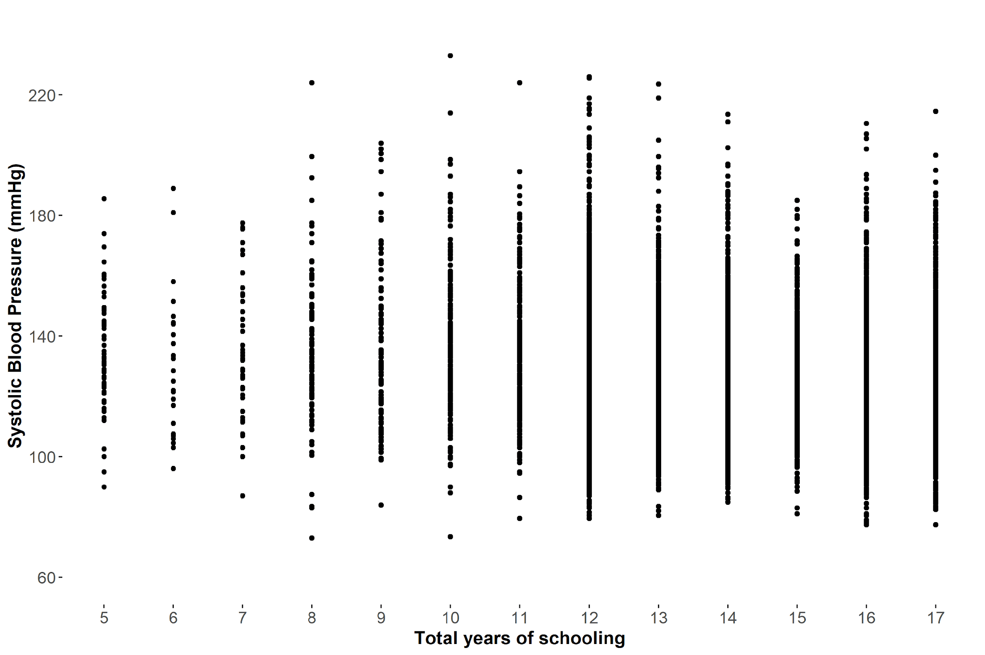
Objective: Quantify the association of education with SBP

Slide 26
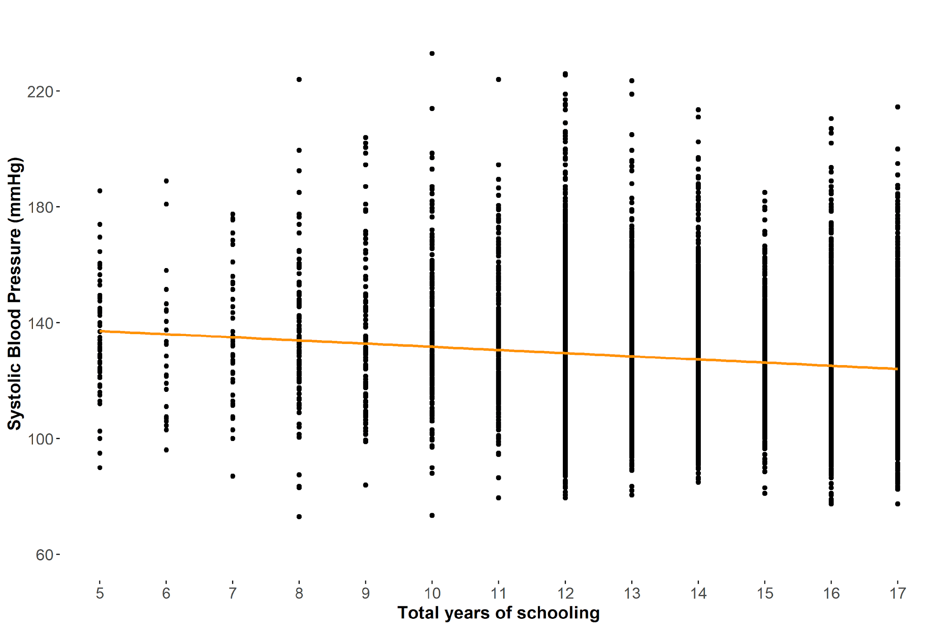
Potential solution: lm(sbp ~ schlyrs)
Notes:
Switch to R here (show unadjusted then adjusted)

Slide 27
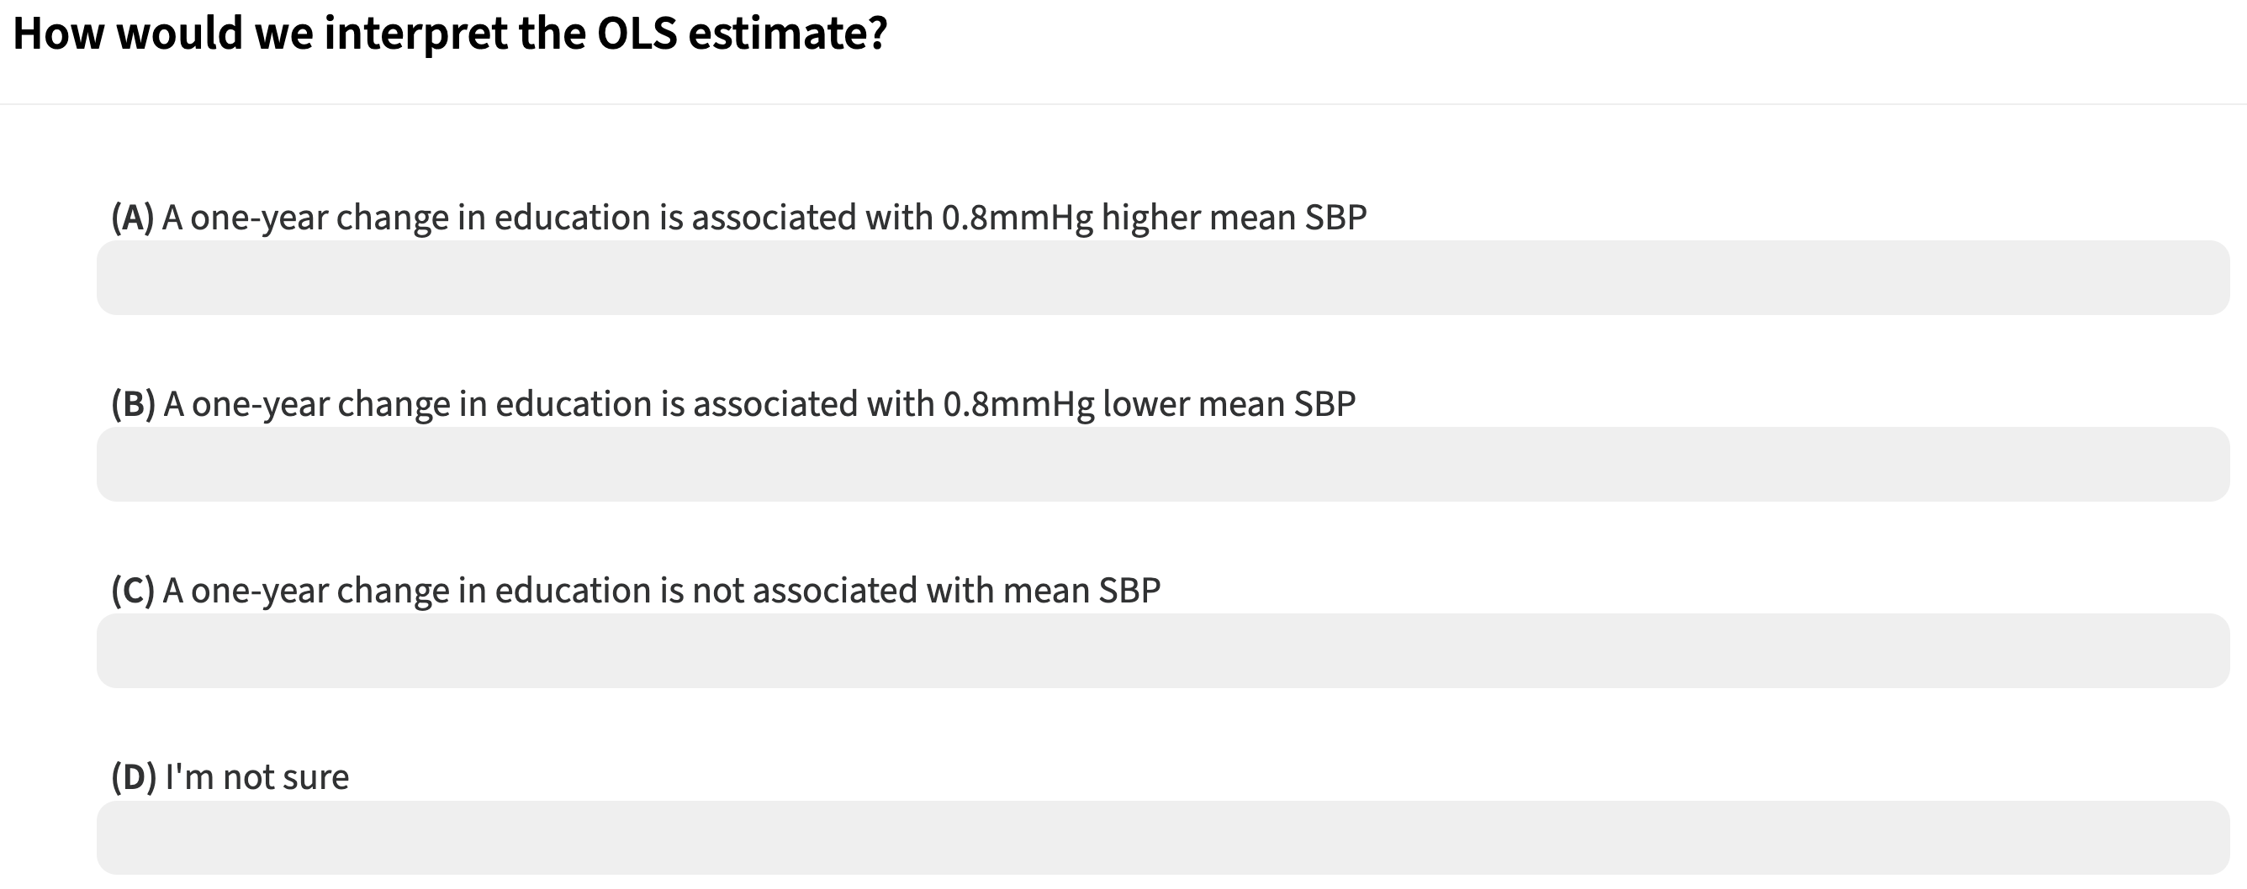
Notes:
Adjusted model results (est = -0.79)

Slide 28
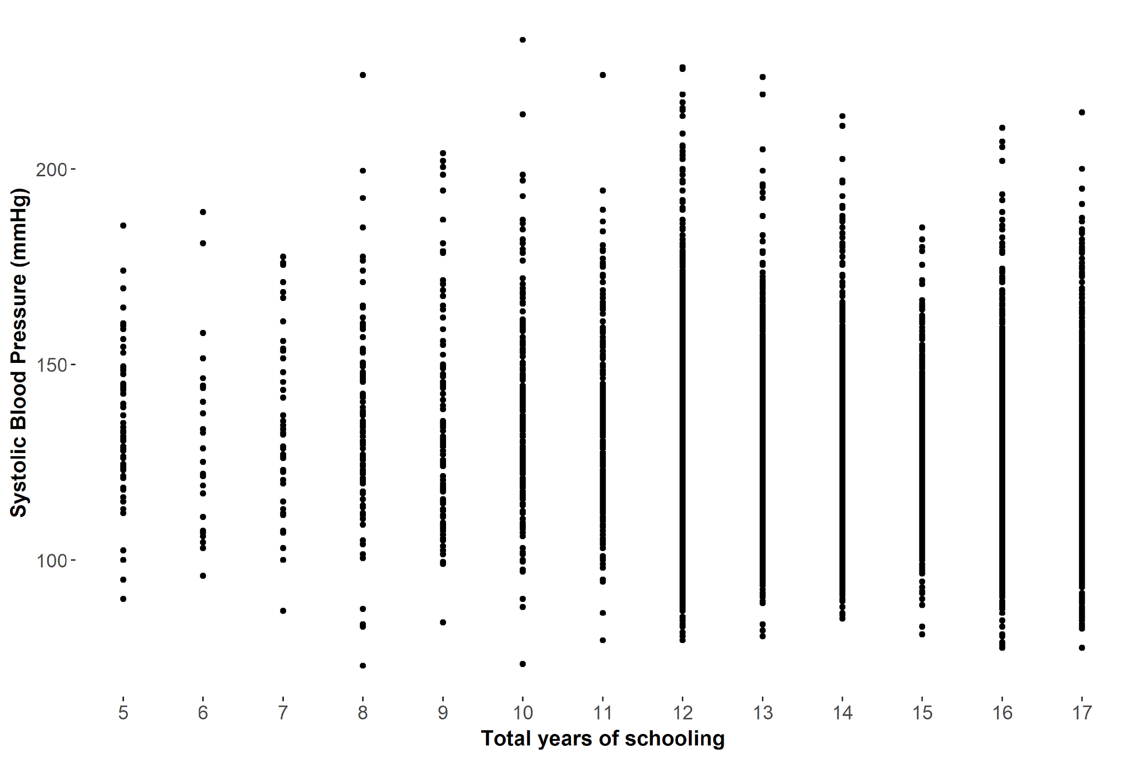
Calculate mean SBP by education level (i.e., the conditional expectation)

Slide 29
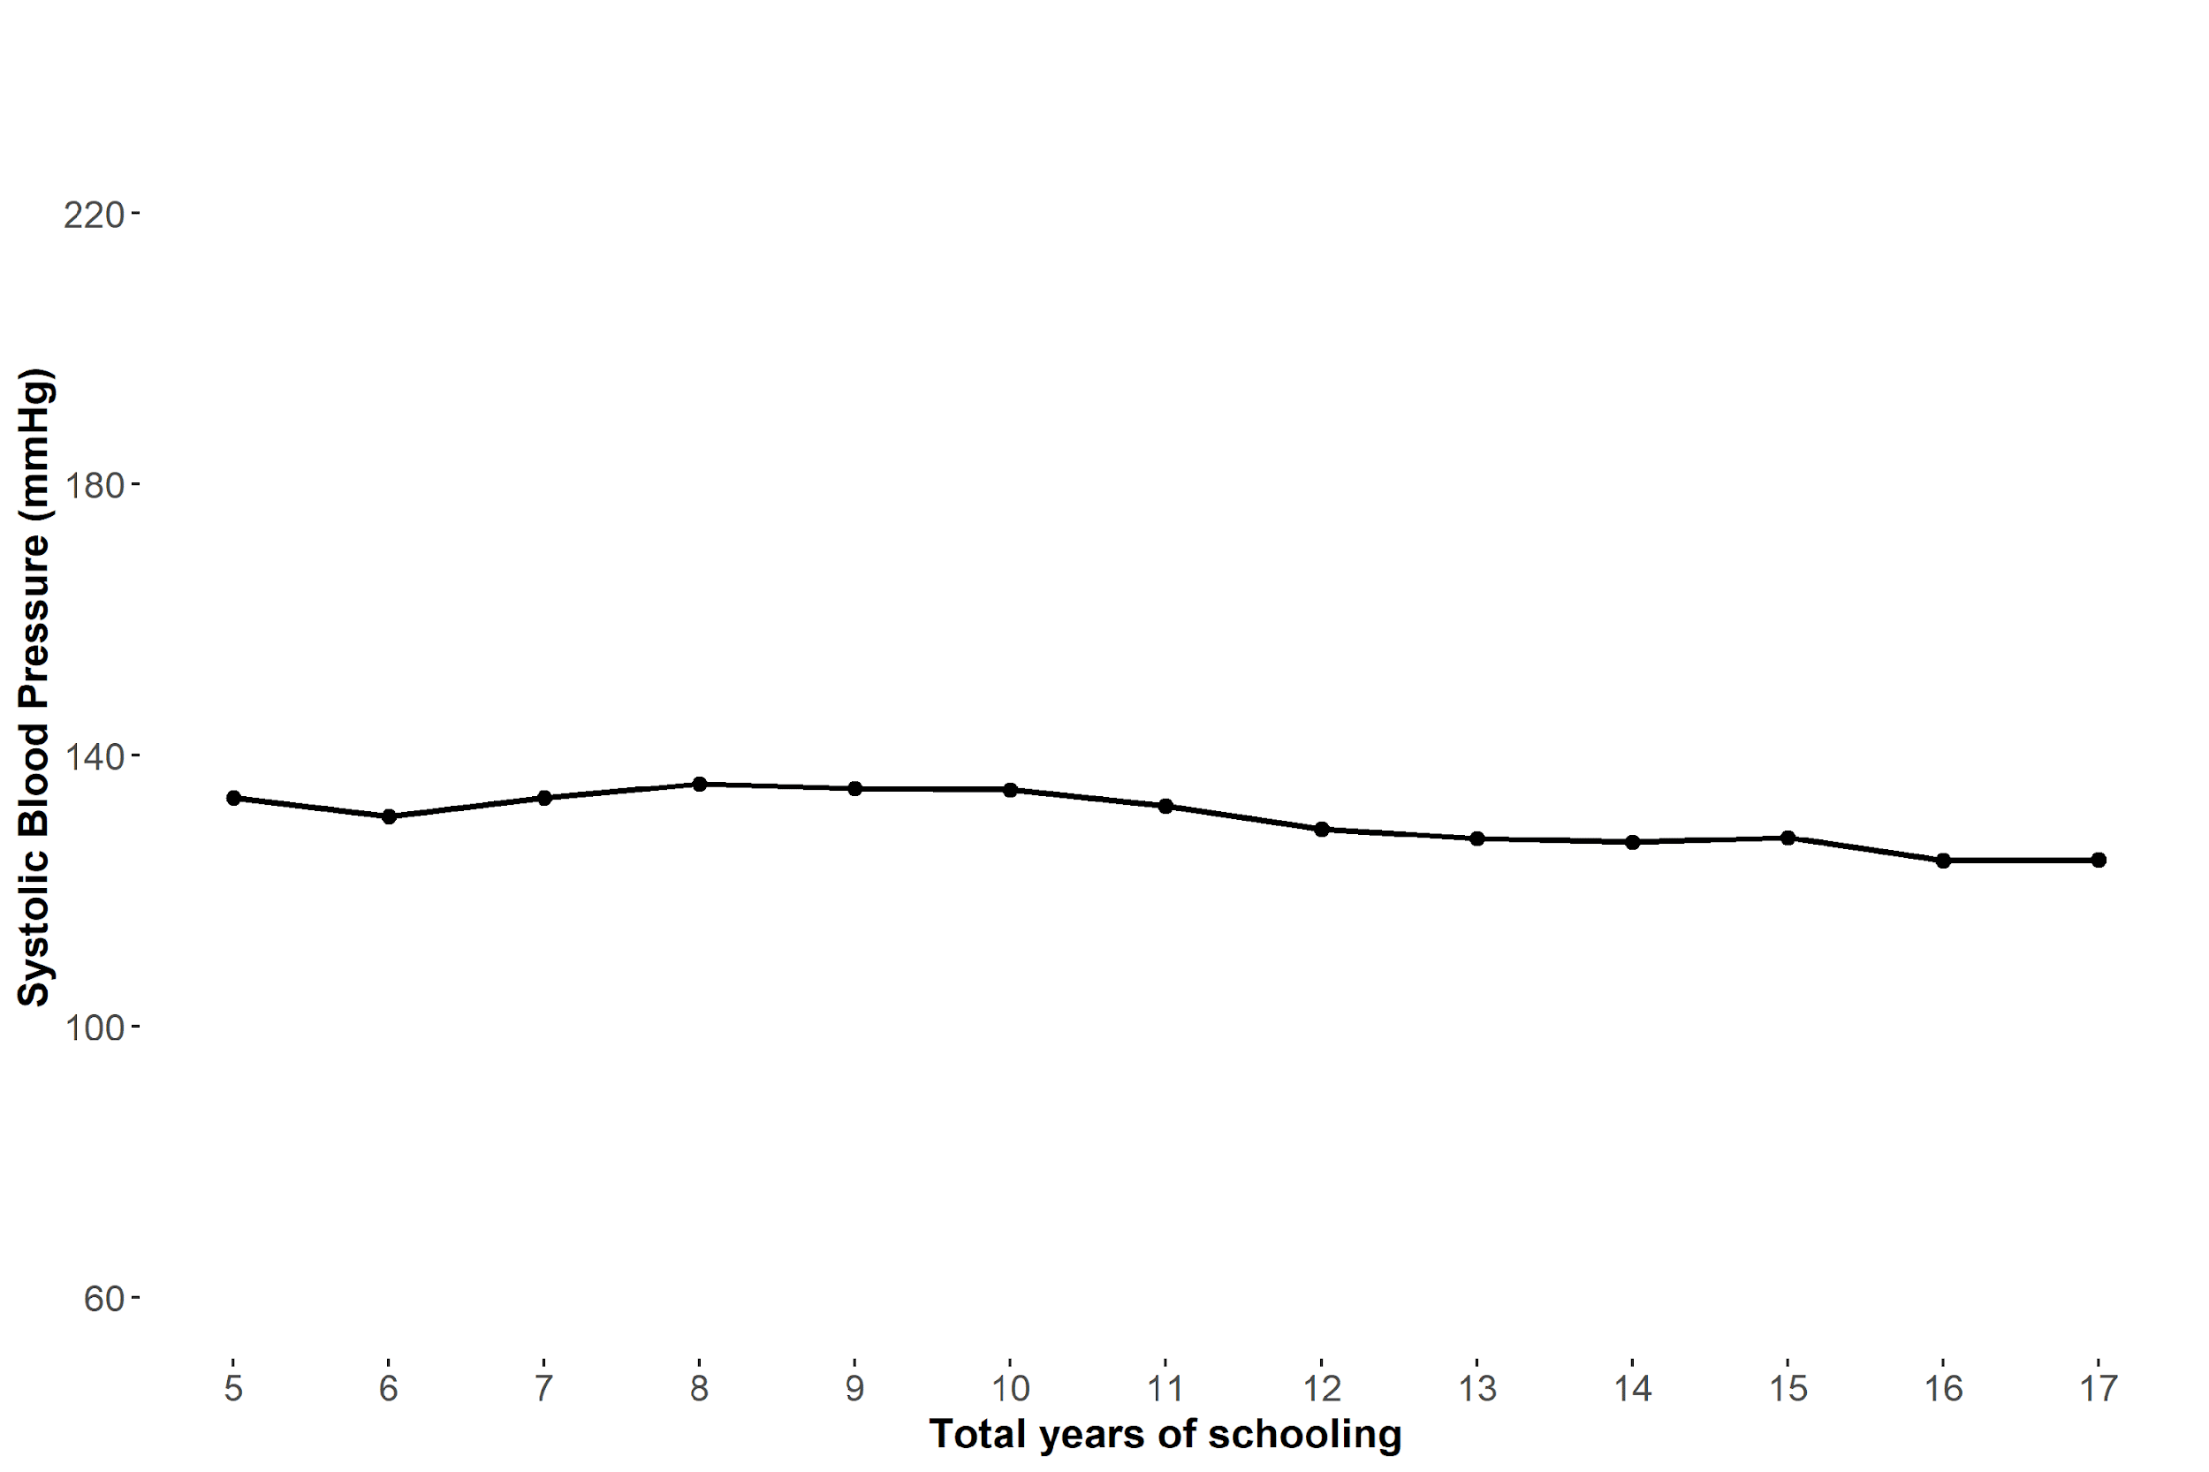
Conditional expectation function (CEF) links the conditional means

Slide 30
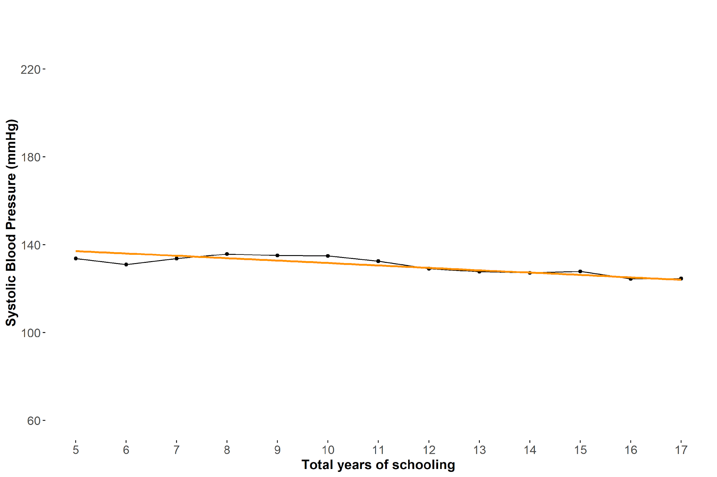
Linear regression line ≈ CEF

Slide 31

$$E\left[SBP | schlyrs\right]=β_{0}+β_{1}schlyrs_{i}$$
Notes:
Expression

Slide 32
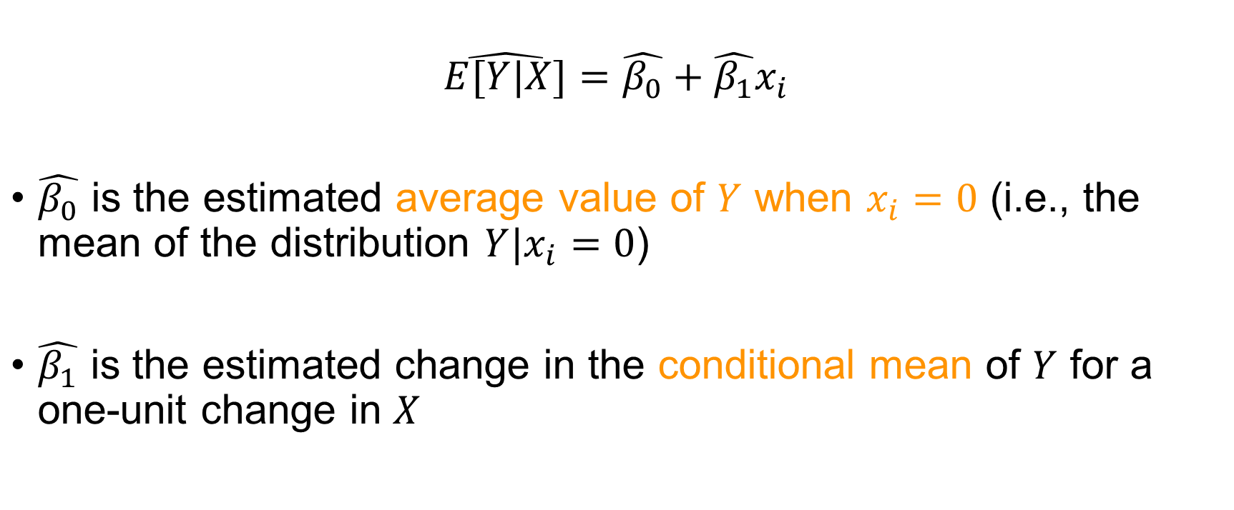
Interpreting coefficients of a simple linear regression
$$\hat{E[Y|X]}=\hat{β_{0}}+\hat{β_{1}}x_{i}$$
$\hat{β_{0}}$ is the estimated average value of $Y$ when $x_{i}=0$ (i.e., the mean of the distribution $Y|x_{i}=0$)
$\hat{β_{1}}$ is the estimated change in the conditional mean of $Y$ for a one-unit change in $X$

Slide 33
Since it is a model of the conditional expectation function, linear regression provides us with an estimate for how the mean of the outcome changes as we change the exposure by one unit

Slide 34
What if we want to calculate estimates for how other parts of the distribution change as we change the exposure by one unit?

Slide 35
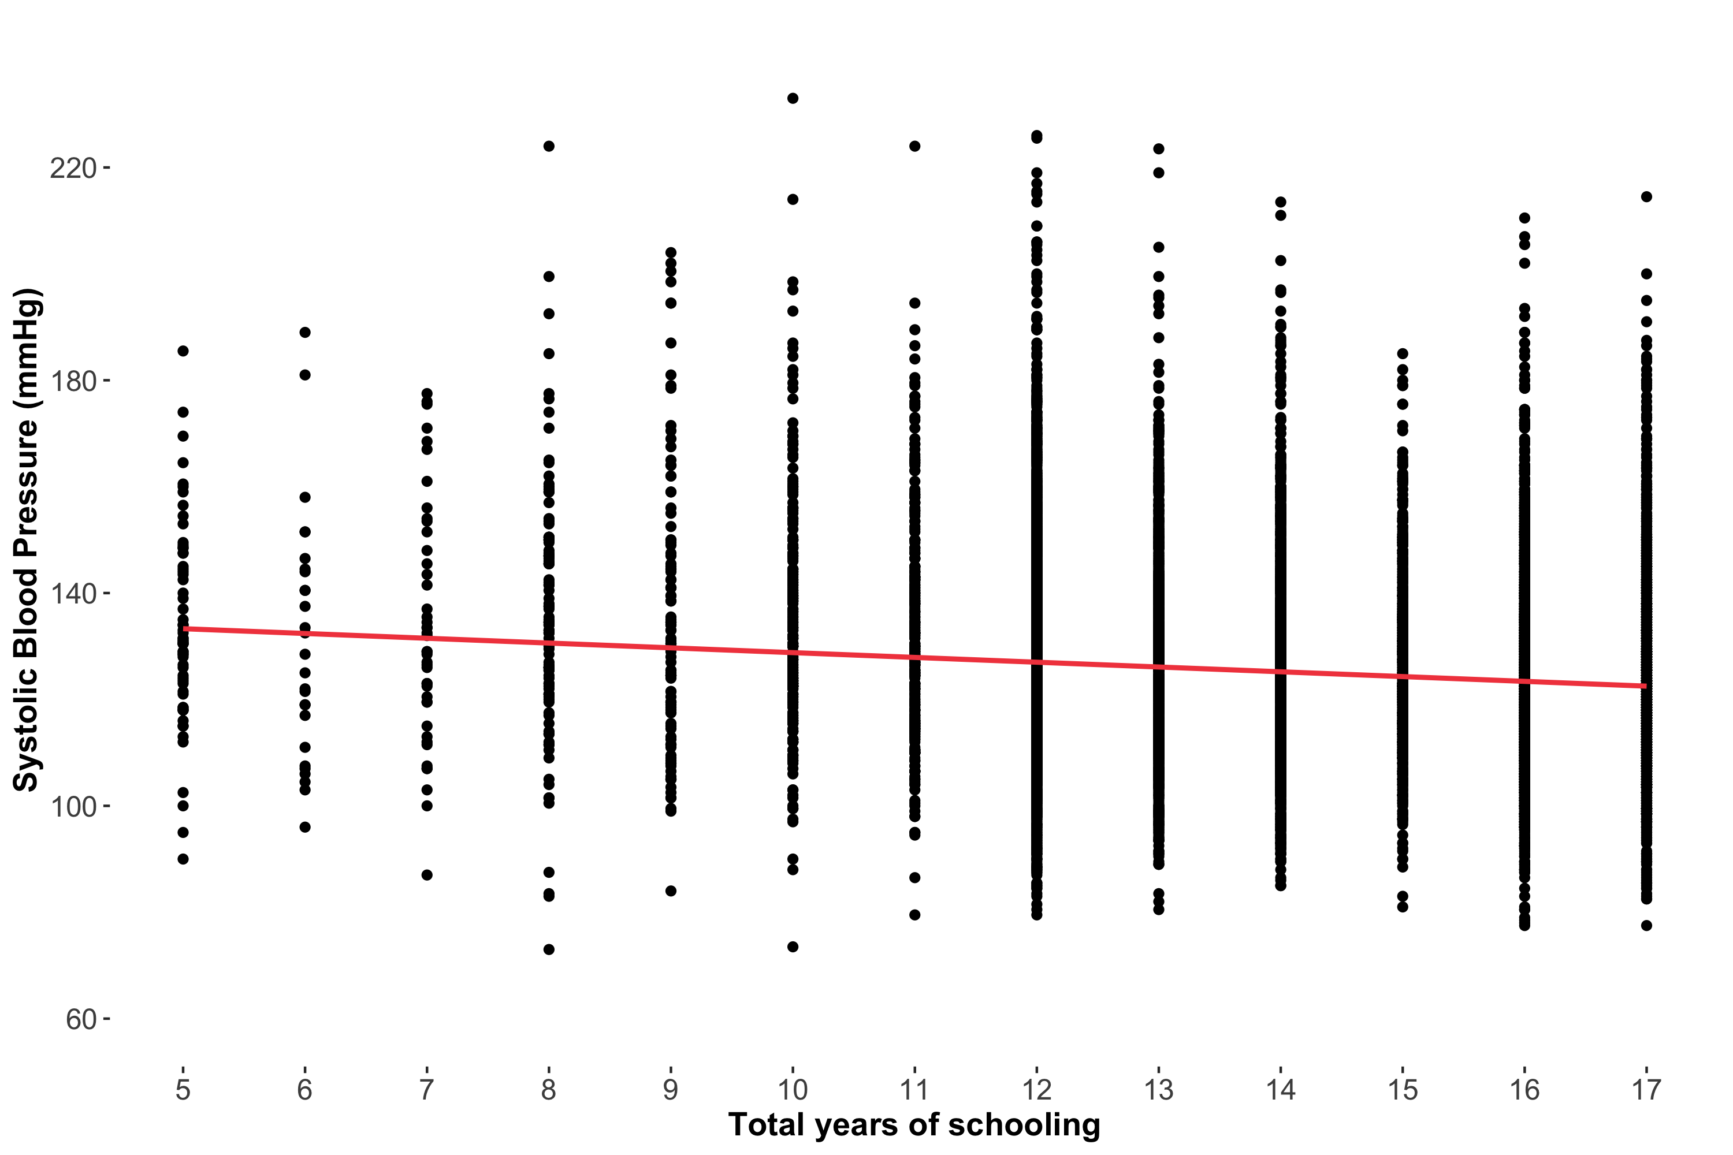
Notes:
Switch to R here (show CQR adjusted)
Quantreg package, rq()

Slide 36
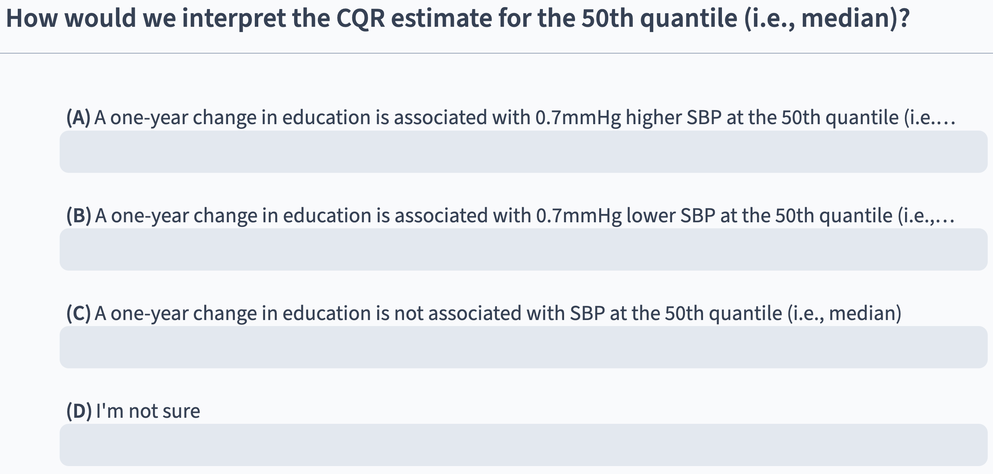
Notes:
CQR 50 adjusted (est = -0.72)

Slide 37
Interpreting CQR results follows the same framework as interpreting linear regression results, except estimates are now about how the quantile of interest of the outcome changes (as opposed to the mean)
Notes:
Congratulations, you fit your first CQR!

Slide 38
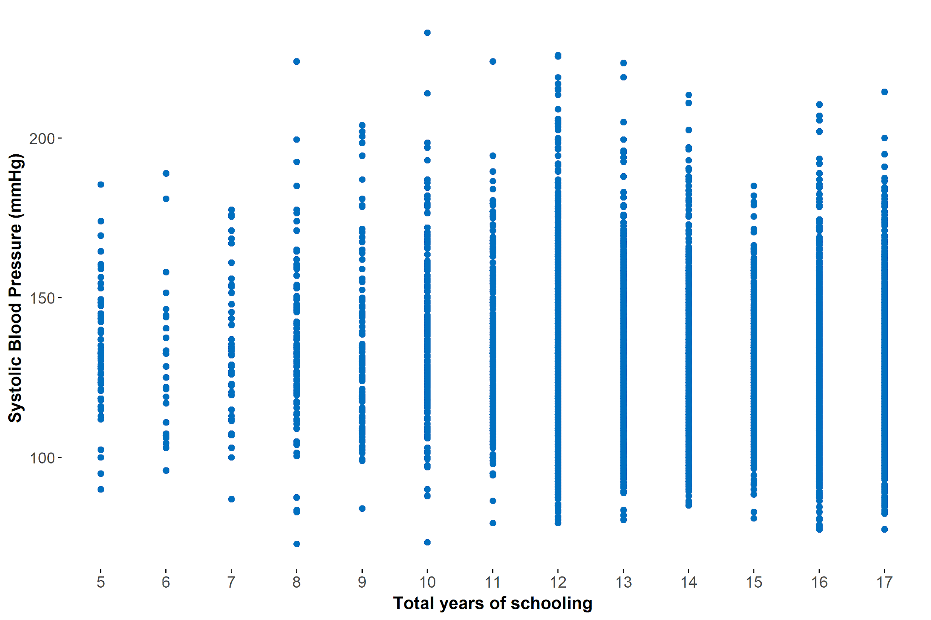
Imagine that we calculated the conditional 25th quantile instead

Slide 39
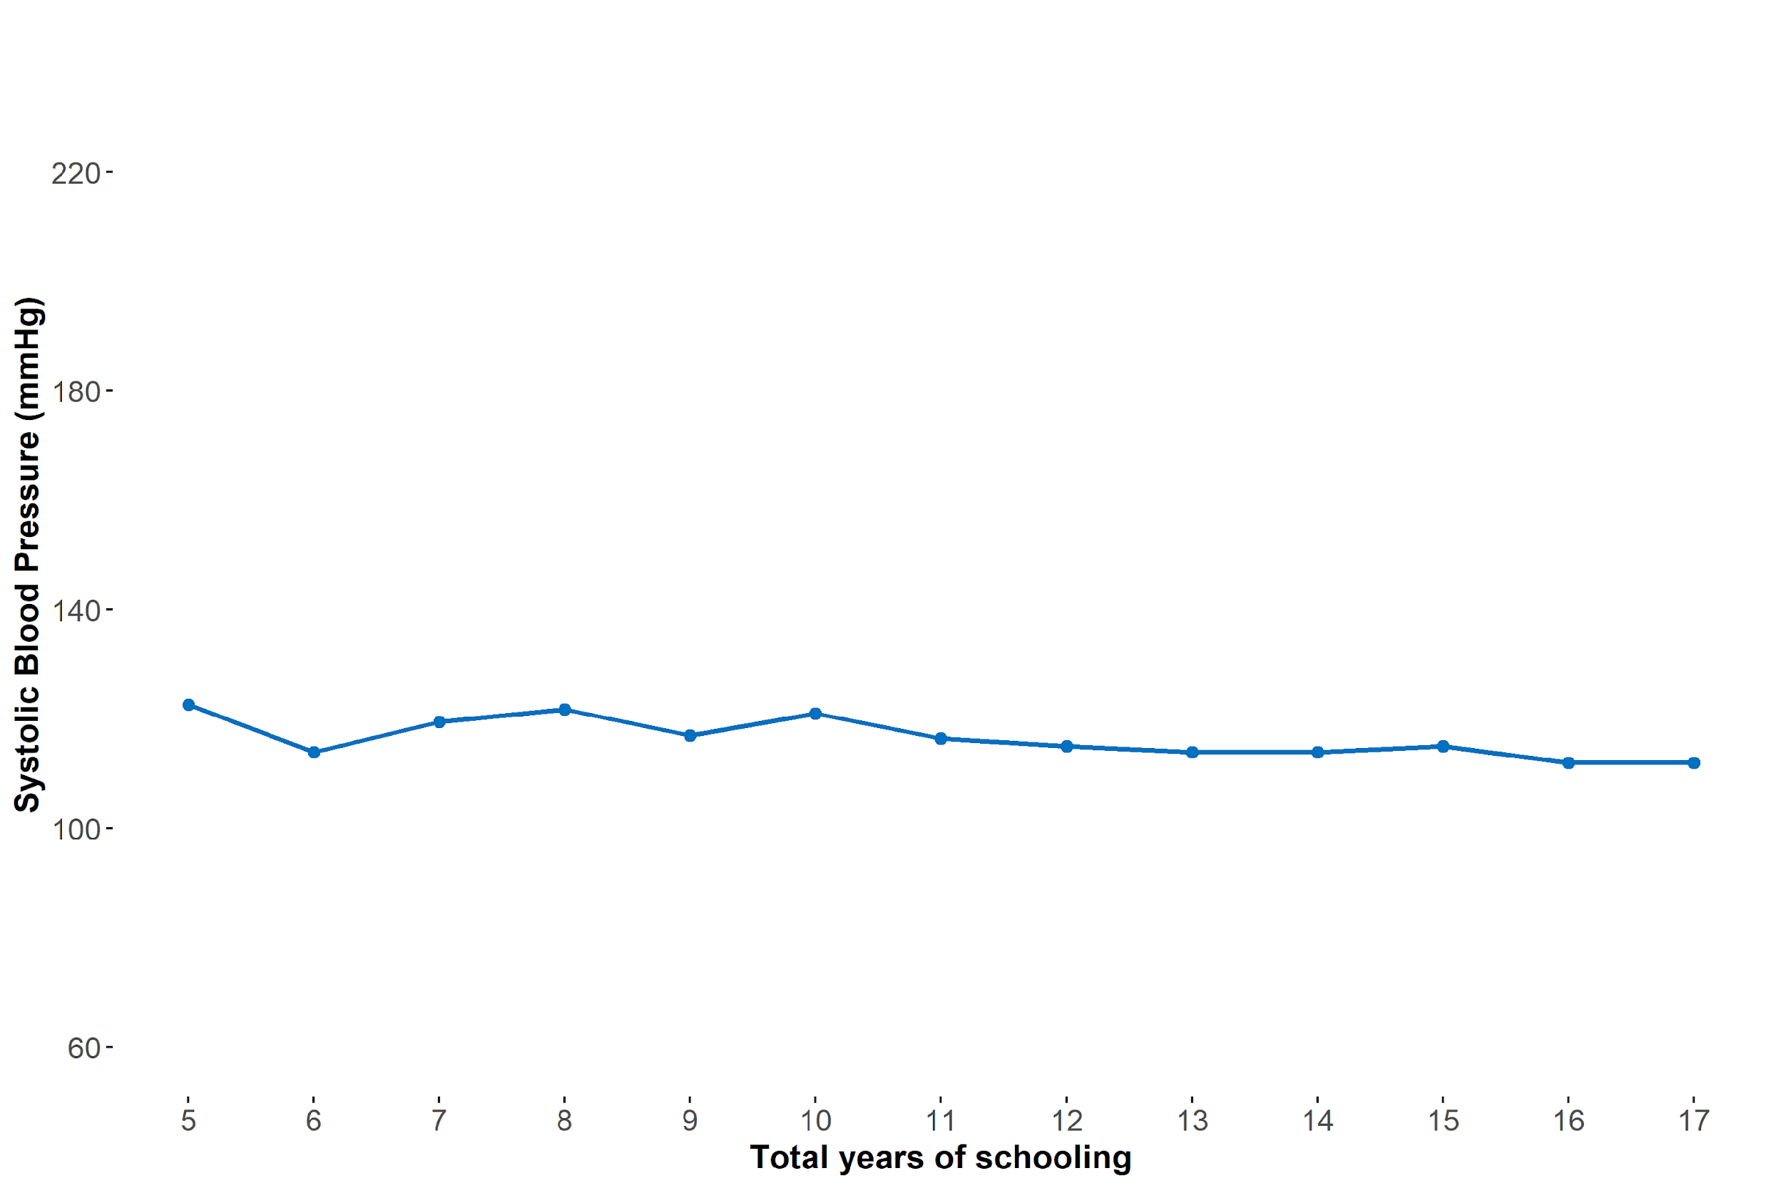
Conditional quantile function (CQF) at the 25th quantile

Slide 40
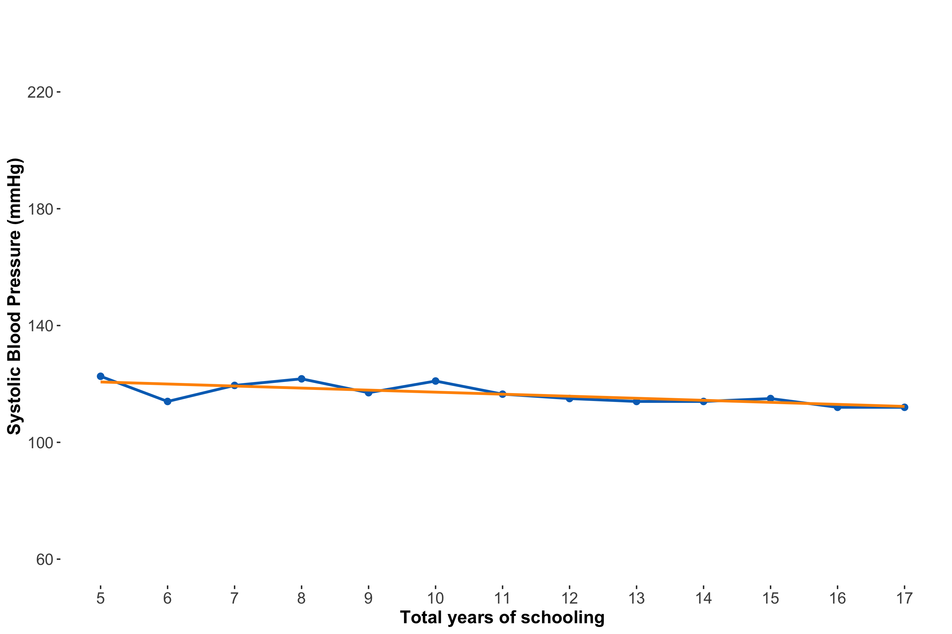
Conditional quantile regression line ≈ CQF

Slide 41

$$Q_{τ}(SBP|schlyrs)=α_{0, τ}+α_{1, τ}schlyrs_{i}$$
Notes:
What are the differences you see between this equation and the linear regression equation?

Slide 42

$$Q_{0.25}(SBP|schlyrs)=α_{0, 0.25}+α_{1, 0.25}schlyrs_{i}$$

Slide 43
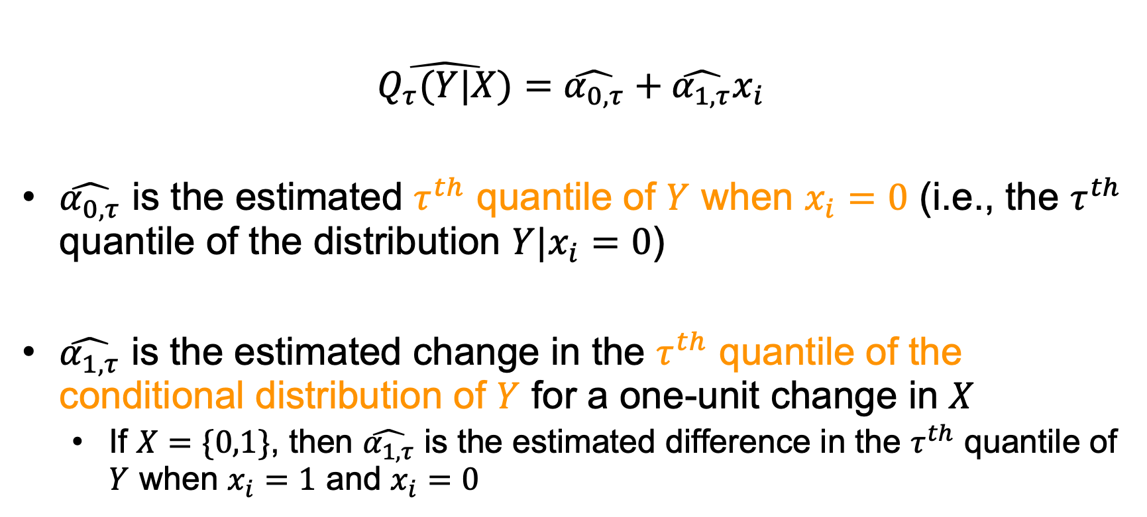
Interpreting coefficients of a univariate conditional quantile regression line
$$\hat{Q_{τ}(Y|X)}=\hat{α_{0,τ}}+\hat{α_{1,τ}}x_{i}$$
$\hat{α_{0,τ}}$ is the estimated $τ^{th}$ quantile of $Y$ when $x_{i}=0$ (i.e., the $τ^{th}$ quantile of the distribution $Y|x_{i}=0$)
$\hat{α_{1,τ}}$ is the estimated change in the $τ^{th}$ quantile of the conditional distribution of $Y$ for a one-unit change in $X$
If $X=\{0,1\}$, then $\hat{α_{1,τ}}$ is the estimated difference in the $τ^{th}$ quantile of $Y$ when $x_{i}=1$ and $x_{i}=0$

Slide 44
Just as linear regression models the conditional expectation function, conditional quantile regression models the conditional quantile function

Slide 45
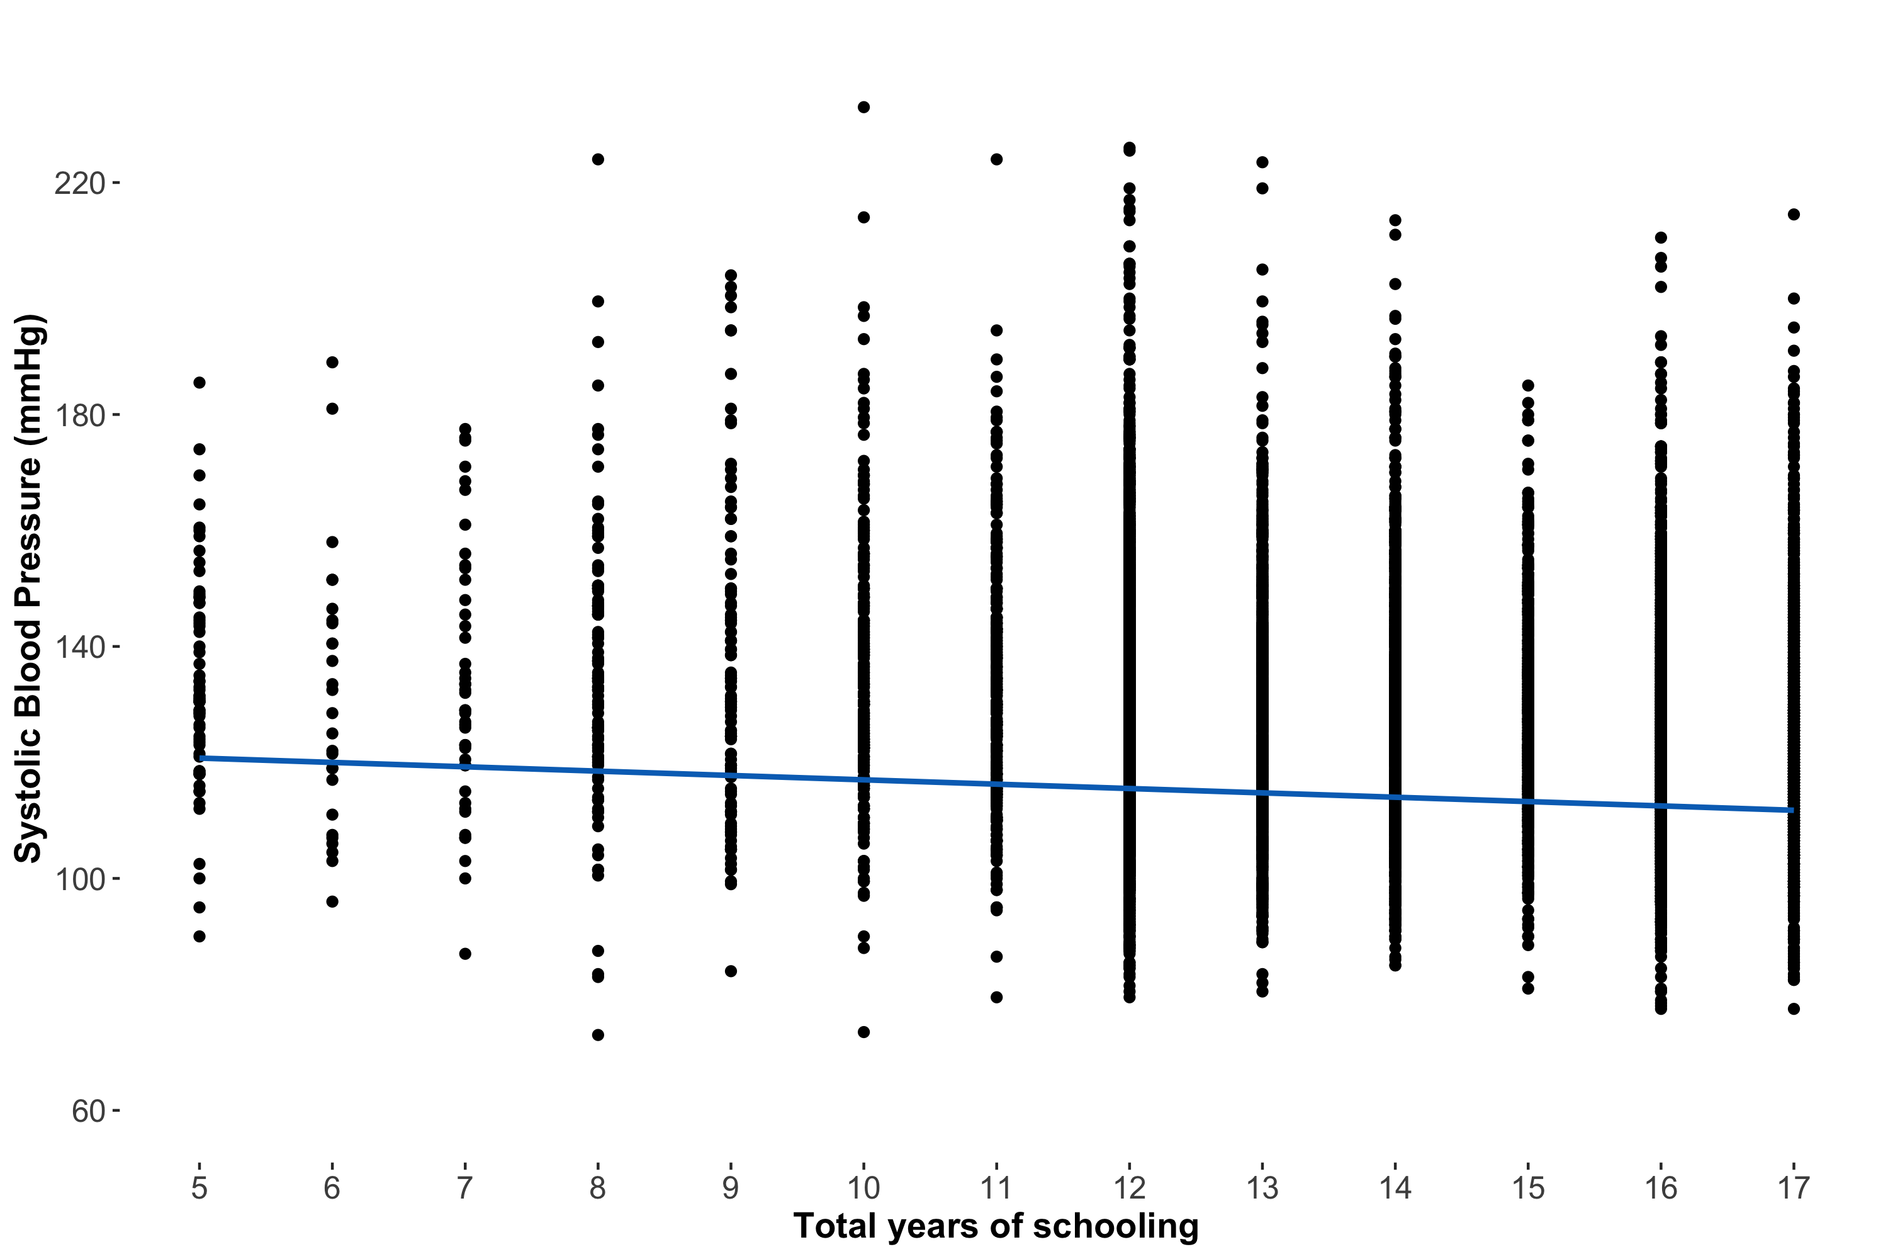
Notes:
Switch to R here (q25 adjusted model)

Slide 46
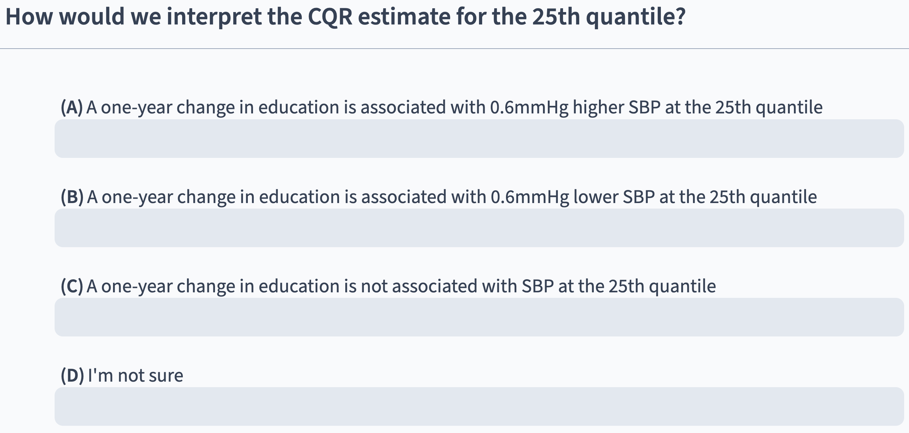
Notes:
q25 adjusted (est = -0.64)
Congratulations, you fit your second CQR!
Estimate is different from mean (-0.8) and median (-0.7)
Goodness of fit code

Slide 47
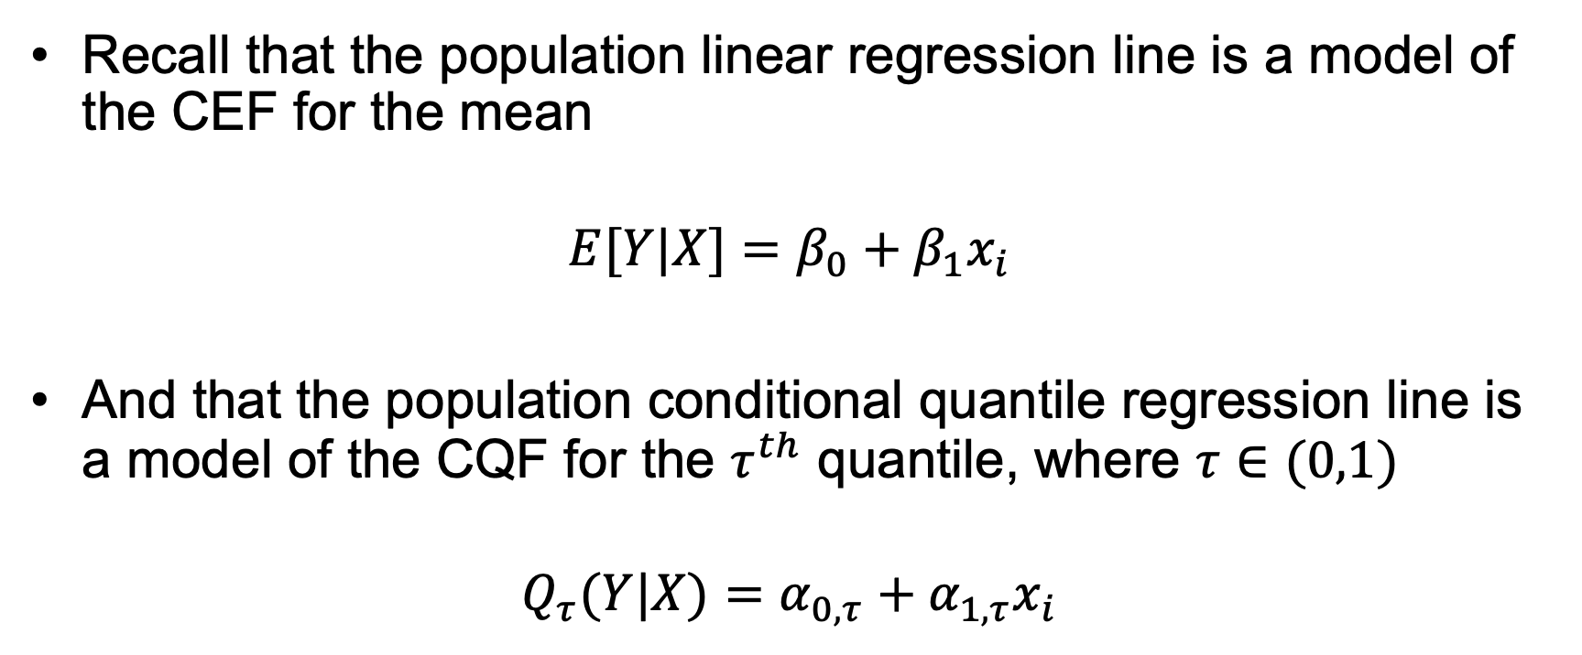
Regression lines ≈ Conditional functions
Recall that the population linear regression line is a model of the CEF for the mean
$$E[Y|X]=β_{0}+β_{1}x_{i}$$
And that the population conditional quantile regression line is a model of the CQF for the $τ^{th}$ quantile, where $τ∈(0,1)$
$$Q_{τ}(Y|X)=α_{0,τ}+α_{1,τ}x_{i}$$

Slide 48
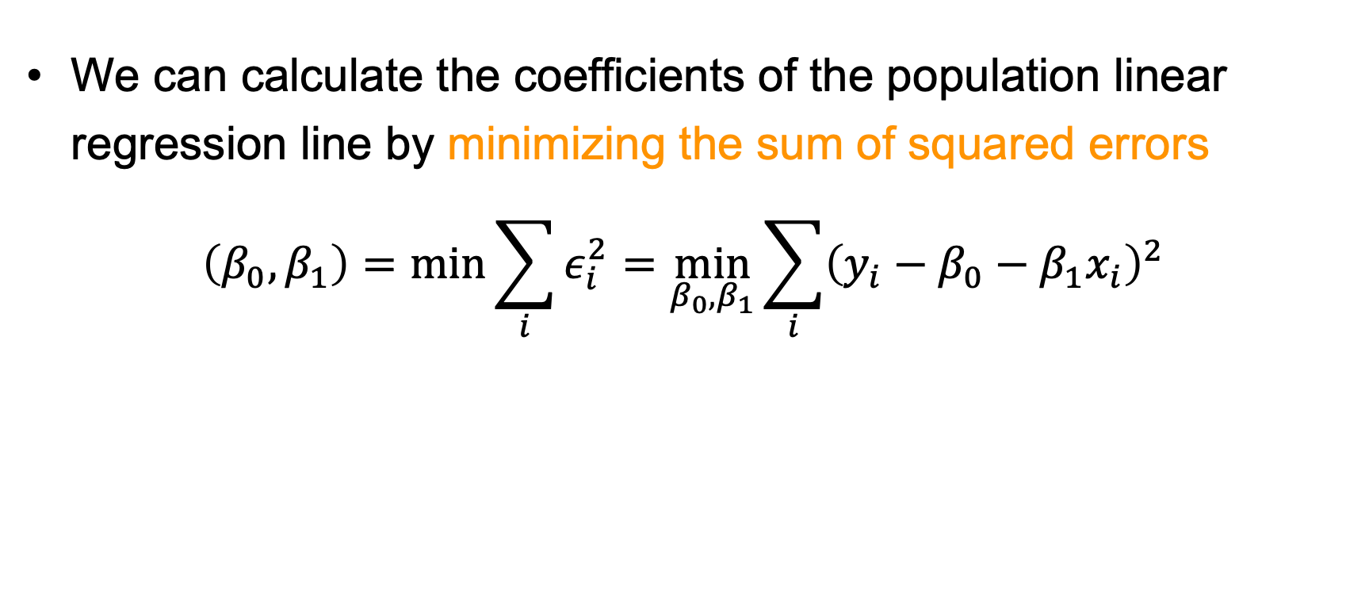
Coefficients of the population linear regression line
We can calculate the coefficients of the population linear regression line by minimizing the sum of squared errors
$$\left(β_{0},β_{1}\right)=\min_{}{\sum_{i}{ε_{i}^{2}}}=\min_{β_{0},β_{1}}{\sum_{i}{{\left(y_{i}−β_{0}−β_{1}x_{i}\right)}^{2}}}$$

Slide 49
Estimating linear regression coefficients in our sample
There are several ways to estimate coefficients of the sample linear regression
Ordinary Least Squares
Moment estimator
Maximum likelihood estimator

Slide 50
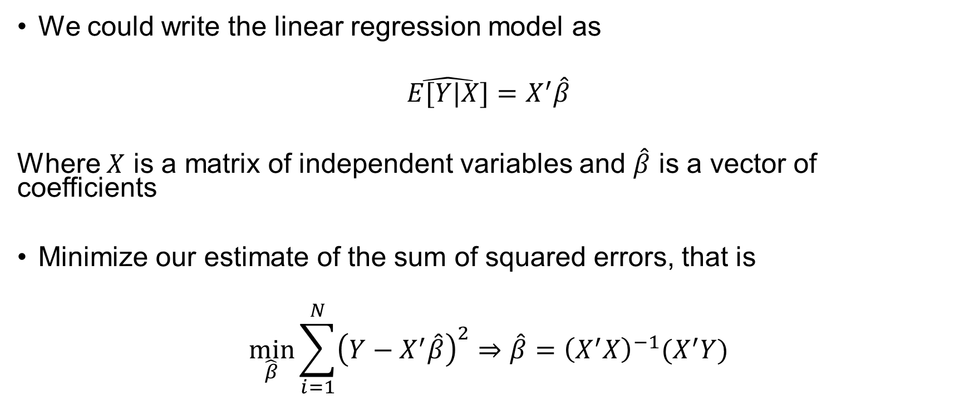
Ordinary Least Squares (OLS)
We could write the linear regression model as
$$\hat{E[Y|X]}=X^{′}\hat{β}$$
Where $X$ is a matrix of independent variables and $\hat{β}$ is a vector of coefficients
Minimize our estimate of the sum of squared errors, that is
$$\min_{\hat{β}}{\sum_{i=1}^{N}{{\left(Y−X^{′}\hat{β}\right)}^{2}}}⇒\hat{β}={\left(X^{′}X\right)}^{−1}(X^{′}Y)$$

Slide 51
How do we estimate coefficients of a conditional quantile regression?

Slide 52


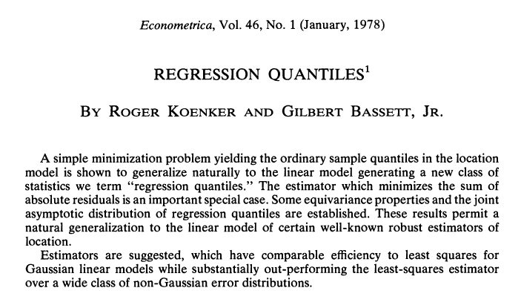
Koenker and Bassett (1978). Regression Quantiles. Econometrica 46(1): 33-50
Roger Koenker. Source: link
Gilbert Bassett, Jr. Source: link
Notes:
Over 17k citations

Slide 53
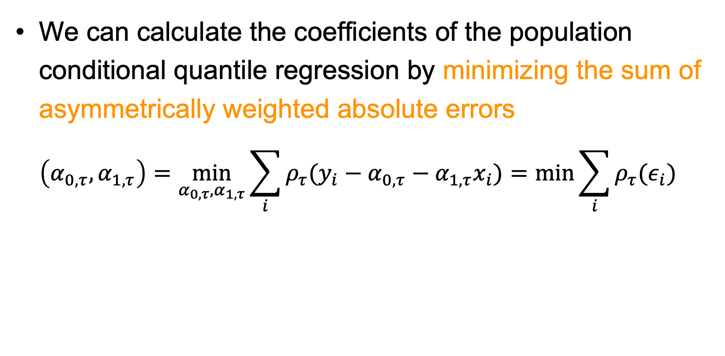
Coefficients of the population conditional quantile regression line
We can calculate the coefficients of the population conditional quantile regression by minimizing the sum of asymmetrically weighted absolute errors
$$\left(α_{0,τ},α_{1,τ}\right)=\min_{α_{0,τ},α_{1,τ}}{\sum_{i}{ρ_{τ}(y_{i}−α_{0,τ}−α_{1,τ}x_{i})=\min_{}{\sum_{i}{ρ_{τ}(ε_{i})}}}}$$
Notes:
Differences?

Slide 54
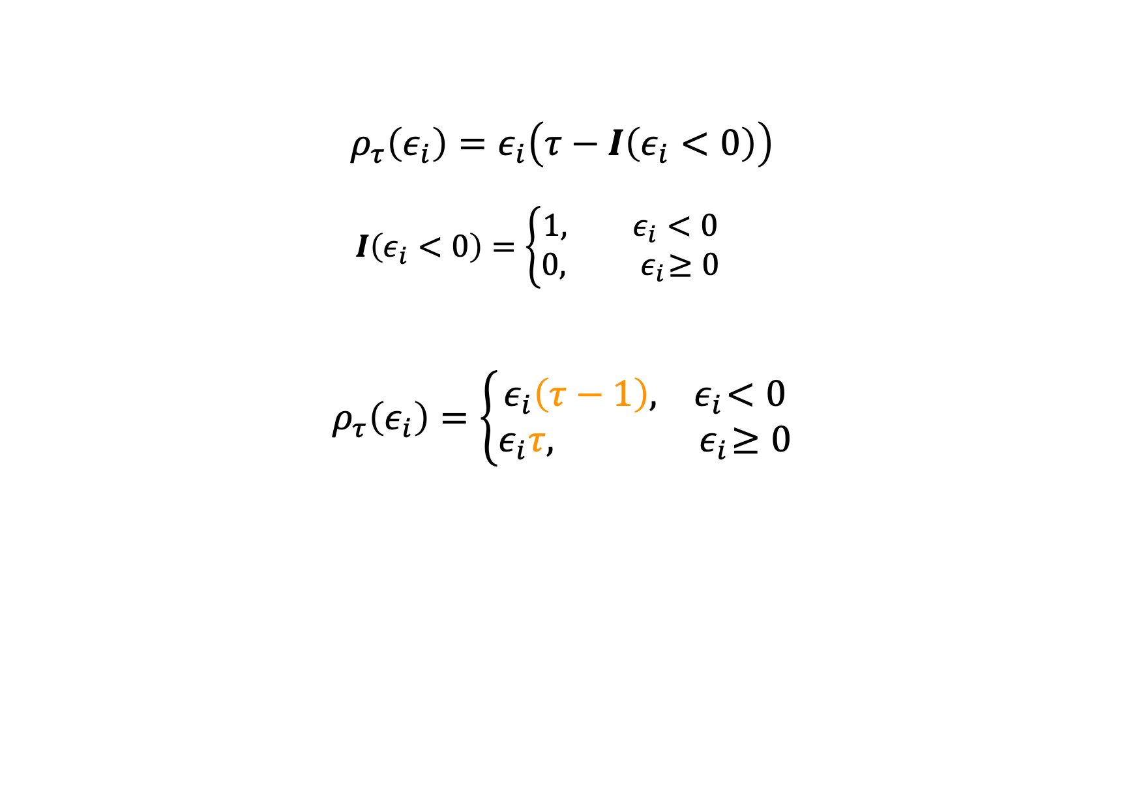
Rho rho rho your boat
$$ρ_{τ}\left(ε_{i}\right)=ε_{i}\left(τ−I\left(ε_{i}<0\right)\right)$$
$$I\left(ε_{i}<0\right)=\left\{\begin{aligned}1, ε_{i}<0 \\ &0,{ ε}_{i}≥0\end{aligned}\right.$$
$$ρ_{τ}\left(ε_{i}\right)=\left\{\begin{aligned}ε_{i}\left(τ−1\right),{ ε}_{i}<0 \\ &ε_{i}τ,{ ε}_{i}≥0\end{aligned}\right.$$
$$=\left(1−τ\right)\left|ε_{i}\right|I\left(ε_{i}<0\right)+τ\left|ε_{i}\right|I\left(ε_{i}≥0\right)$$

Slide 55
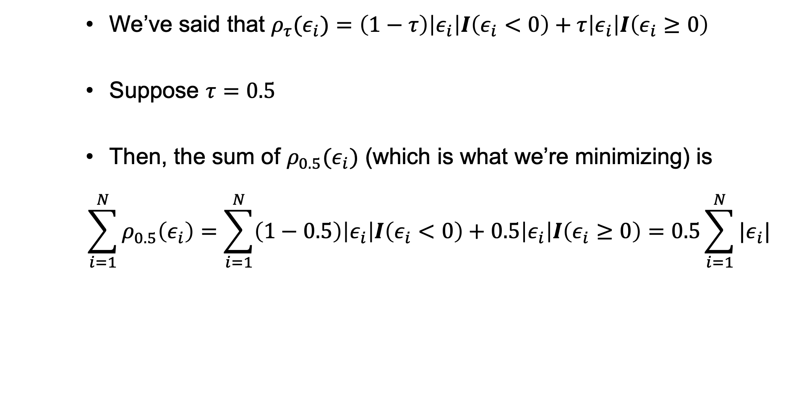
Contextualizing rho
We’ve said that $ρ_{τ}(ε_{i})=\left(1−τ\right)\left|ε_{i}\right|I\left(ε_{i}<0\right)+τ\left|ε_{i}\right|I\left(ε_{i}≥0\right)$
Suppose $τ=0.5$
Then, the sum of $ρ_{0.5}(ε_{i})$ (which is what we’re minimizing) is
$$\sum_{i=1}^{N}{ρ_{0.5}\left(ε_{i}\right)}=\sum_{i=1}^{N}{\left(1−0.5\right)\left|ε_{i}\right|I\left(ε_{i}<0\right)+0.5\left|ε_{i}\right|I\left(ε_{i}≥0\right)}=0.5\sum_{i=1}^{N}{|ε_{i}|}$$
Notes:
This is how we calculate the coefficients of q0.5

Slide 56
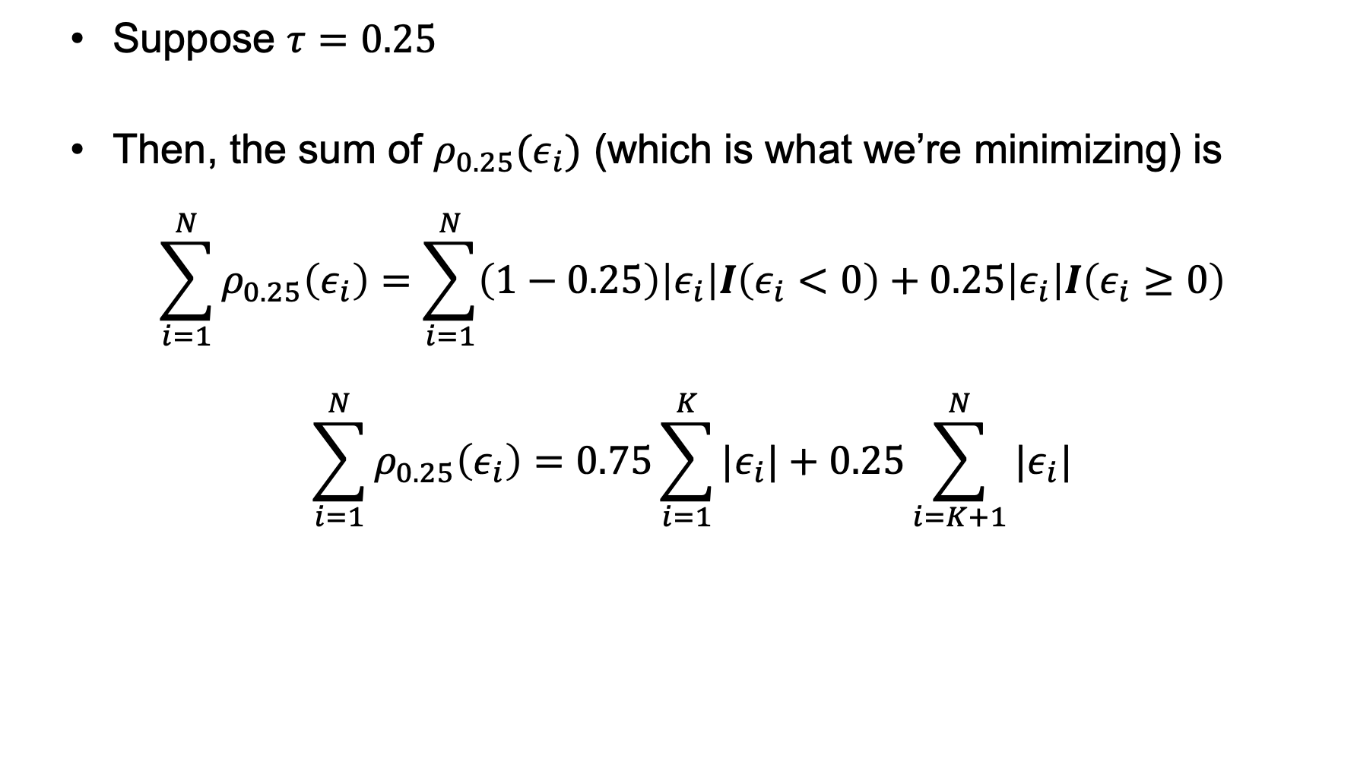
Contextualizing rho (again)
Suppose $τ=0.25$
Then, the sum of $ρ_{0.25}(ε_{i})$ (which is what we’re minimizing) is
$$\sum_{i=1}^{N}{ρ_{0.25}\left(ε_{i}\right)}=\sum_{i=1}^{N}{\left(1−0.25\right)\left|ε_{i}\right|I\left(ε_{i}<0\right)+0.25\left|ε_{i}\right|I\left(ε_{i}≥0\right)}$$
$$\sum_{i=1}^{N}{ρ_{0.25}\left(ε_{i}\right)}=0.75\sum_{i=1}^{K}{|ε_{i}|}+0.25\sum_{i=K+1}^{N}{|ε_{i}|}$$

Slide 57
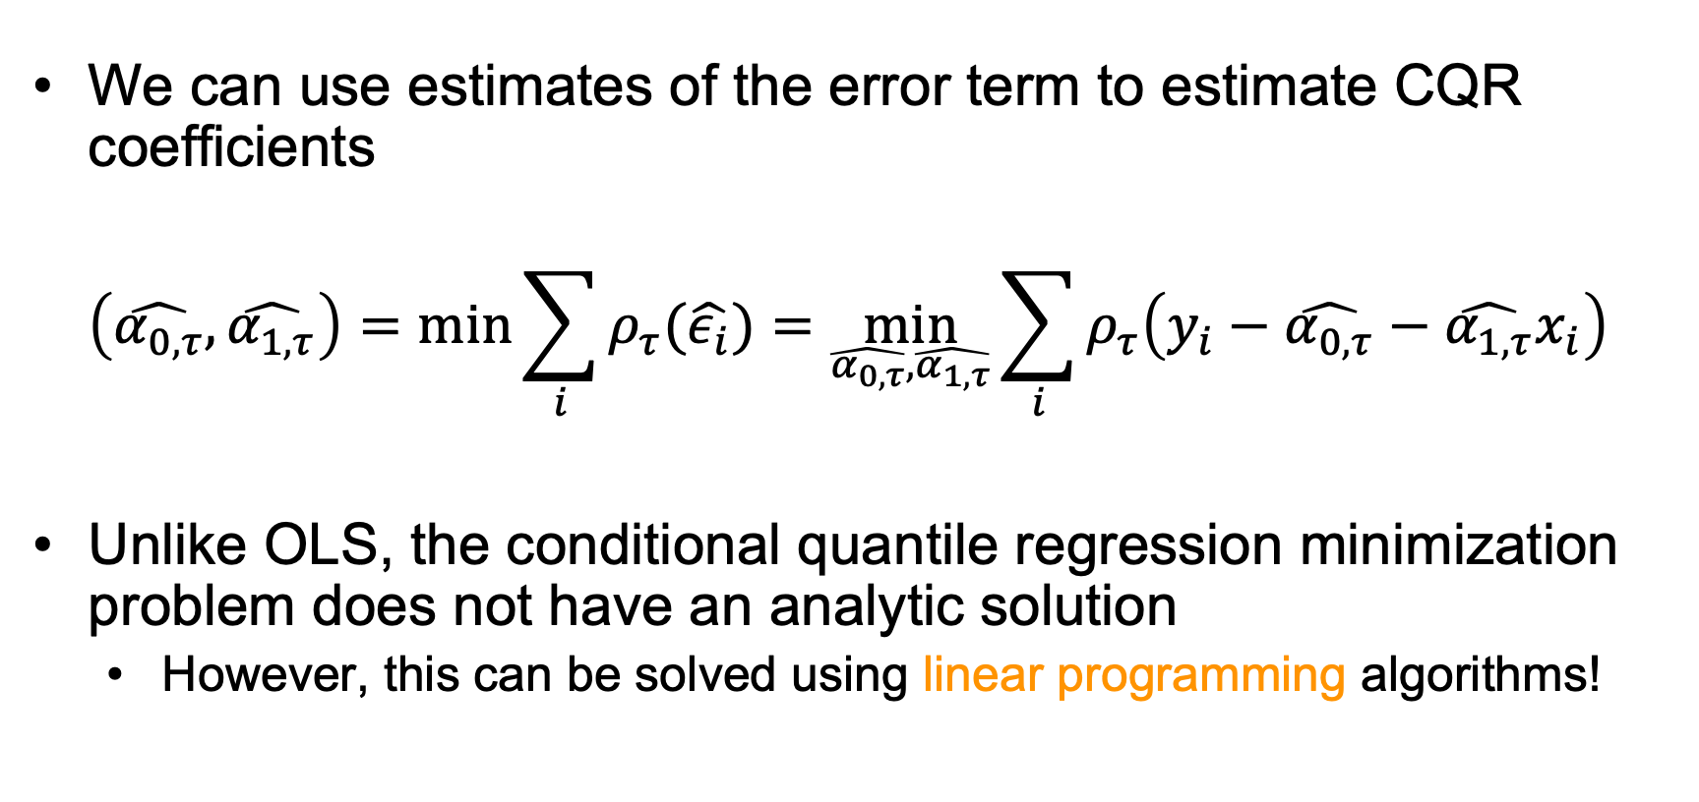
Estimating conditional quantile regression coefficients in our sample
We can use estimates of the error term to estimate CQR coefficients
$$\left(\hat{α_{0,τ}},\hat{α_{1,τ}}\right)=\min_{}{\sum_{i}{ρ_{τ}(\hat{ε_{i}})}}=\min_{\hat{α_{0,τ}},\hat{α_{1,τ}}}{\sum_{i}{ρ_{τ}\left(y_{i}−\hat{α_{0,τ}}−\hat{α_{1,τ}}x_{i}\right)}}$$
Unlike OLS, the conditional quantile regression minimization problem does not have an analytic solution
However, this can be solved using linear programming algorithms!

Slide 58
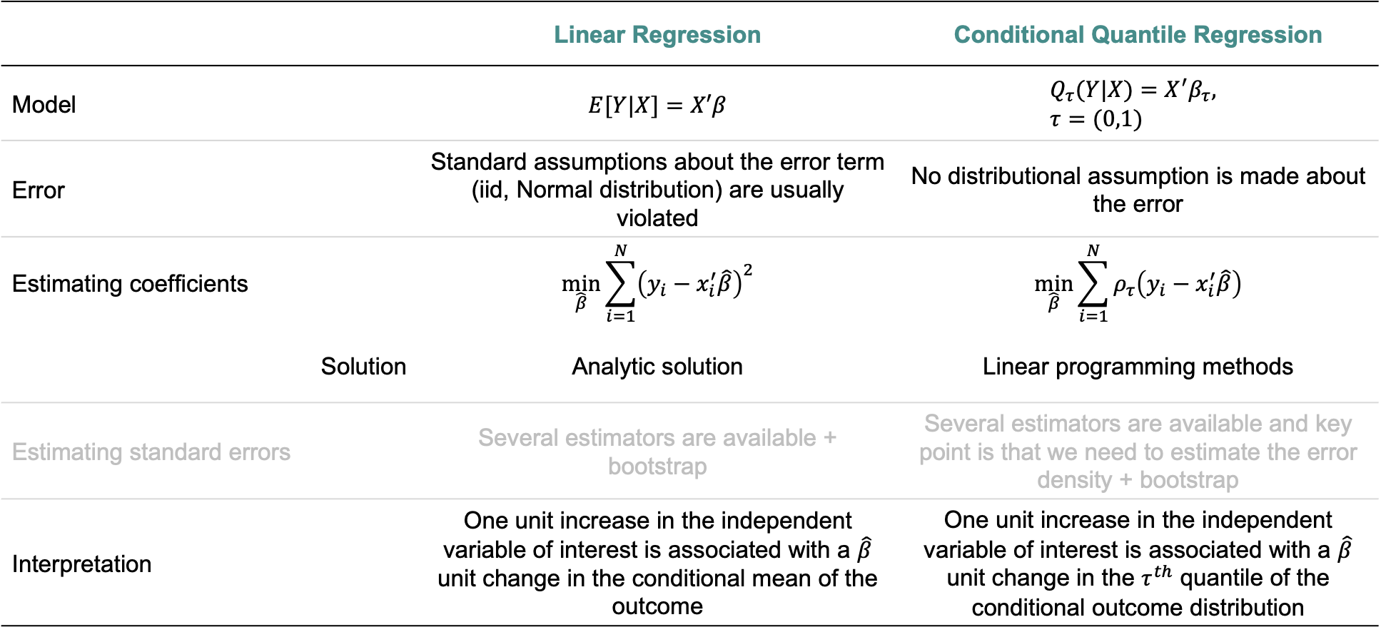
 | Linear Regression | Conditional Quantile Regression
Model | $$E[Y|X]=X′β$$ | $$Q_{τ}(Y|X)=X^{′}β_{τ}, \\ τ=(0,1)$$
Error | Standard assumptions about the error term (iid, Normal distribution) are usually violated | No distributional assumption is made about the error
Estimating coefficients | $$\min_{\hat{β}}{\sum_{i=1}^{N}{{\left(y_{i}−x_{i}^{′}\hat{β}\right)}^{2}}}$$ | $$\min_{\hat{β}}{\sum_{i=1}^{N}{ρ_{τ}\left(y_{i}−x_{i}^{′}\hat{β}\right)}}$$
Solution | Analytic solution | Linear programming methods
Estimating standard errors | Several estimators are available + bootstrap | Several estimators are available and key point is that we need to estimate the error density + bootstrap
Interpretation | One unit increase in the independent variable of interest is associated with a $\hat{β}$ unit change in the conditional mean of the outcome | One unit increase in the independent variable of interest is associated with a $\hat{β}$ unit change in the $τ^{th}$ quantile of the conditional outcome distribution

Slide 59

Why is the mean model one of the most common choices of method for analyses? (please also take our survey on pre-analysis plans)
Notes:
So, if it is that easy to evaluate the relationship at other parts of the distribution...
Mean models can give us an incomplete picture of the relationship between an exposure and outcome; when are mean models appropriate?

Slide 60
What about heterogeneous effects?

Slide 61
Linear regression results suggest no association between breastfeeding and BMI

Slide 62
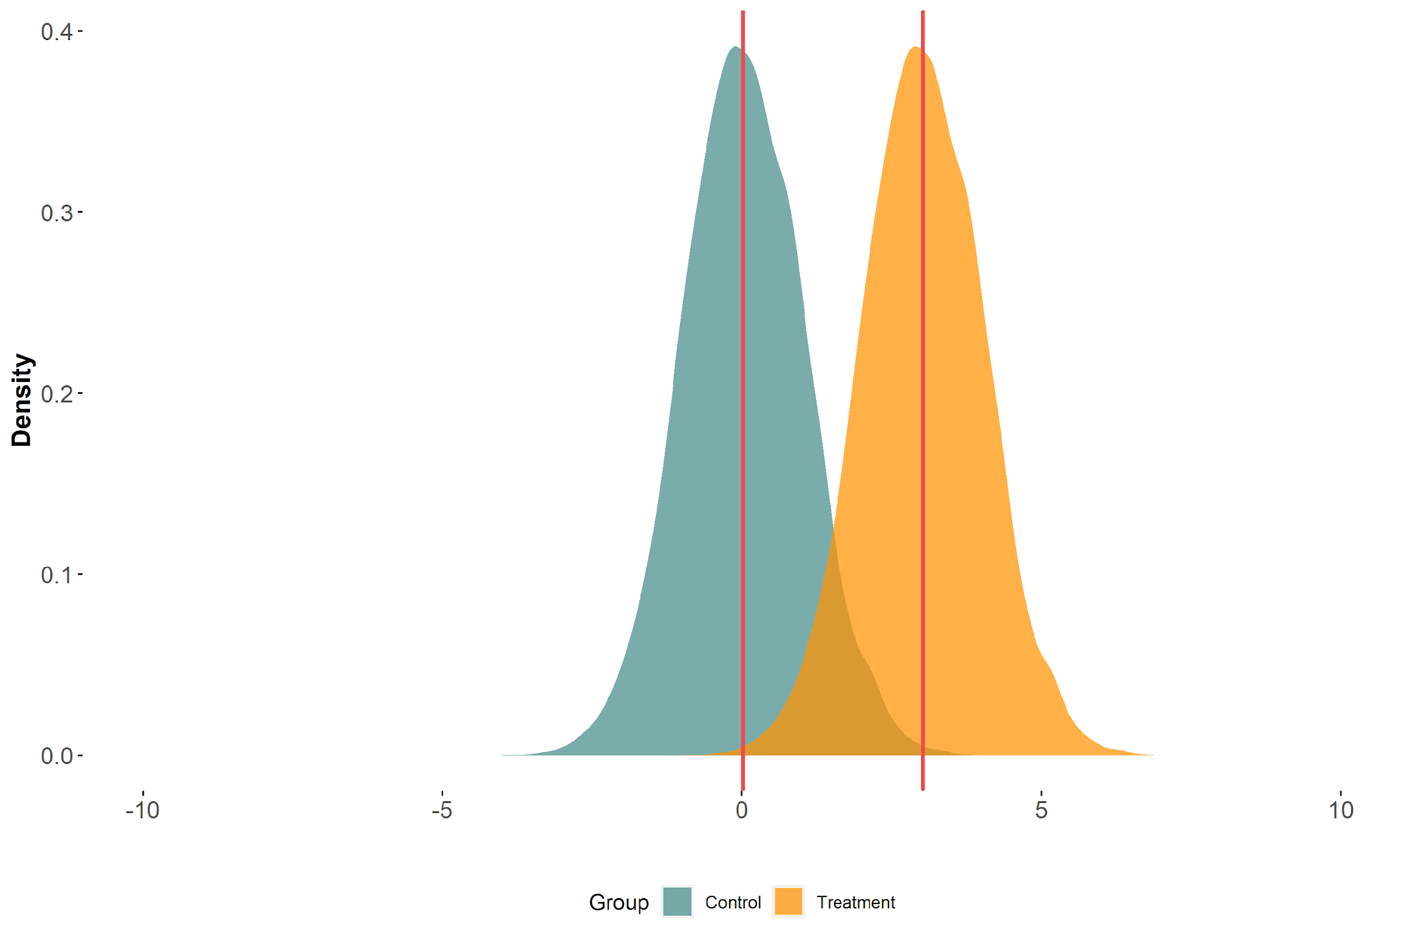
Imagine that a treatment shifts the outcome distribution uniformly

Slide 63
Difference in means

Slide 64
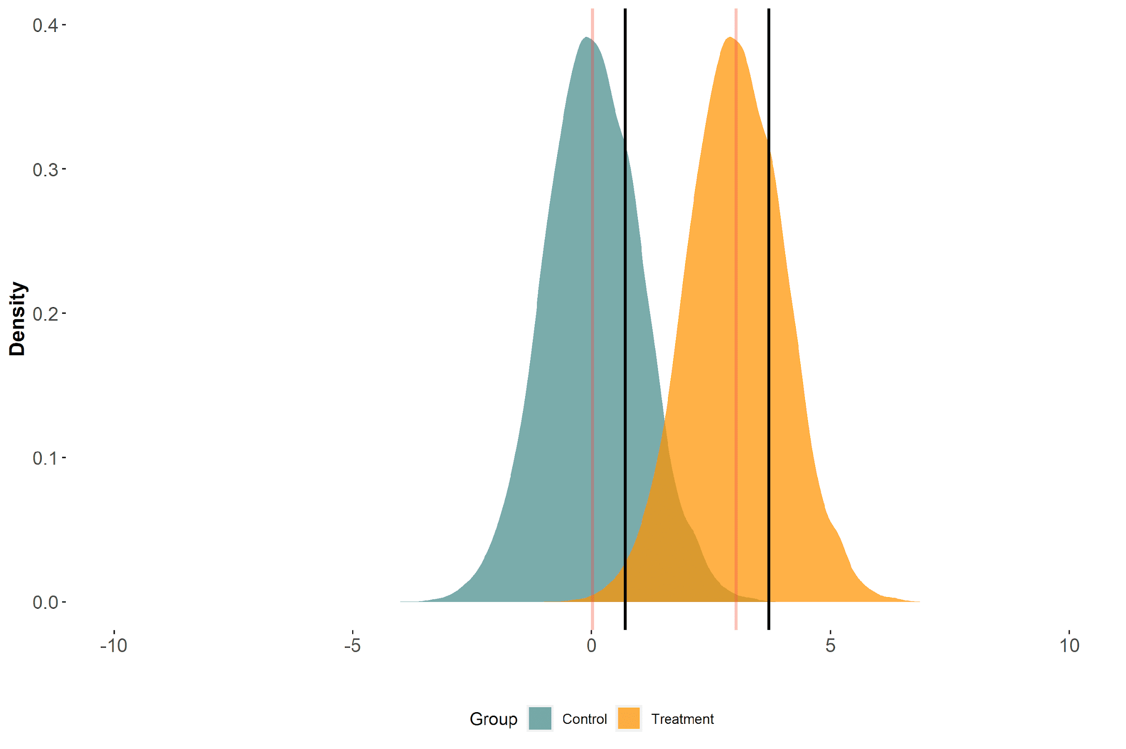
Difference in means = difference in 75th percentiles

Slide 65
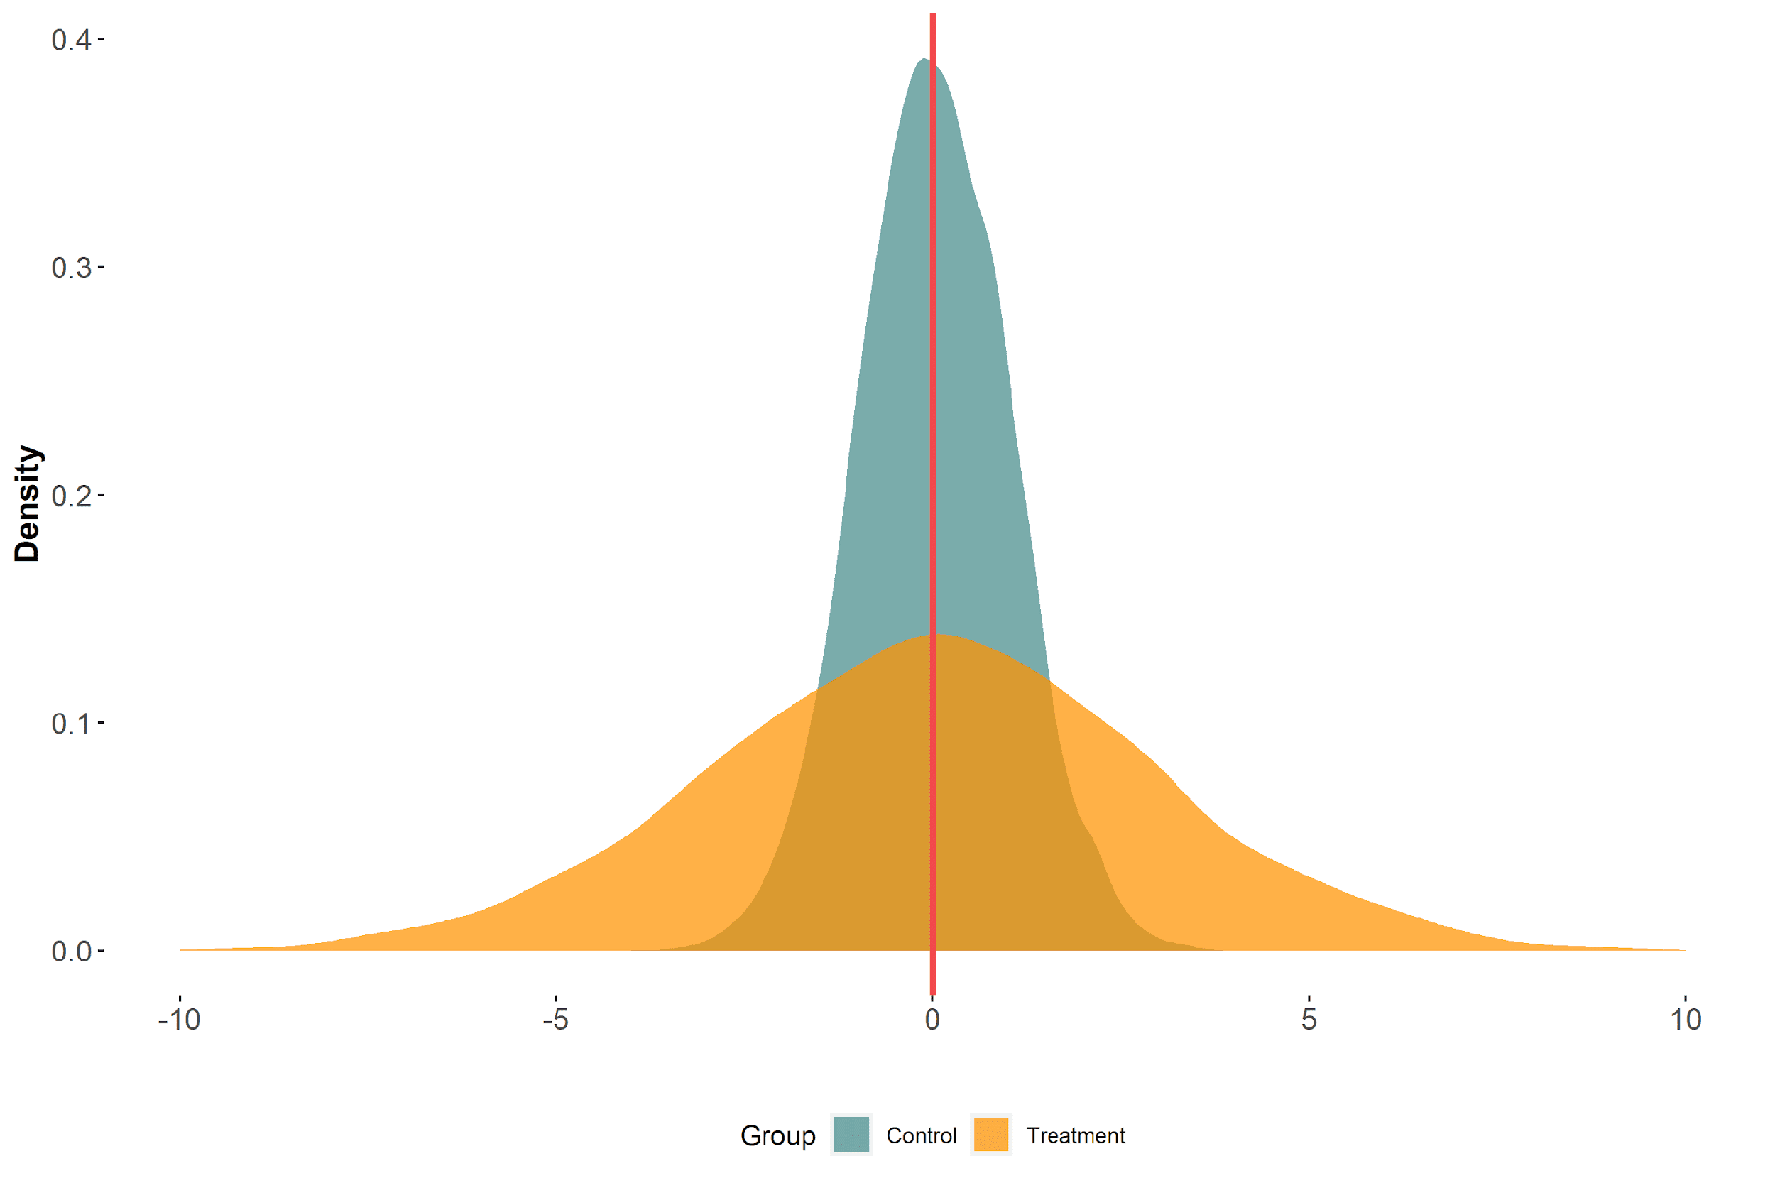
Imagine that a treatment affects the outcome distribution’s scale only

Slide 66
Difference in means

Slide 67
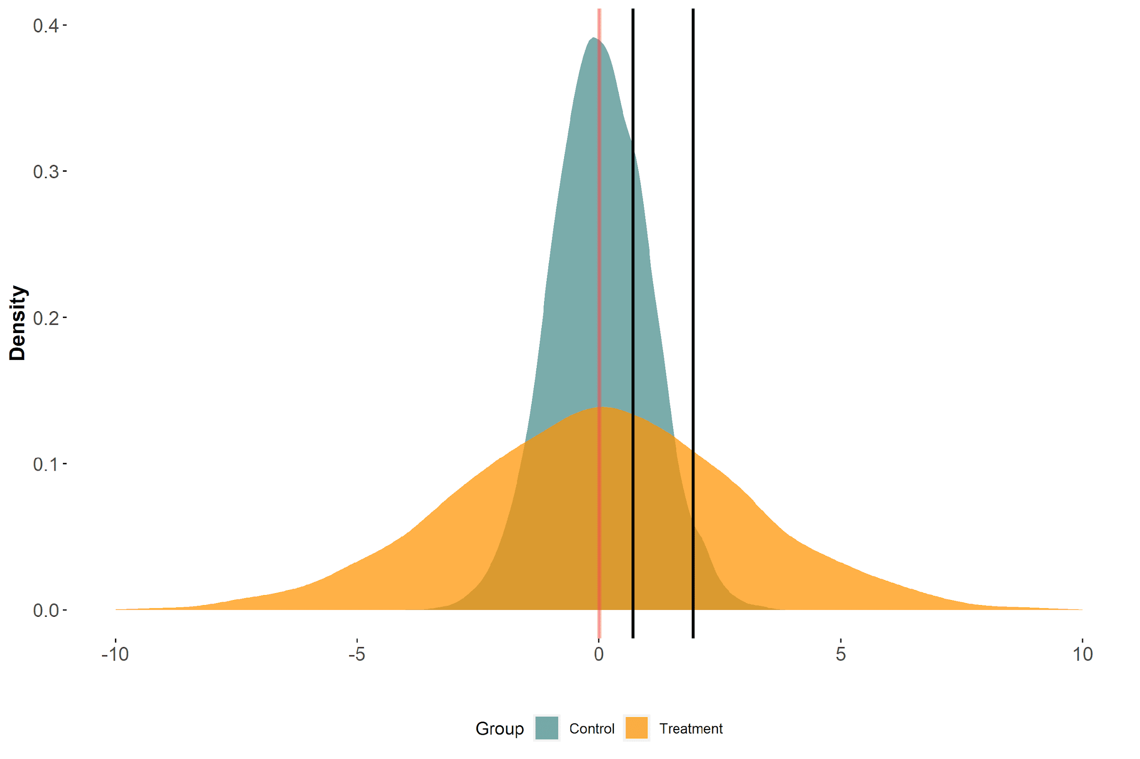
Difference in means ≠ difference in 75th percentiles

Slide 68
Means may tell tall tales about tails (repeat 5 times fast)

Slide 69
But in reality, the changes might not be so dramatic
Notes:
And in turn the effect associated with a change in our exposure?

Slide 70
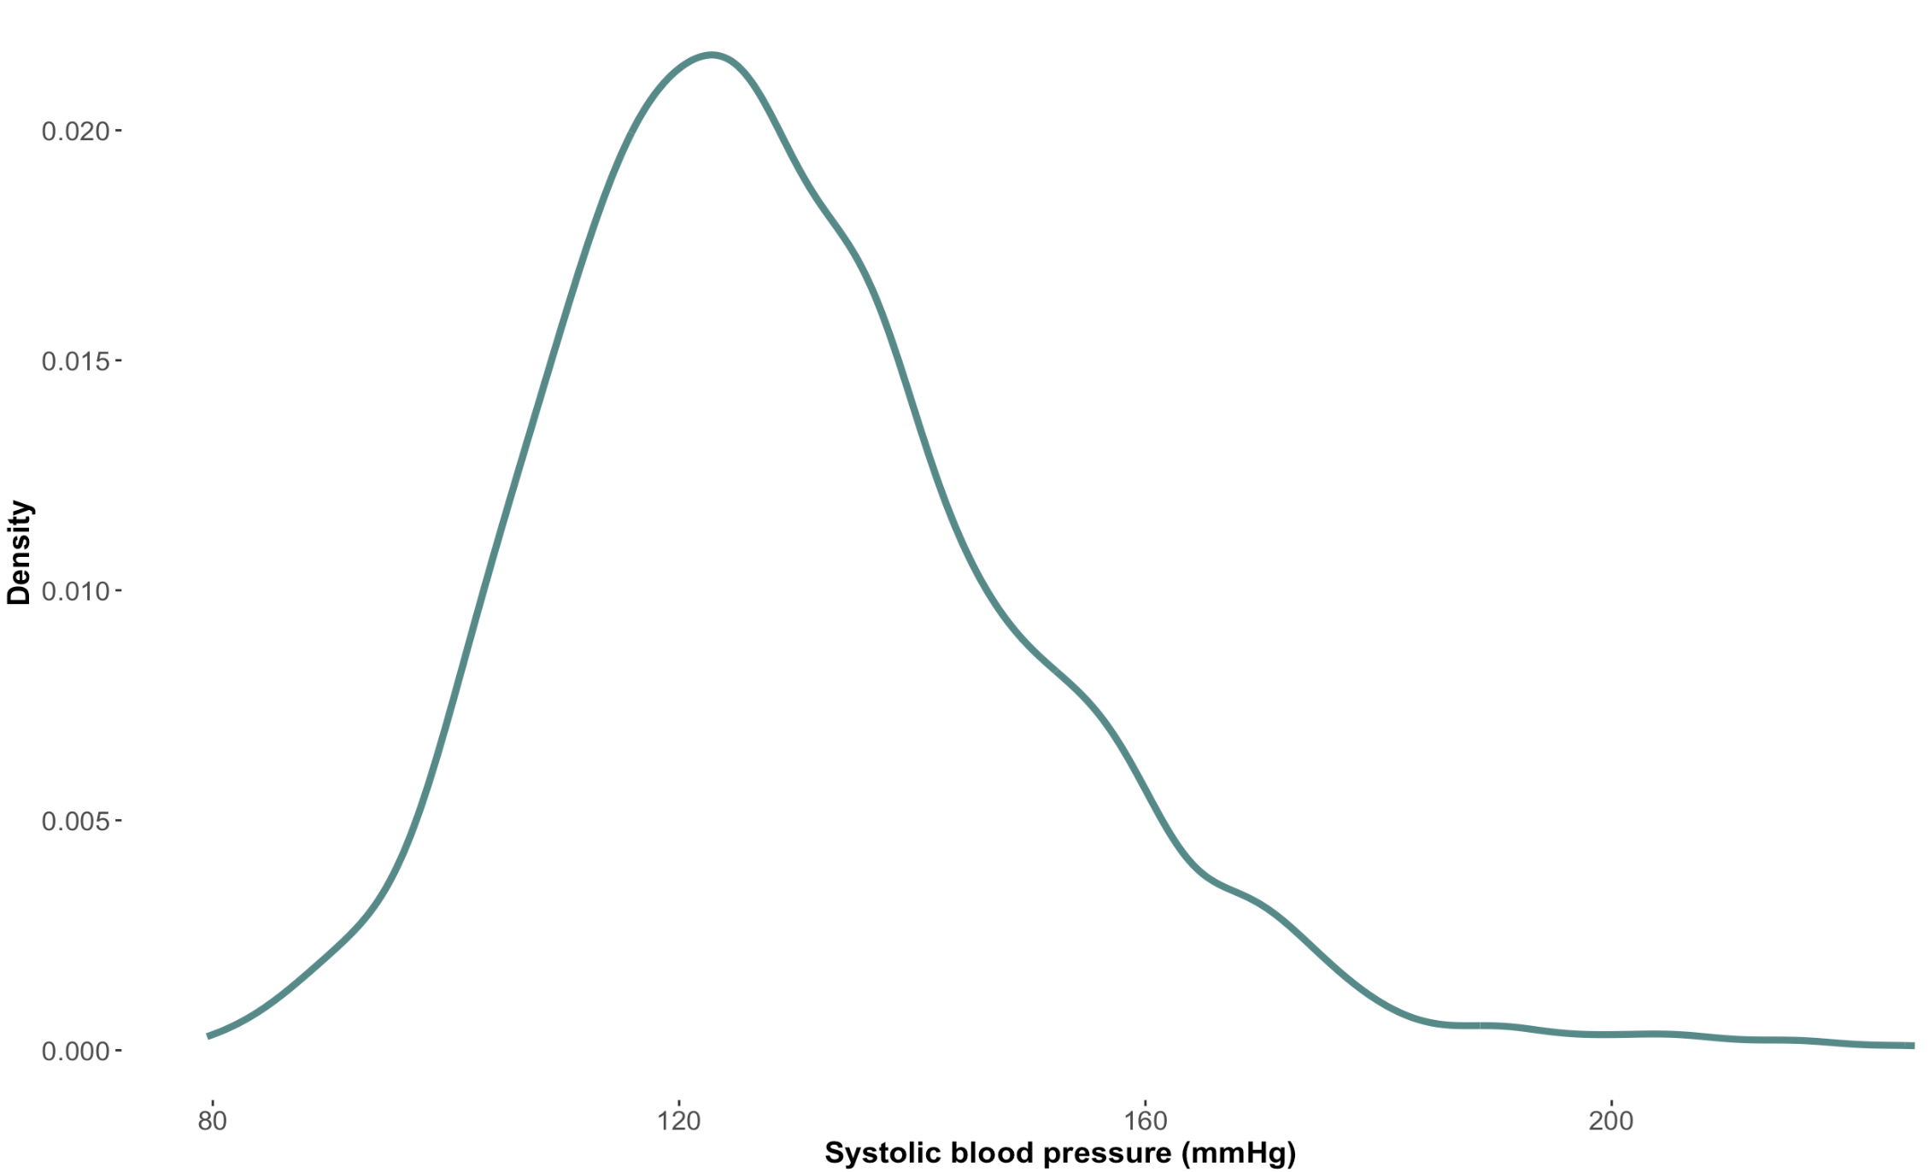
Distribution for participants with 12 years of education

Slide 71
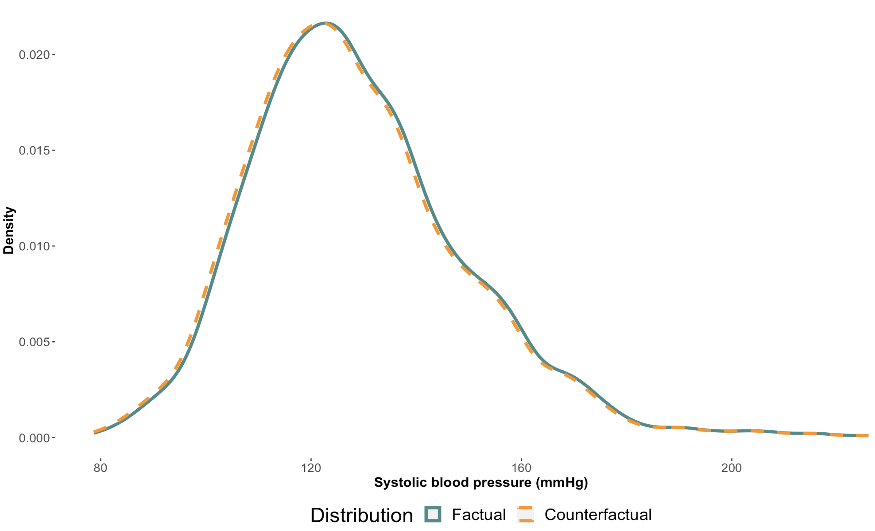
Linear Regression Counterfactual Distribution (12 years)
Notes:
Uniform change of -0.77mmHg

Slide 72
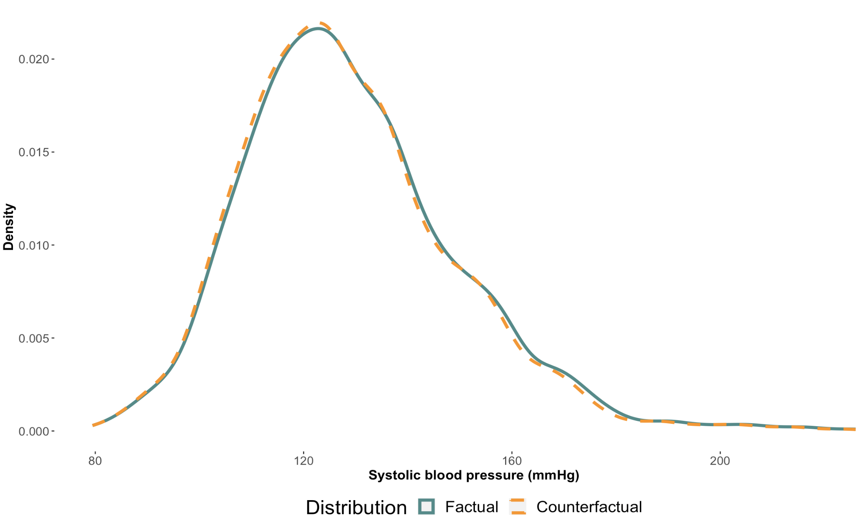
CQR Counterfactual Distribution (12 years)
Notes:
Non uniform change

Slide 73
Why do we care about distributions?
Notes:
And in turn the effect associated with a change in our exposure?

Slide 74
The tails matter too: case of blood pressure
This figure is a recreation of a figure from Fuchs et. al. (2020 with simulated data.
Notes:
Empirical reality; why we want to know about how an exposure might effect difference parts of a distribution. (would really want to impact the higher quantiles of outcome)
20 mmHg change from 120-140 is an increase of 32 in absolute risk, but a 20mmHg change from 160-280 is an increase of 128 (double) of absolute risk

Slide 75

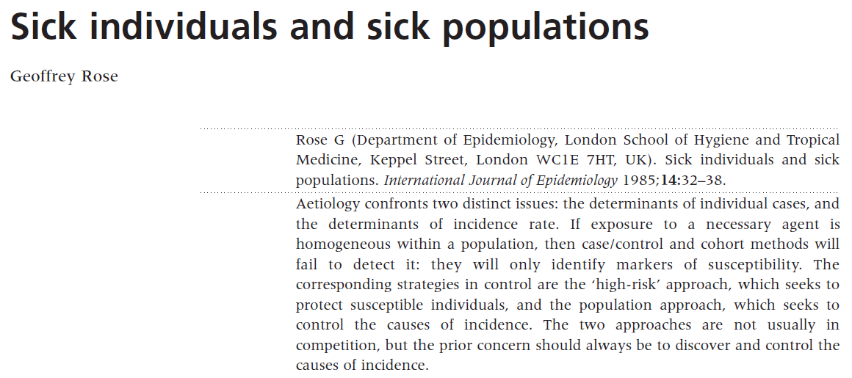
“Geoffrey Rose’s big idea”*
*The title of this slide comes from a Commentary written by A Hofman and JP Vandenbroucke (1992). Link
Notes:
Epidemiologic theory also motivates the need to investigate differences in the association across the entire outcome distribution
Note: The title of this slide is also the title of a 1992 commentary on Rose’s work. Link: https://www.ncbi.nlm.nih.gov/pmc/articles/PMC1884728/pdf/bmj00105-0011.pdf

Slide 76
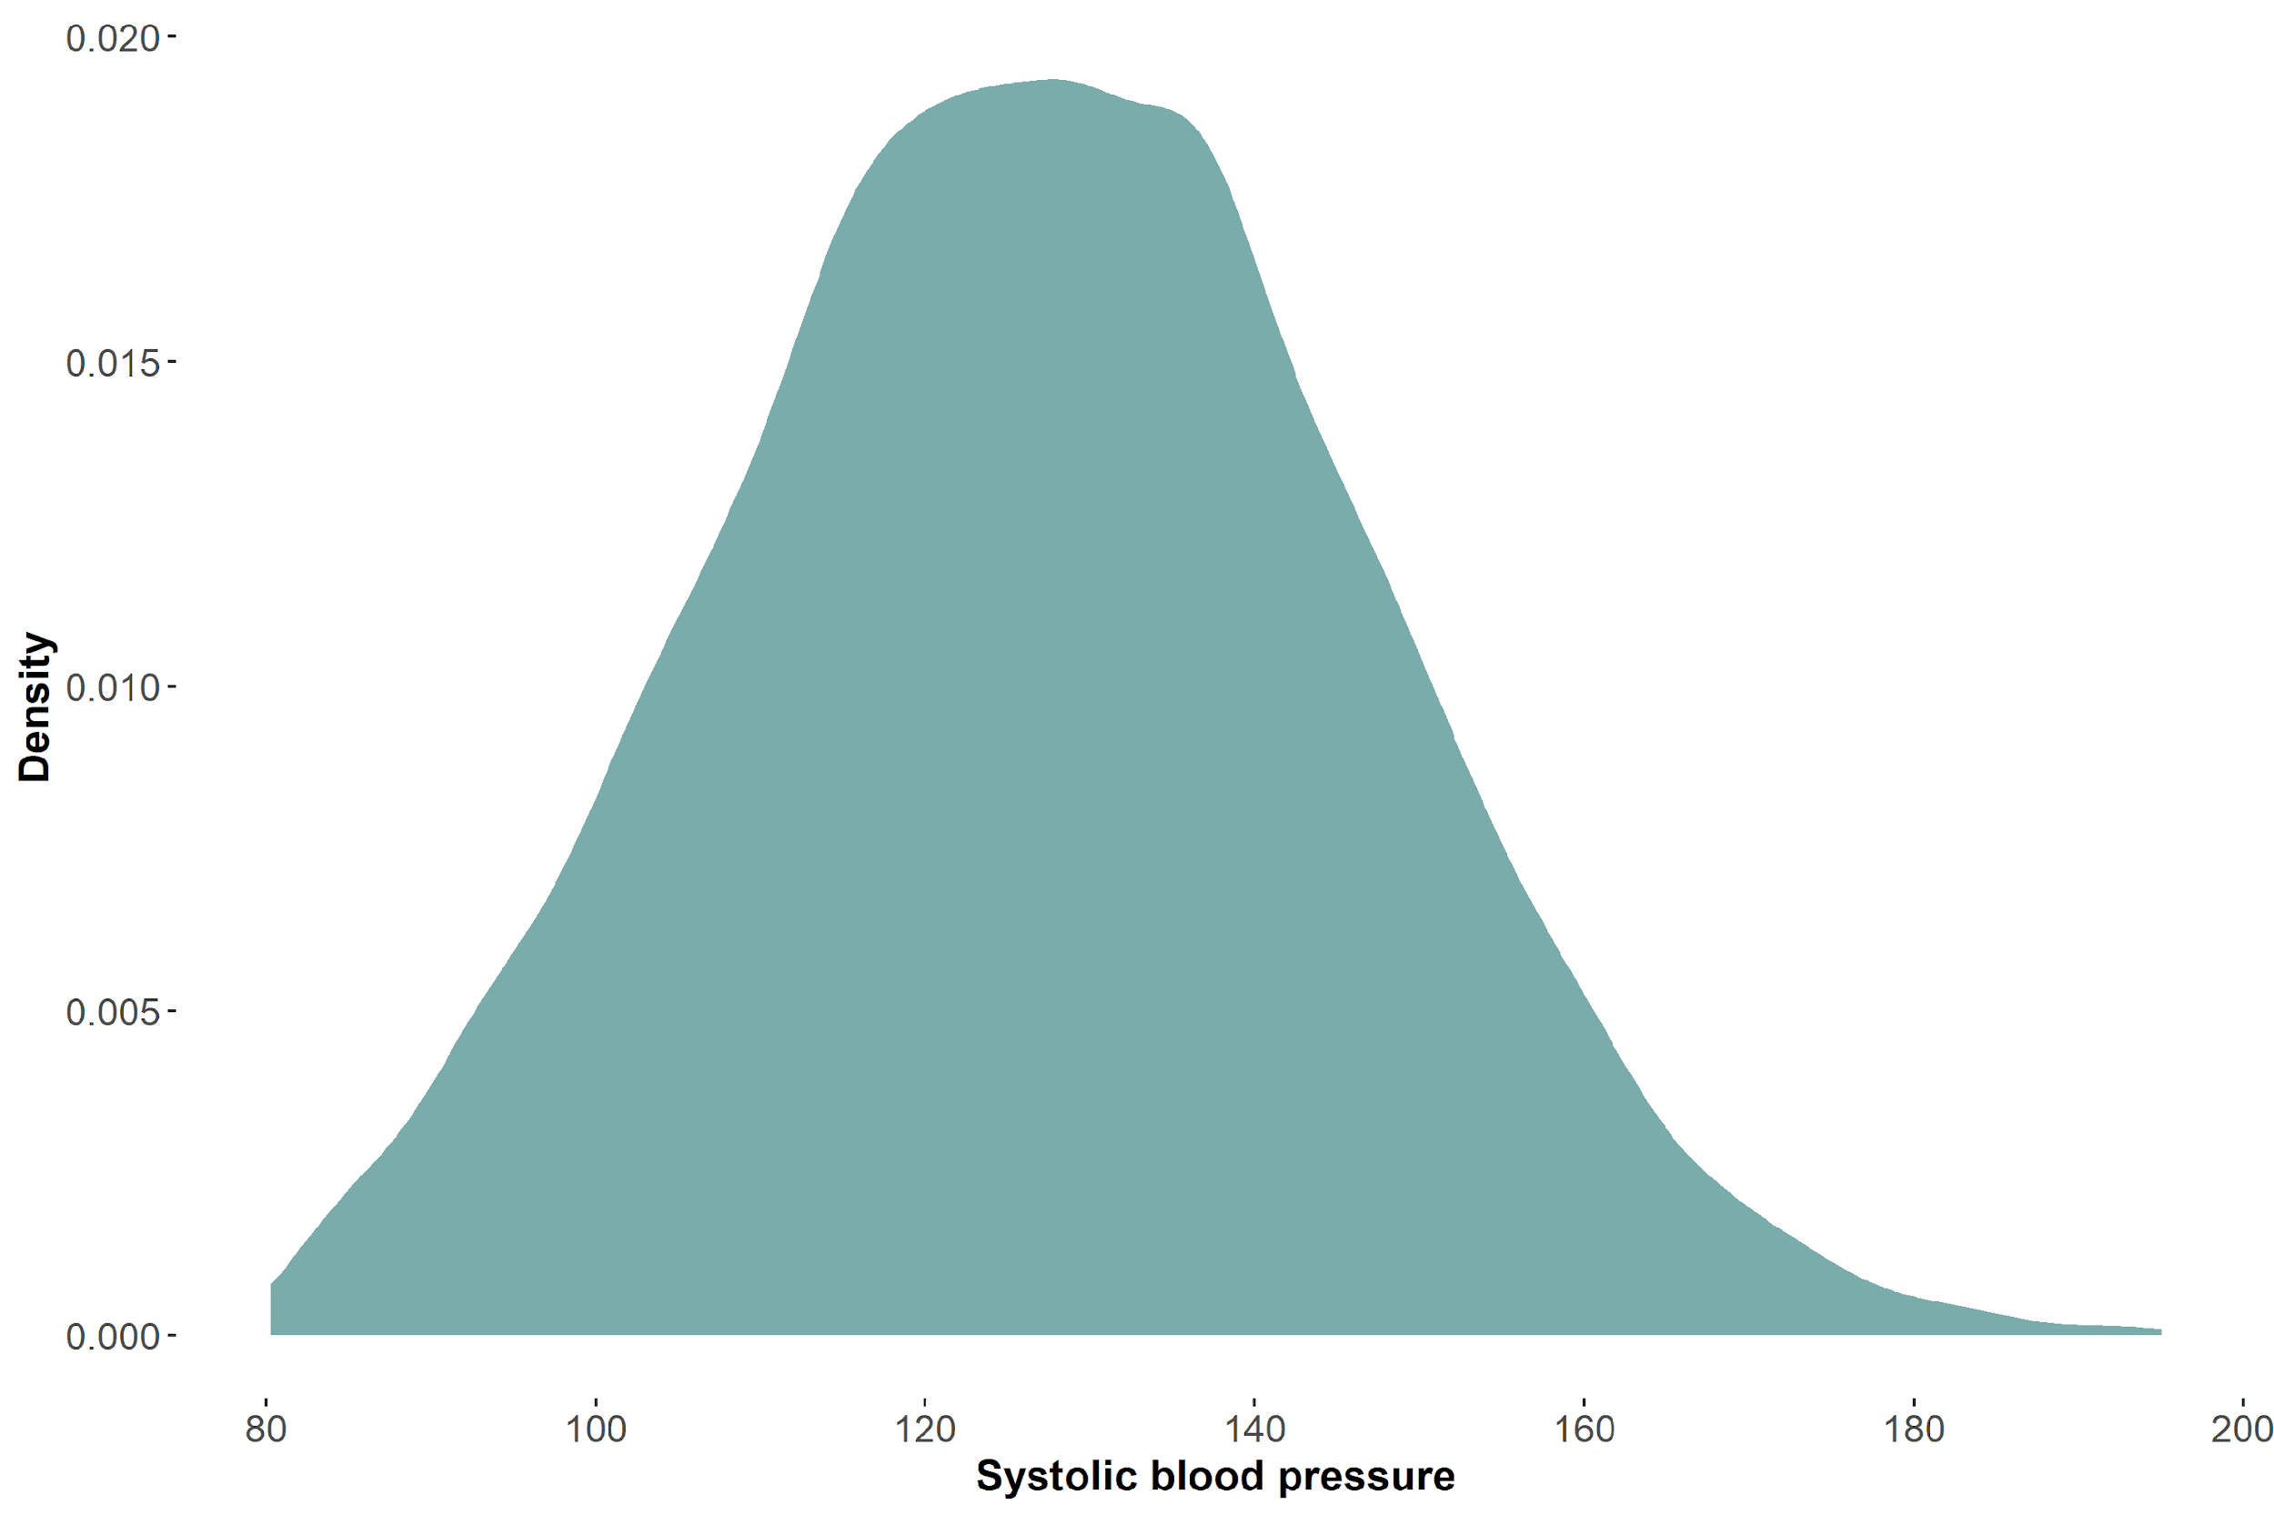
Illustrating Rose’s big idea

Slide 77
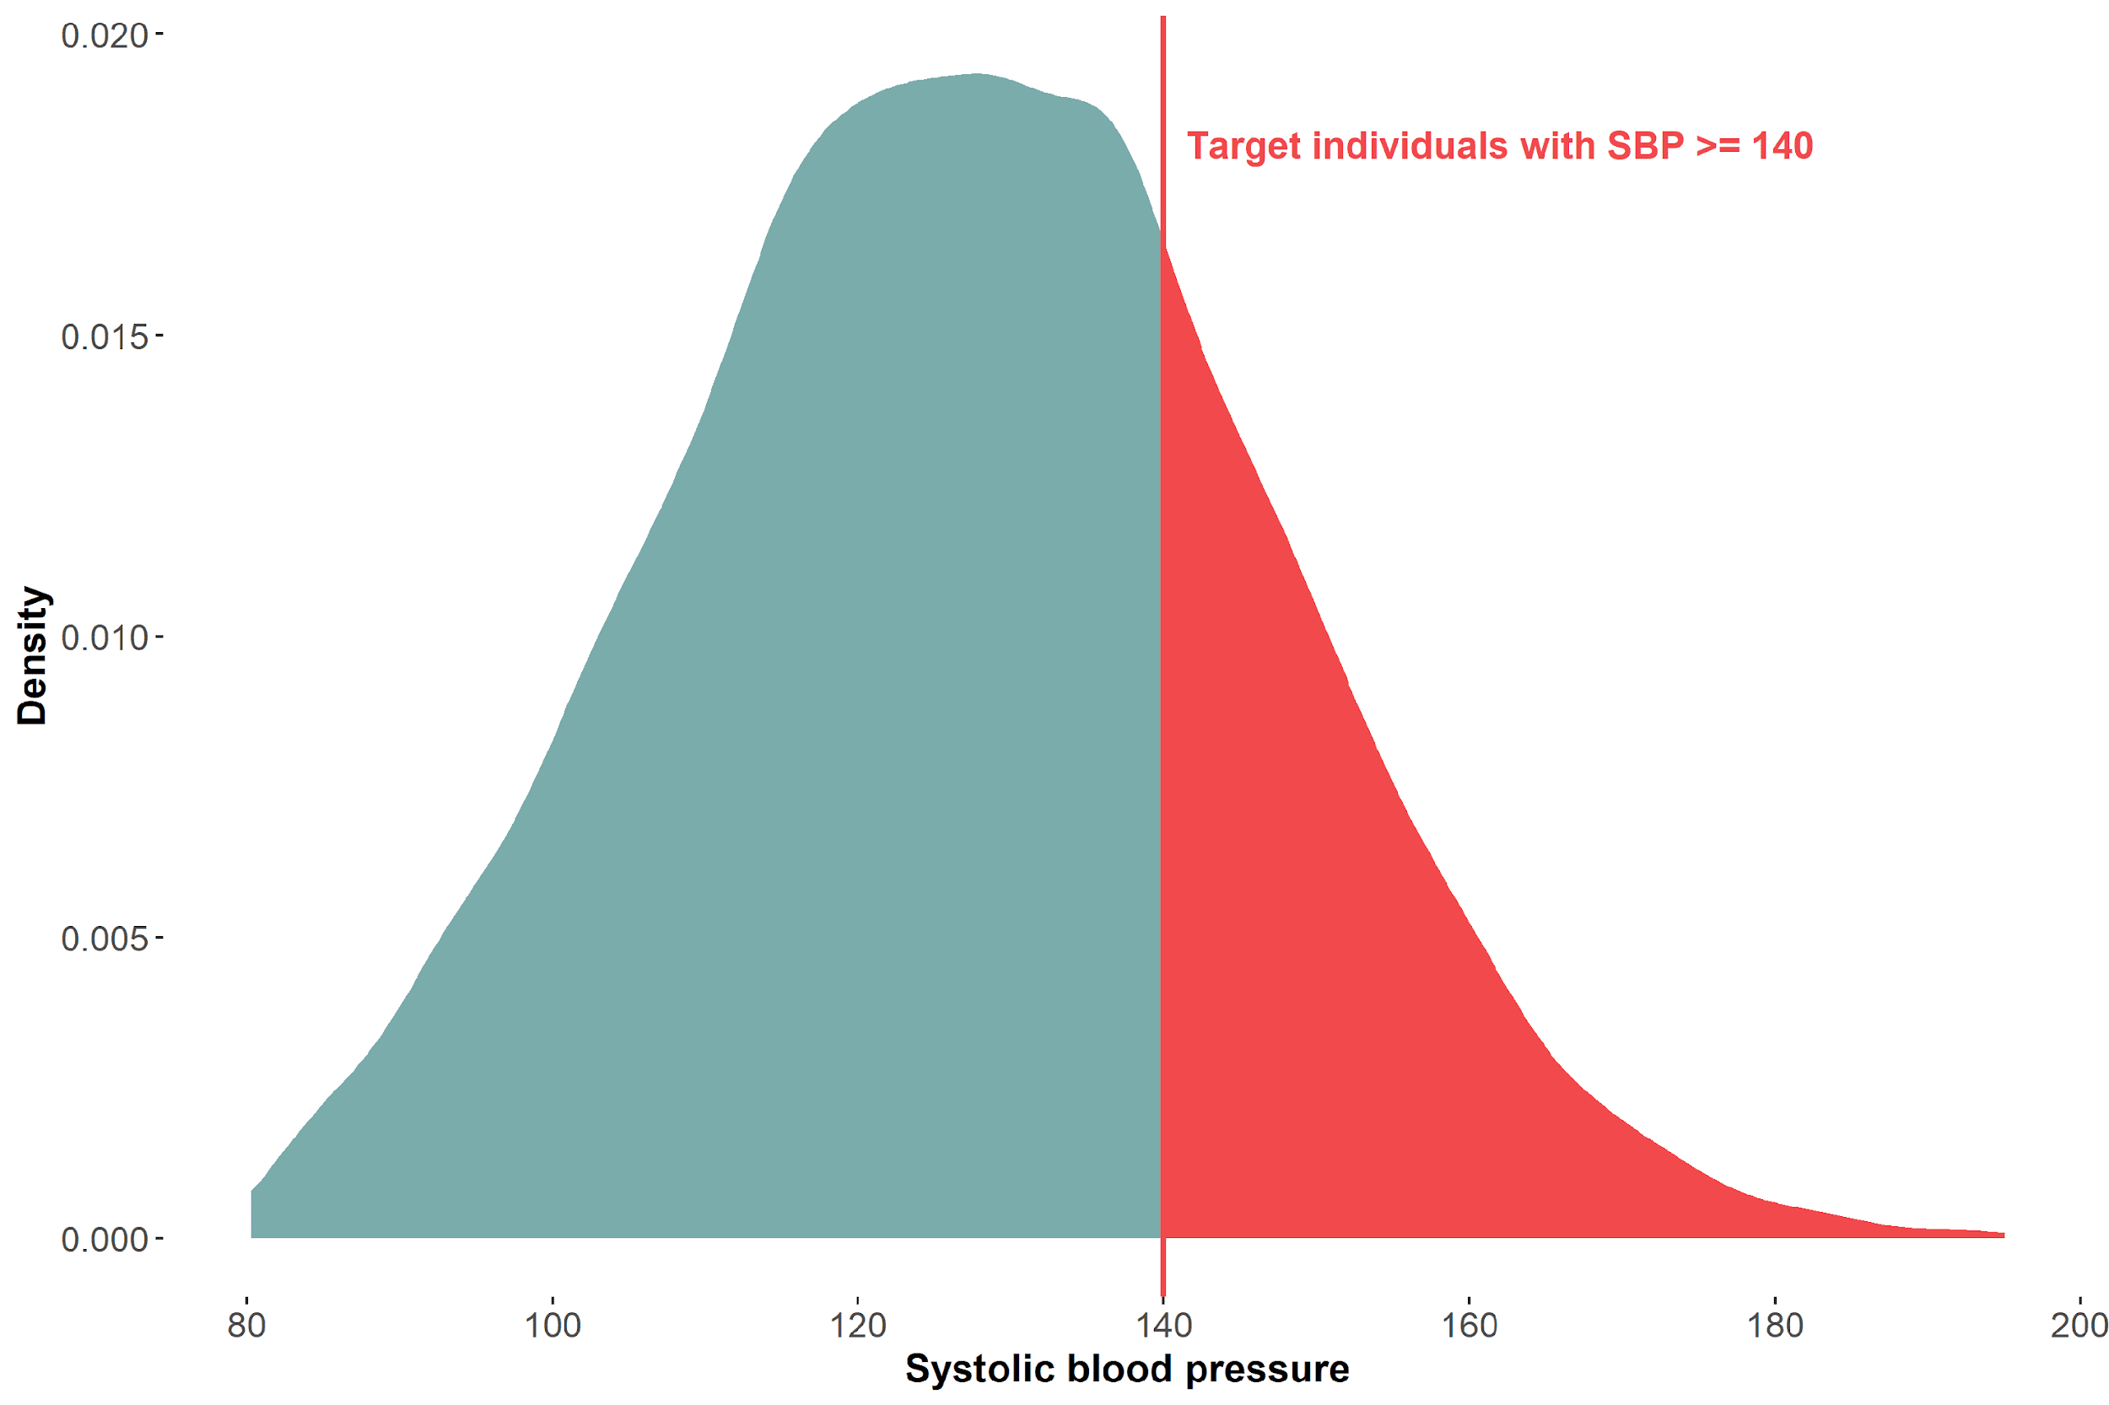
High risk approach for prevention

Slide 78
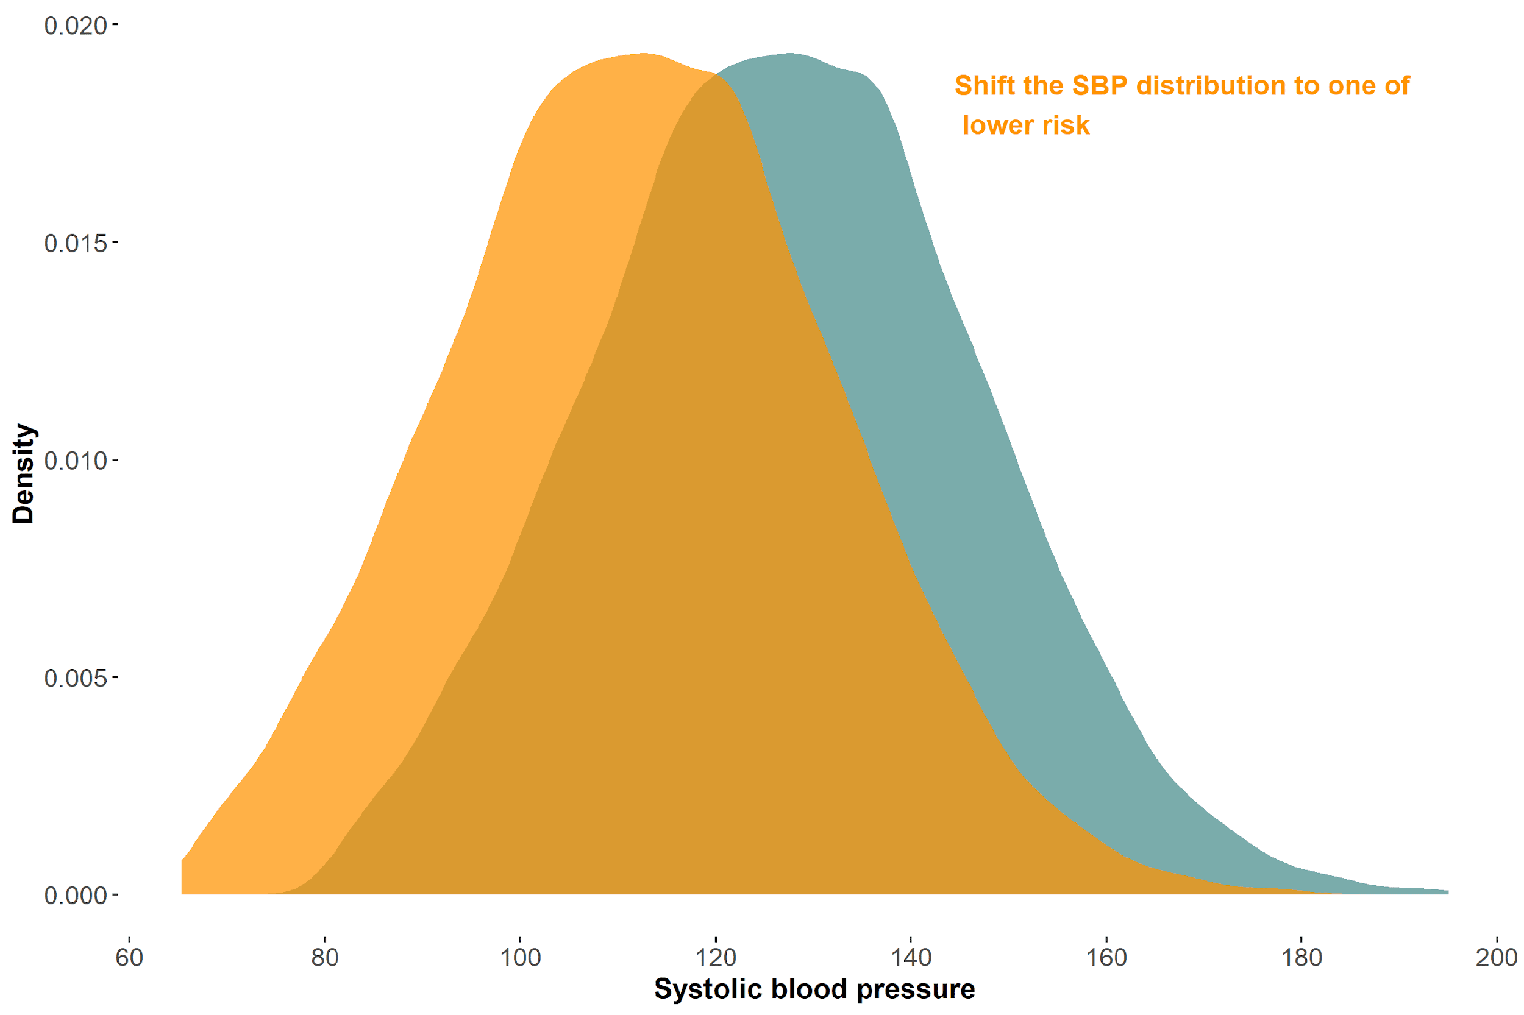
Population approach for prevention
Notes:
Note unconditional distribution
Does focus on the mean

Slide 79
Prevention approaches
High risk approach is useful when…
There are identifiable risk factors that can be targeted in specific individuals/groups
Effective interventions are available for high-risk populations
Targeting individuals can lead to significant reductions in disease incidence or severity
Resources are limited
Population approach is useful when…
Addressing social determinants, environmental factors, or behavioral norms can lead to population-wide improvements in health outcomes
The disease or health issue is widespread across the population
There are opportunities for policy changes or community-level interventions
Preventative measures benefit from reaching a broad audience (e.g., vaccinations)

Slide 80
Equity in Epidemiology (and Research)
Population level interventions address structural determinants of health which primarily tend to effect minoritized populations
Quantile regressions offer a more nuanced way of evaluating population interventions

Slide 81
Any other reasons to use quantile regressions?

Slide 82
Quantile regressions are robust 💪🏾💪🏼💪🏾
Quantile regression estimates are usually unaffected by:
Outliers in the outcome
Monotonic transformation of the outcome (e.g., natural log)
Top coded or bottom coded outcomes
Notes:
Statistical properties

Slide 83
How does an outlier change the distributions? (SBP = 1,000,000)
Mean
Without outlier: 127.63mmHg
With outlier: 240.28mmHg
75th Quantile
Without outlier: 138.50mmHg
With outlier: 138.50mmHg

Slide 84
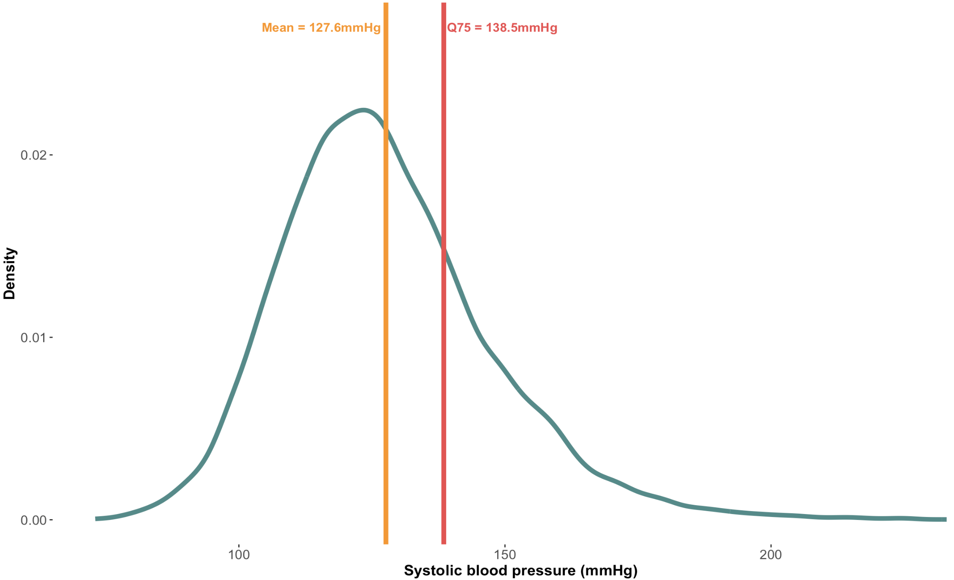
Distribution of SBP in our sample
Notes:
Quite a few people with SBP above 150

Slide 85
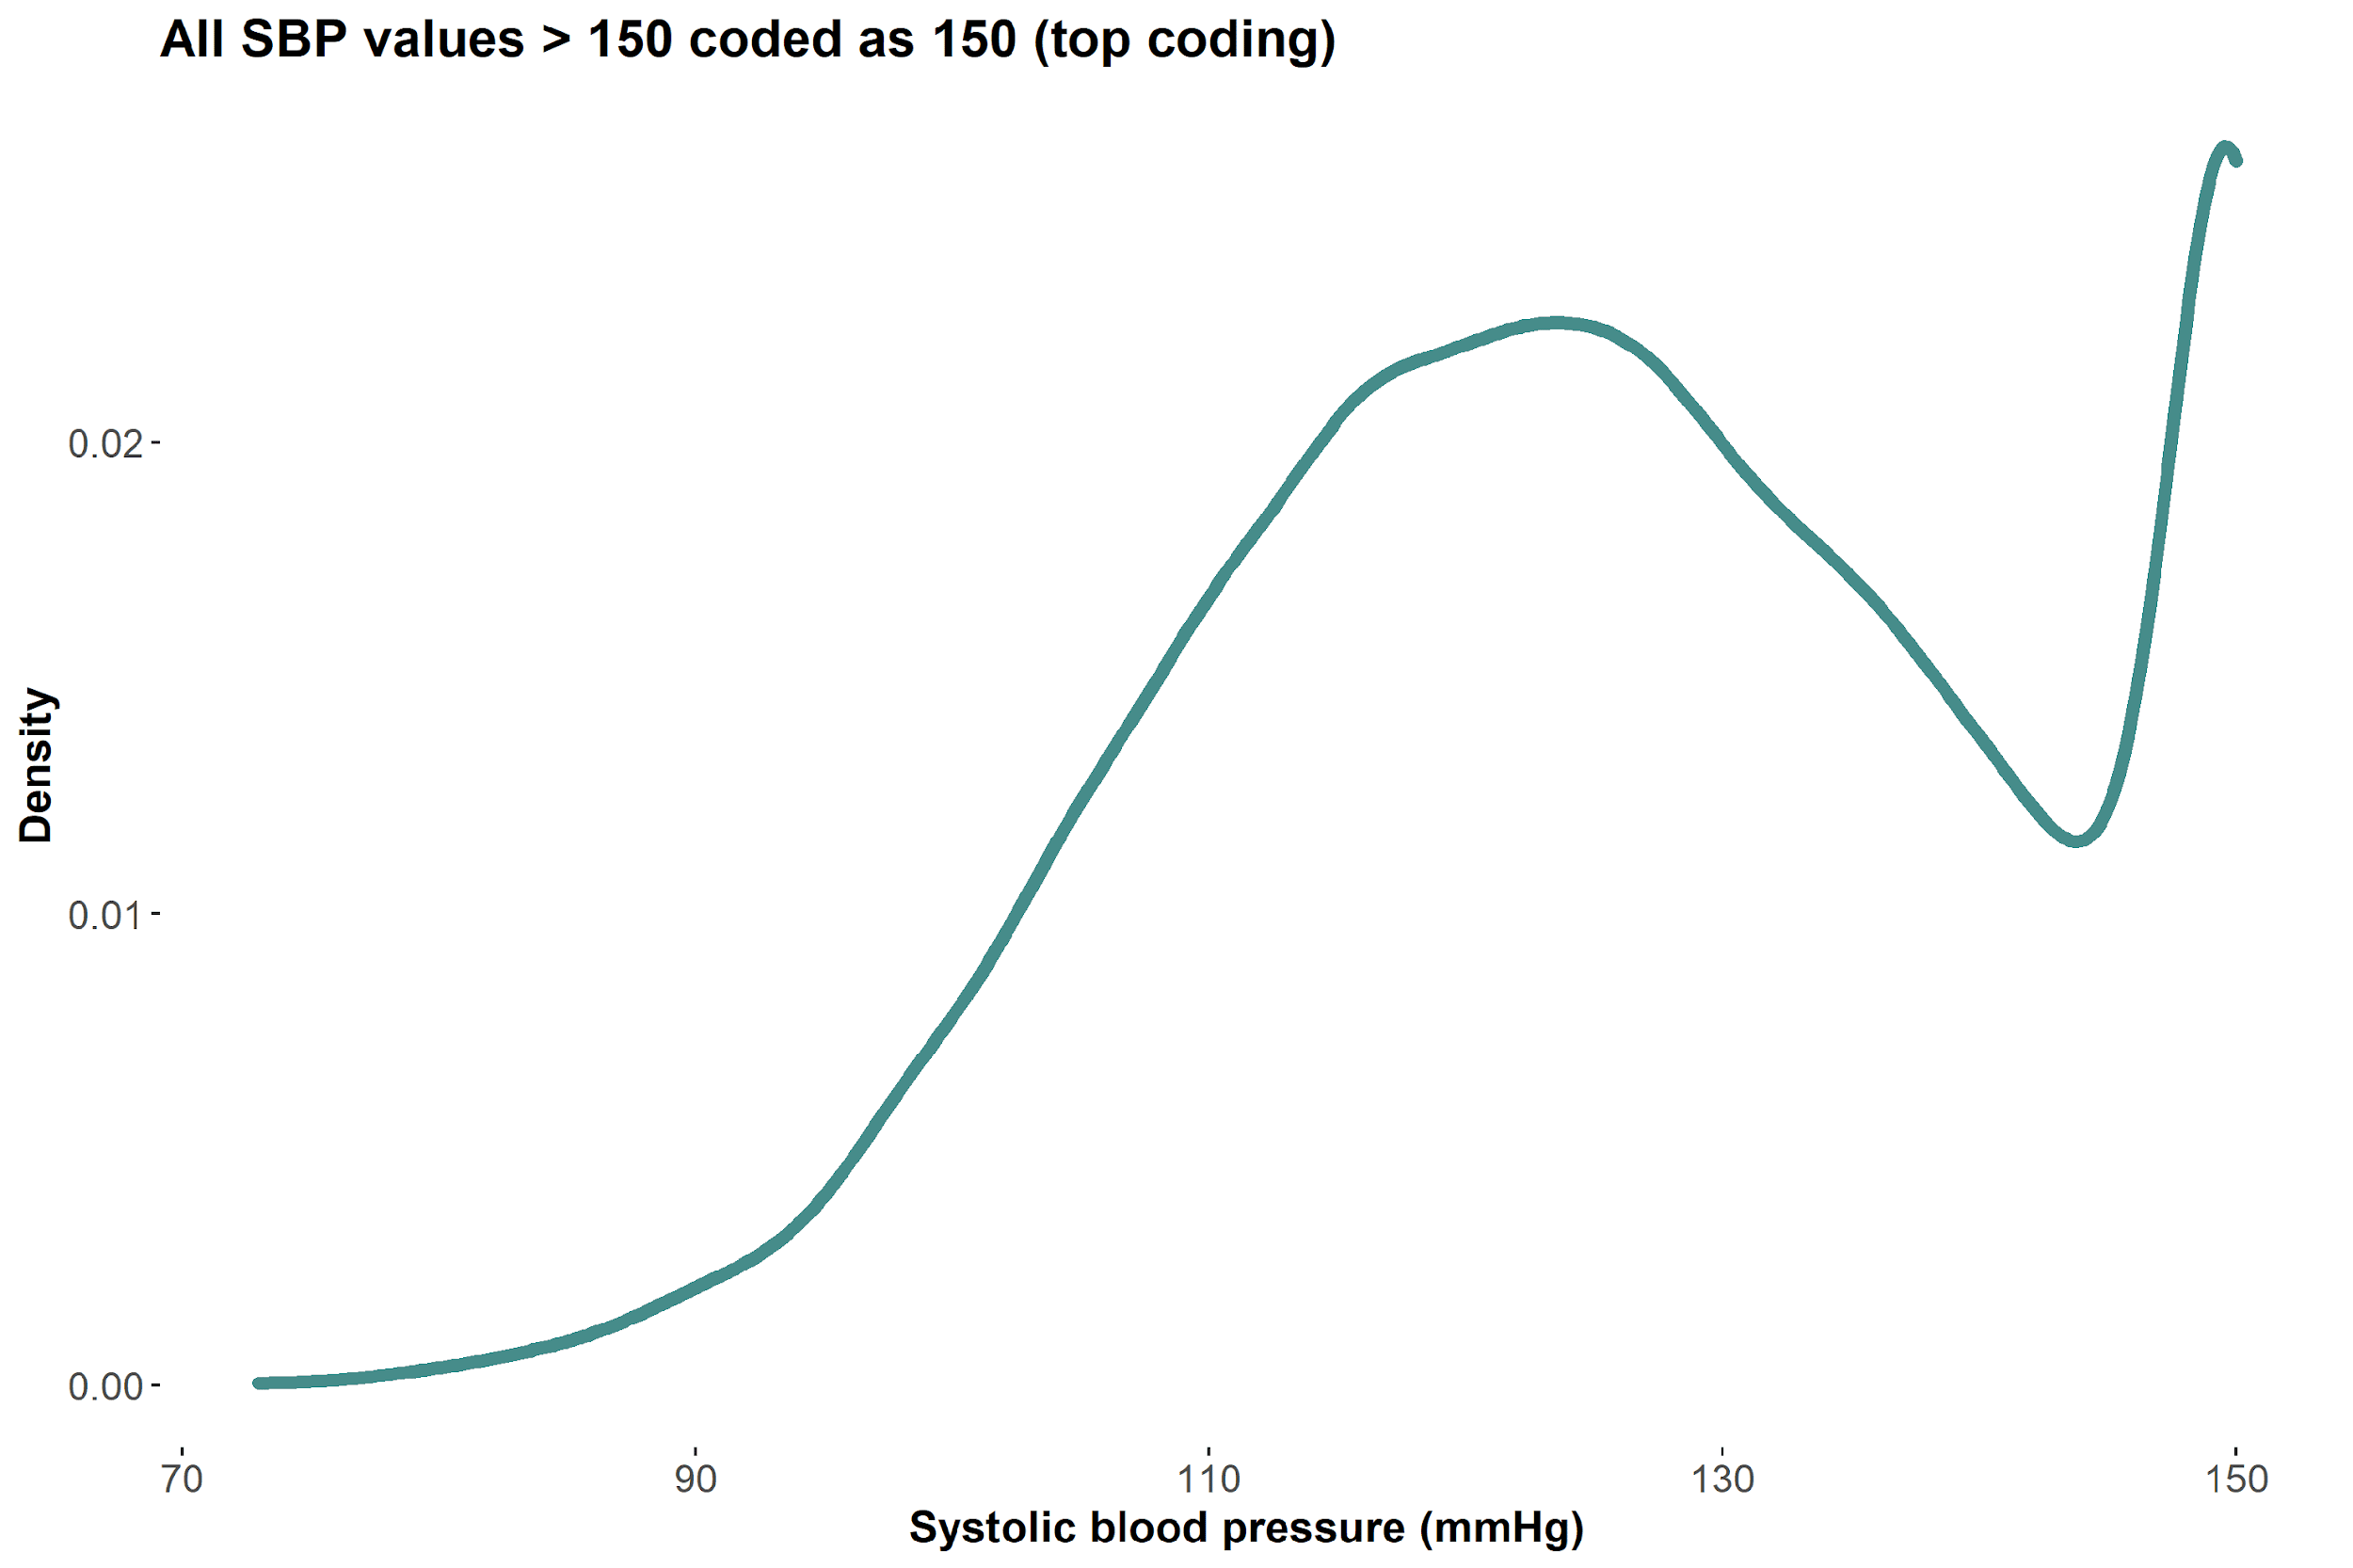
Robust quantiles: Most quantiles unaffected by top/bottom coding💪🏾💪🏼💪🏾
Notes:
R code: fit top/bottom boded version of data and compare how the coefficients change

Slide 86
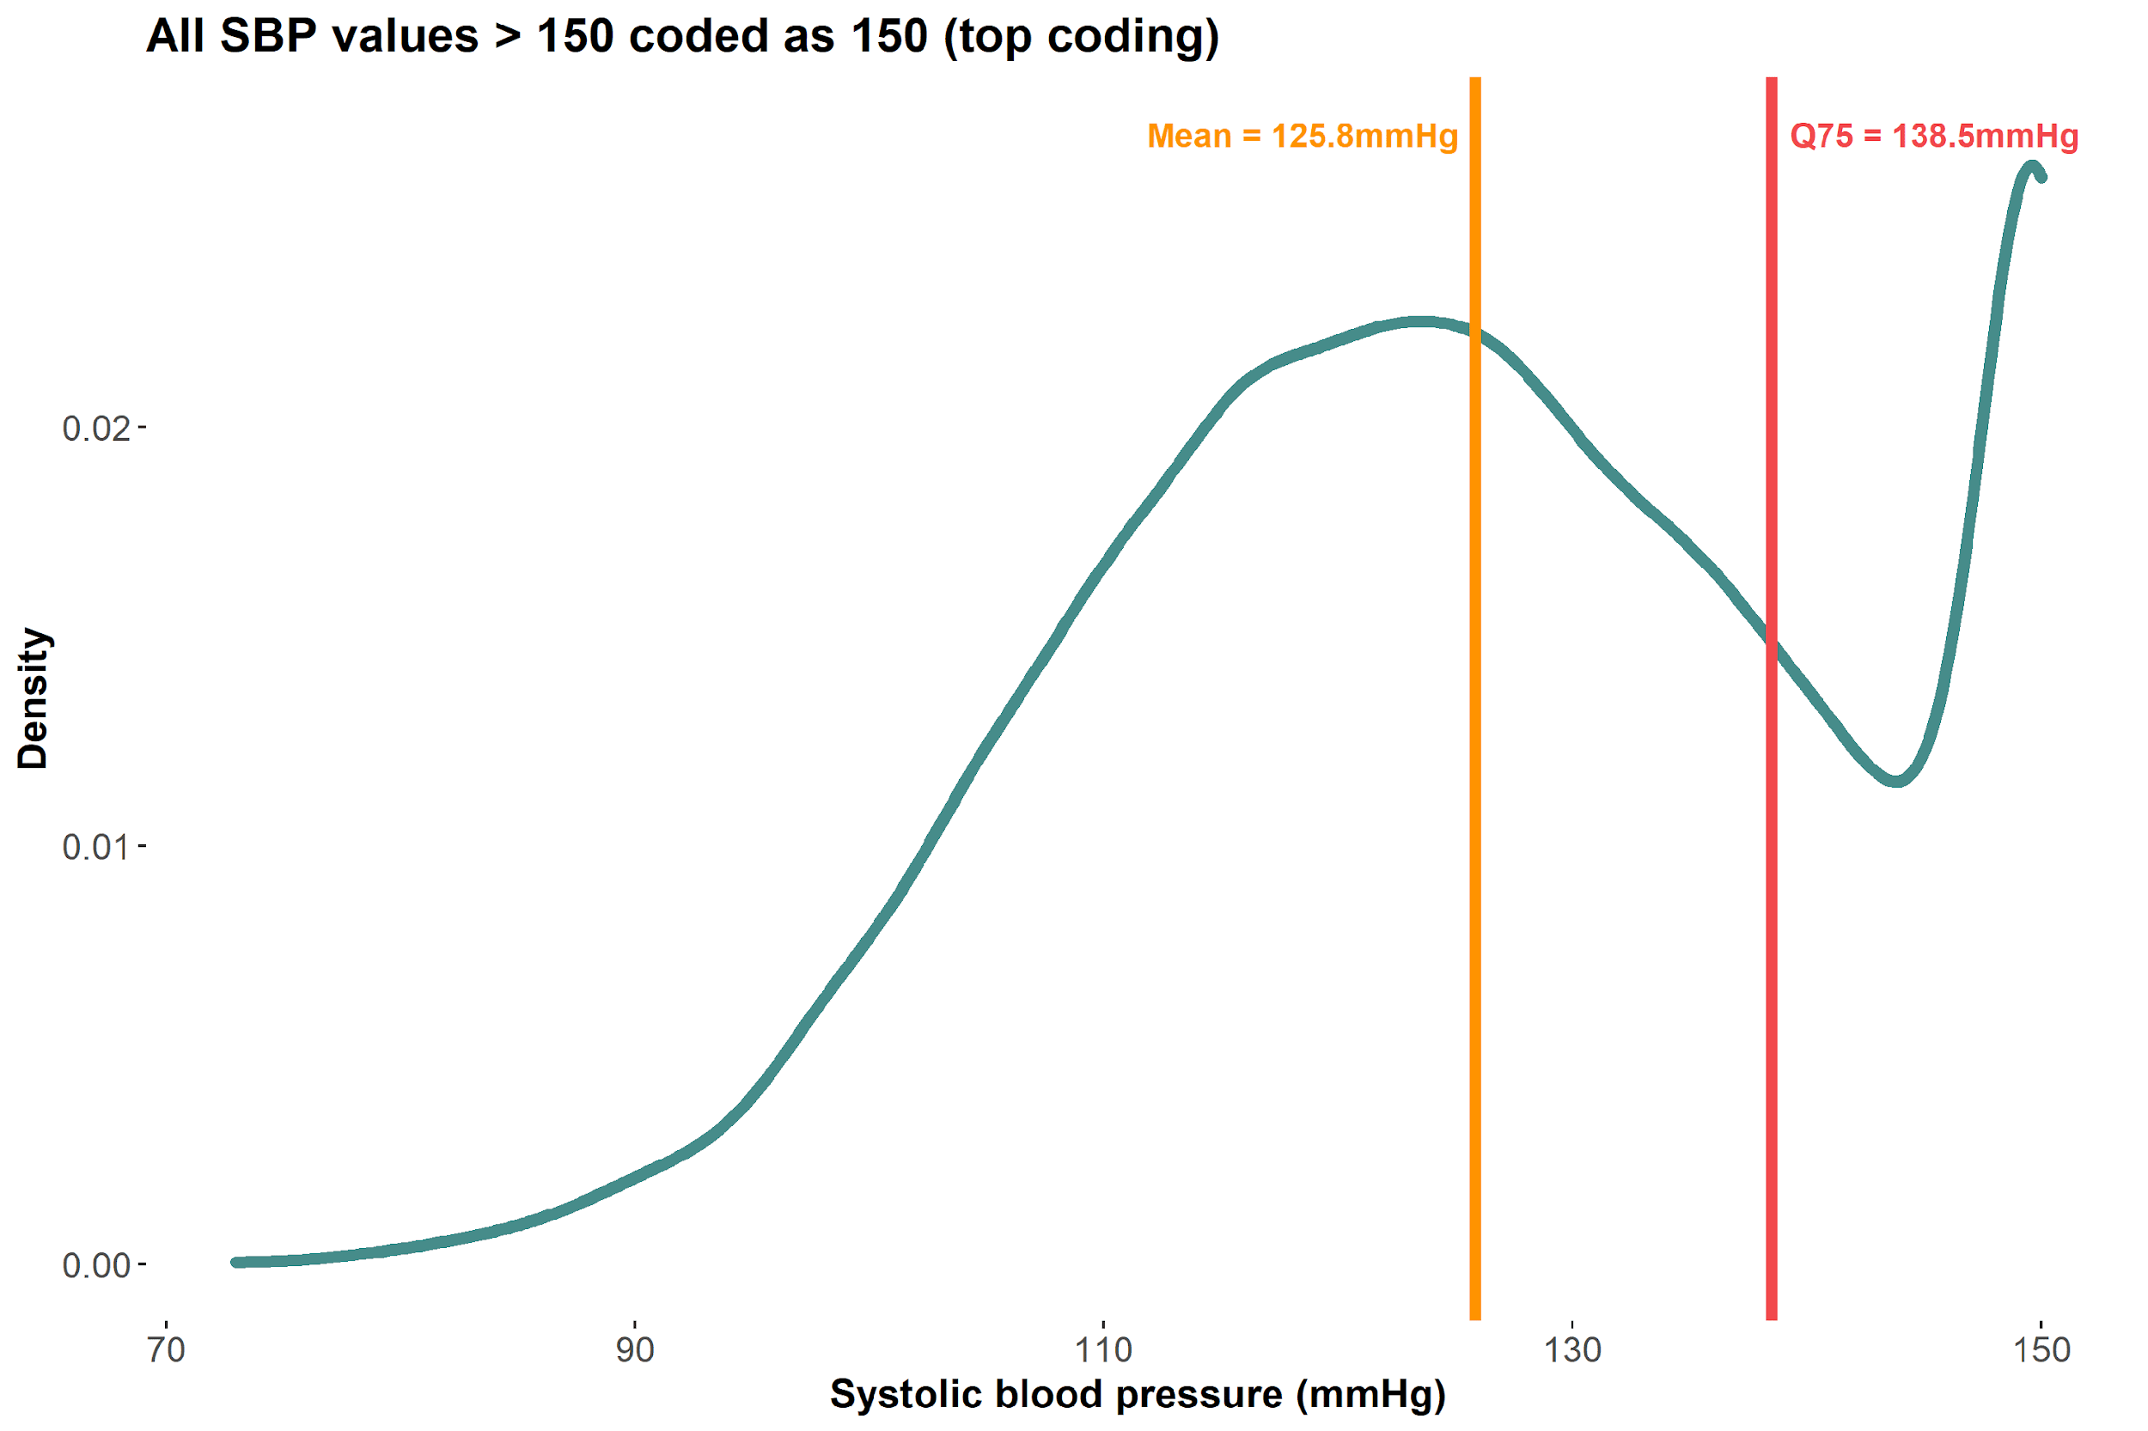
Robust quantiles: Most quantiles unaffected by top/bottom coding 💪🏾💪🏼💪🏾
Mean changed from 127.6mmHg to 125.8mmHg, but the 75th quantile did not change!
Notes:
Because the quantiles aren’t changing, you can make the argument that the associated estimate on school years would be the same for quantile regression at the 75th quantile, but a linear regression estimate would change/be skewed due to the change at the mean when including an outlier or top coding

Slide 87
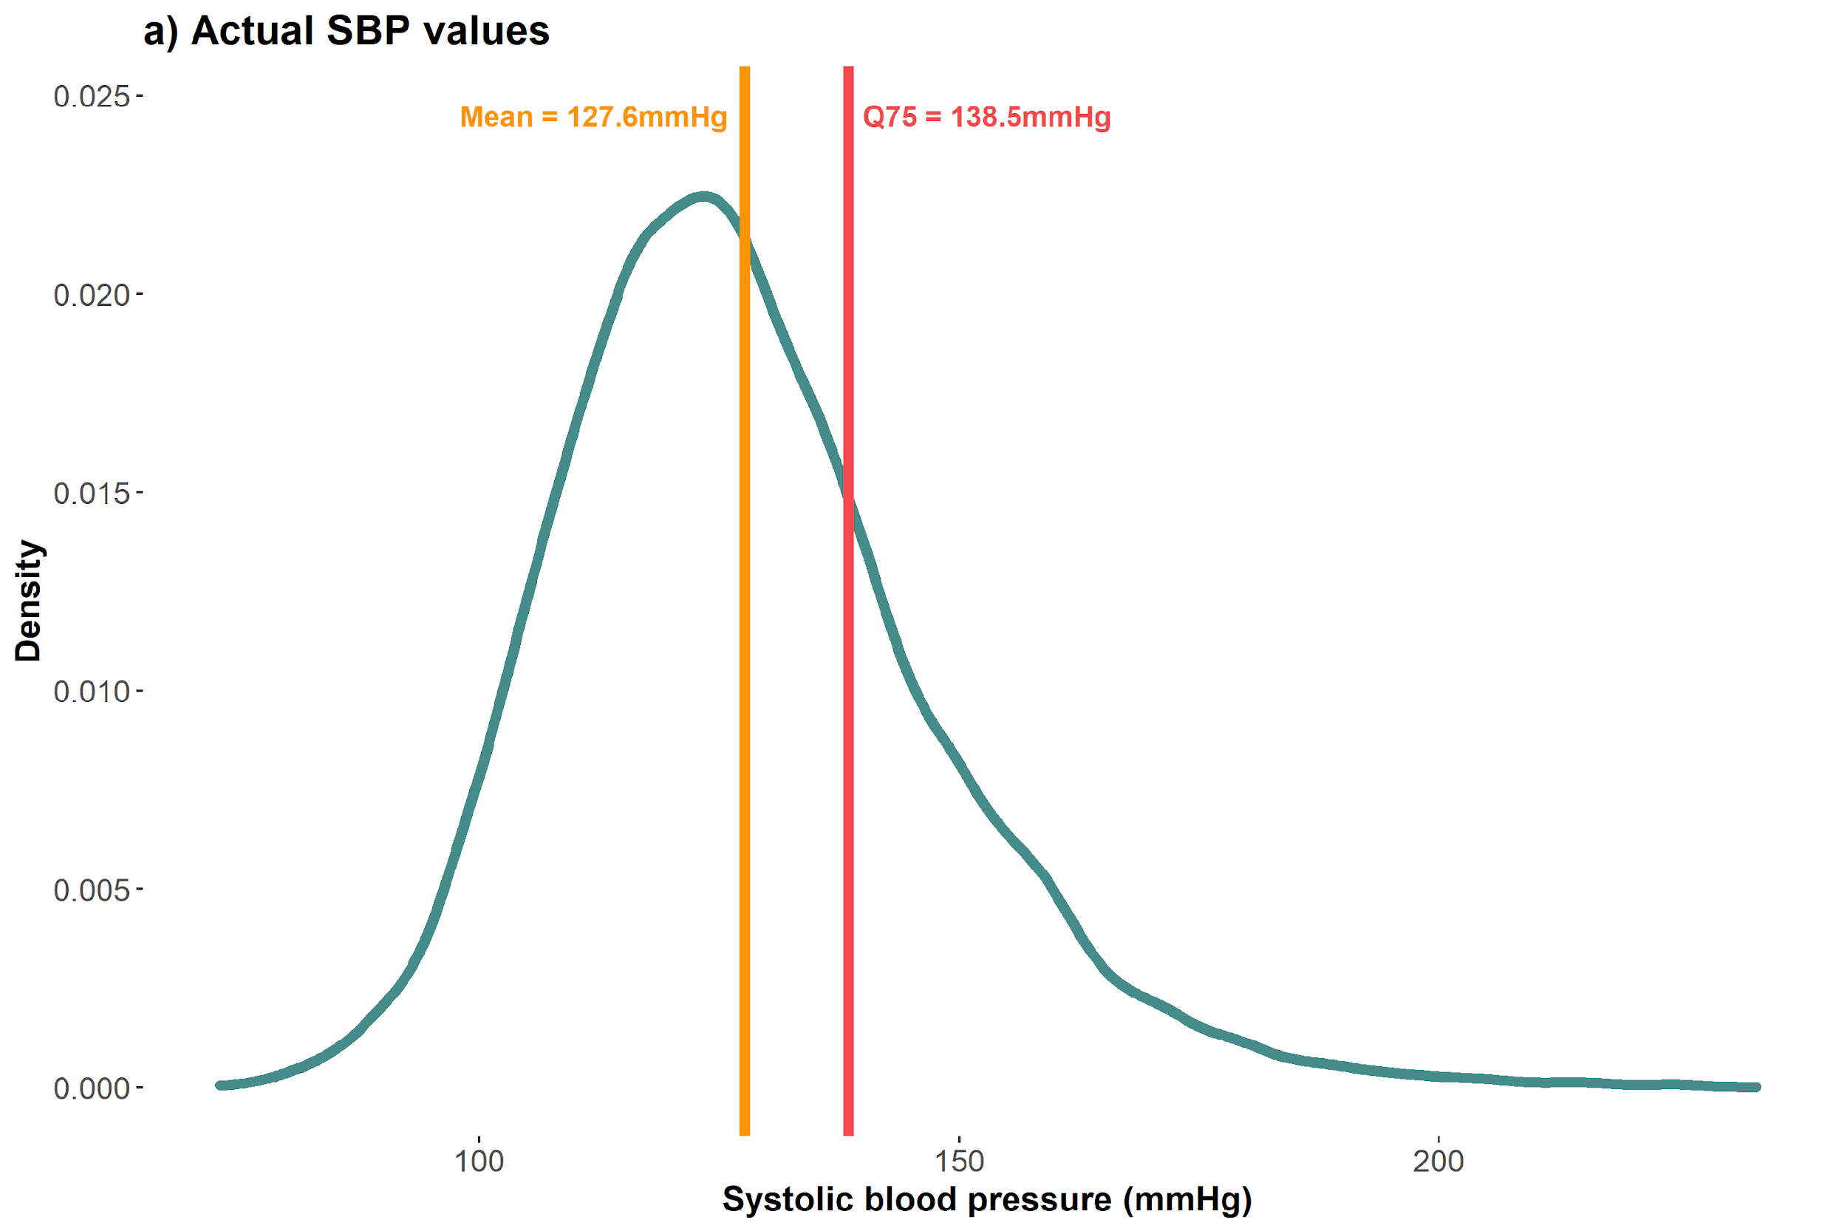
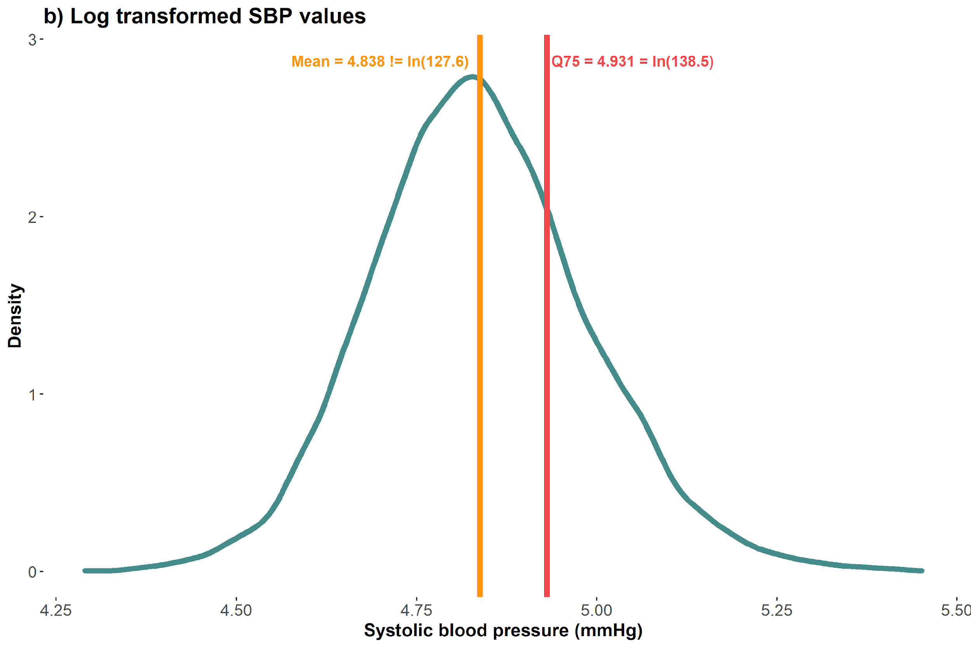
Robust quantiles: Equivariance to monotonic transformations 💪🏾💪🏼💪🏾
Notes:
Log(127.6) = 4.85 (but mean of log transformed distribution is 4.84); would be a larger change if we transformed a variable with a skewed distribution
Log(138.5) = 4.93 (75th quantile of the log transformed distribution)
Why do you think this is important? Extrapolation

Slide 88
10-minute break (please also take our survey on pre-analysis plans)

Slide 89
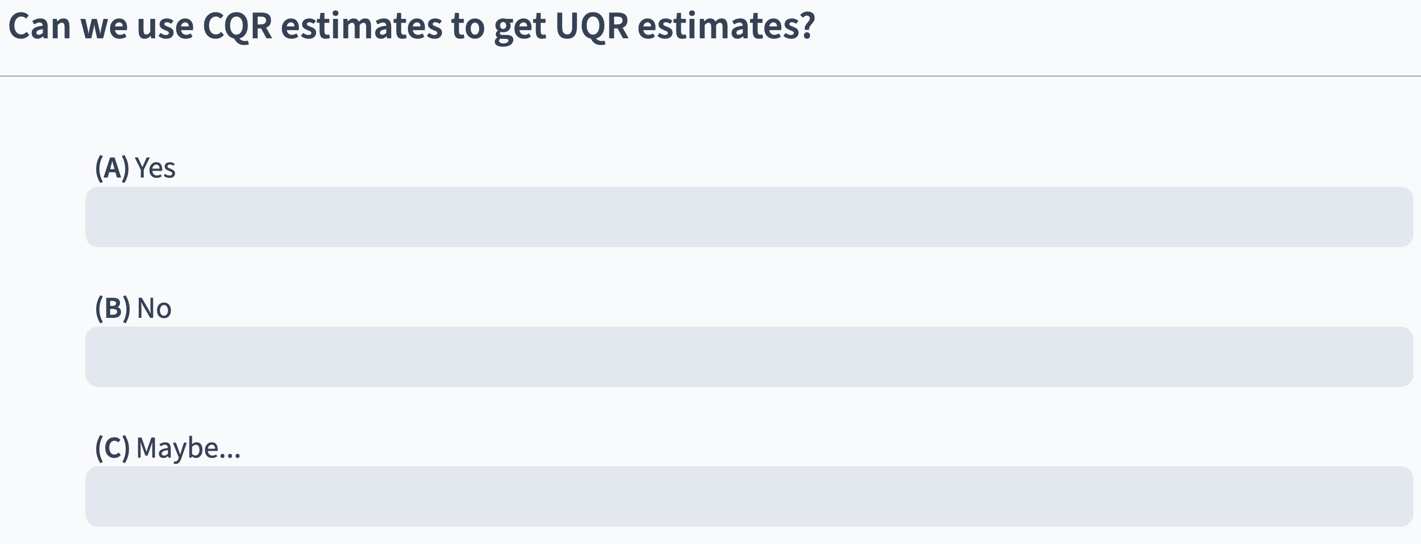
Notes:
Interpretation of CQR in an unconditional distribution (multiple choice)

Slide 90
Why can(’t) we use CQR estimates to to get estimates for the unconditional distribution?
Technically possible…
Computationally difficult ☹

Slide 91
According to Borah and Basu (2013)
Conditional quantile regressions quantify contrasts of the unconditional outcome distribution if:
Outcome is only a function of the exposure
Exposure induces only a location shift in the outcome in the presence of other covariates
But not if
Exposure interacts with other covariates in the DGP

Slide 92
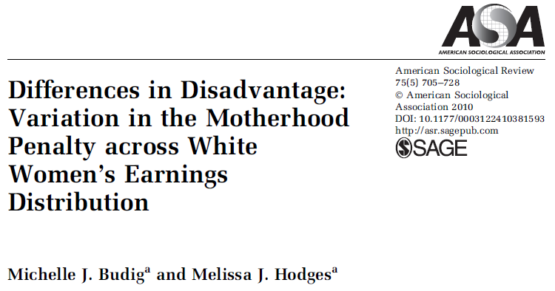
Controversy about the motherhood wage penalty for low-wage women

Slide 93
Variation in motherhood wage penalty Budig et. al. (2010)
Several studies show there is a motherhood wage penalty for American women
Does the penalty vary for low-wage vs. middle-wage vs. high-wage workers?
Methods:
Data: National Longitudinal Survey of Youth, a nationally representative longitudinal study of individuals aged 14-21 in 1979 (1979-2004 waves)
Exposure: Total number of children reported at time of interview
Outcome: Natural log of hourly wages, top- and bottom-coded at $1 and $200
Analysis: conditional quantile regression model

Slide 94
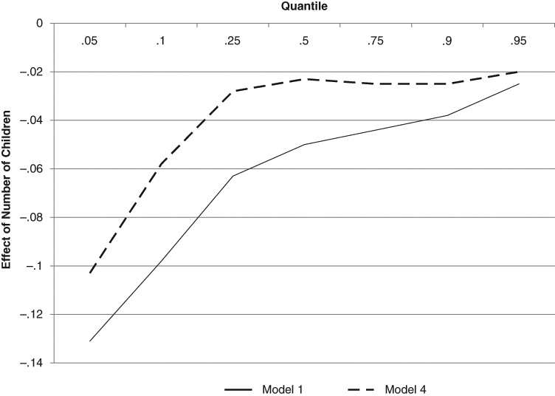
“Mothers who can least afford to lose wages are the ones incurring the largest proportionate penalties”

Slide 95
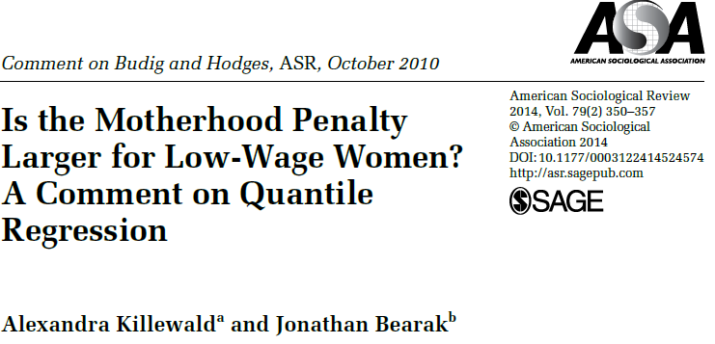
A combative commentary on the Budig et. al. paper

Slide 96


Killewald’s key critique

Slide 97


More appropriate method changes the main results!
Killewald et. al.’s replication of Budig et. al. results by applying conditional quantile regression (Figure 1 of the paper)
Killewald et. al.’s results for the motherhood wage penalty after applying more appropriate methods (Figure 2 of the paper)
Quantile
Quantile

Slide 98

Implications of new results using appropriate methods

Slide 99
Unconditional quantile regressions (UQR)

Slide 100




Sergio Firpo. Source: link
Nicole Fortin. Source: link
Firpo, Fortin, Lemieux (2009). Unconditional Quantile Regressions. Econometrica 77(3): 953-973
Thomas Lemieux. Source: link

Slide 101

Firpo’s unconditional quantile regression method quantifies the change in the $τ^{th}$ quantile of the unconditional outcome distribution for a small change in the exposure distribution

Slide 102
How does the Firpo et. al. (2009) method work?

Slide 103
Recentered Influence Function (RIF) to the rescue!
Recentered influence function (RIF): sum of a distributional statistic’s influence function and the distributional statistic itself
RIF regression: regression of the RIF on the exposure and other covariates of interest
Effect of a small shift in the unconditional exposure distribution (i.e., the Unconditional Quantile Partial Effect) on quantile of the unconditional outcome distribution
Several methods of estimating RIF regression including OLS
Notes:
Logistic, polynomial

Slide 104
What’s an Influence Function?
Influence functions (IF) are a way of assessing the “robustness” of distributional statistics
IF calculates change in a distributional statistic of interest for a “small” change in the distribution
Examples of distributional statistics include means, quantiles, Gini coefficients, etc.
Each distributional statistic has an influence function specific to it
Notes:
Different equations for IFs depending on which statistic is of interest

Slide 105

Influence Function for quantiles
Influence function for the $τ^{th}$ quantile of $Y$
$$IF\left(y;q_{τ}\right)=\frac{τ−I\left(y≤q_{τ}\right)}{f_{y}(q_{τ})}$$
Where $q_{τ}$ is the value of $Y$ at the $τ^{th}$ quantile, $I(.)$ is the indicator function, and $f_{y}(q_{τ})$ is the density of $Y$ at the $τ^{th}$ quantile
Notes:
Influence function for y at the tauth quantile

Slide 106

What’s a RIF?
Firpo et. al. (2009) define the RIF for the $τ^{th}$ quantile as
$$RIF\left(y;q_{τ}\right)=q_{τ}+IF\left(y;q_{τ}\right)=q_{τ}+\frac{τ−I\left(y≤q_{τ}\right)}{f_{y}(q_{τ})}$$
Expected value of the RIF equals the value of Y at the $τ^{th}$ quantile
$$E\left[RIF\left(y;q_{τ}\right)\right]=E\left[q_{τ}+\frac{τ−I\left(y≤q_{τ}\right)}{f_{y}\left(q_{τ}\right)}\right]=E\left[q_{τ}\right]+E\left[\frac{τ−I\left(y≤q_{τ}\right)}{f_{y}\left(q_{τ}\right)}\right]=q_{τ}$$
Notes:
** Distribute expectation over q(t) and IF

Slide 107
Step 1
Estimate the RIF in the unconditional outcome distribution
Step 2
Regress RIF on exposure + covariates
Step 3
Estimate standard errors using bootstrap or sandwich estimator

Slide 108
Step 1
Estimate the RIF in the unconditional outcome distribution
Step 2
Regress RIF on exposure + covariates
Step 3
Estimate standard errors using bootstrap or sandwich estimator

Slide 109

Step 1: Choose the quantile of interest in the unconditional outcome distribution

Slide 110



Step 1: Estimate the RIF at the quantile of interest
$$RIF\left(SBP_{i};q_{0.25}\right)=q_{0.25}+\frac{τ−I(SBP_{i}≤q_{0.25})}{f_{Y}(q_{0.25})}$$
$$RIF\left(SBP;q_{0.25}\right)=114+\frac{0.25−I(SBP_{i}≤114)}{f_{Y}(114)}$$
$$RIF\left(SBP;q_{0.25}\right)=\left\{\begin{aligned}75.94; I\left(SBP_{i}≤114\right) \\ 126.69; I\left(SBP_{i}>114\right)\end{aligned}\right.$$

Slide 111

Moving from the unconditional distribution to the RIF
Notes:
Moving from continuous distribution to a binary distribution, where the RIF will take on one value for those who fall below and another for those above

Slide 112

Step 1: Estimated RIF at the 25th quantile of SBP
$$RIF(SBP_{i}, q_{0.25})= \left\{\begin{aligned}75.94; I\left(SBP≤114\right) \\ 126.69; I\left(SBP>114\right)\end{aligned}\right.$$
Notes:
Move to R to show RIF values --> line 485

Slide 113




Step 1: Estimated RIF at the 25th, 50th, and 75th quantiles of SBP
$$RIF(SBP_{i}, q_{0.25})= \left\{\begin{aligned}75.94; I\left(SBP≤114\right) \\ 126.69; I\left(SBP>114\right)\end{aligned}\right.$$
$$RIF(SBP_{i}, q_{0.5})= \left\{\begin{aligned}103.00; I\left(SBP≤125.5\right) \\ 148.00; I\left(SBP>125.5\right)\end{aligned}\right.$$
$$RIF(SBP_{i}, q_{0.75})= \left\{\begin{aligned}121.65; I\left(SBP≤138.5\right) \\ 189.05; I\left(SBP>138.5\right)\end{aligned}\right.$$
Notes:
RIF only takes on 2 values regardless of which quantile we’re evaluating
proportion of participants falling in each bin corresponds to the quantile

Slide 114
Step 1
Estimate the RIF in the unconditional outcome distribution
Step 2
Regress RIF on exposure + covariates
Step 3
Estimate standard errors using bootstrap or sandwich estimator

Slide 115

Step 2: Three ways to regress RIF on exposure and covariates
$$RIF\left(y;q_{τ}\right)=q_{τ}+\frac{τ−I\left(y≤q_{τ}\right)}{f_{y}(q_{τ})}=\frac{1}{f_{y}\left(q_{τ}\right)}I\left(y>q_{τ}\right)+q_{τ}−\frac{1−τ}{f_{y}\left(q_{τ}\right)}$$
Three ways of regressing RIF on exposure and covariates:
Linear regression using OLS with RIF as the outcome (RIF-OLS)
Logistic regression using $I\left(y>q_{τ}\right)$ as the outcome (RIF-Logit)
Polynomial regression to model $I\left(y>q_{τ}\right)$ (RIF-NP)
We will focus on RIF-OLS as it is easiest and most practical
Notes:
Equation is to isolate the indicator function since we use it in 2 & 3
End up modeling the indicator function, density is a constant, indicator function will vary (either 1 or 0), q tau and 1- tau are fixed – only source of variation is indicator fxn, regression equations are about modeling variation in the outcome = could model directly instead of using OLS on RIF

Slide 116

Step 2: Fitting the RIF-OLS regression for SBP at the 25th quantile
$$E\left[RIF\left(SBP_{i};q_{0.25}\right) | X,C\right]=α_{0.25}+β_{0.25}x_{i}+λ_{0.25}^{′}C$$
$$E\left[E\left[RIF\left(SBP_{i};q_{0.25}\right) | X,C\right]\right]=E\left[α_{0.25}+β_{0.25}x_{i}+λ_{0.25}^{′}C\right]$$
$$E\left[RIF(SBP_{i};q_{0.25})\right]=α_{0.25}+β_{0.25}E\left[X\right]+λ_{0.25}^{′}E[C]$$
$$E\left[RIF(SBP_{i};q_{0.25})\right]=q_{0.25}$$
Notes:
First thing we do is take expectation of both sides - want to get rid of x and c to get to unconditional mean of RIF – it’s the unconditional mean of RIF that equals qT
Expectation of alpha is just of a constant, so it’s itself

Slide 117
Firpo’s method “tricks” a regression model into modeling quantiles of the unconditional outcome distribution by using the recentered influence function as the outcome

Slide 118


Slide 119

$$E\left[RIF(SBP_{i};q_{0.25})\right]=α_{0.25}+β_{0.25}E\left[X\right]+λ_{0.25}^{′}E[C]$$
How do we interpret $β_{0.25}$?
Notes:
Switch to R --> line 566

Slide 120

Notes:
How do we interpret beta 0.25?
Beta 0.25 is the change in the 25th quantile of the conditional distribution of SBP for a unit change in school years
Beta 0.25 is the change in the 25th quantile of the unconditional distribution of SBP for a unit change in school years
Beta 0.25 is the change in the 25th quantile of the conditional distribution of SBP for a unit change in mean school years in the study sample
Beta 0.25 is the change in the 25th quantile of the unconditional distribution of SBP for a unit change in mean school years in the study sample

Slide 121

Interpreting coefficients of the RIF-OLS model
$$E\left[RIF(SBP_{i};q_{τ})\right]=α_{τ}+β_{τ}E\left[X\right]+λ_{τ}^{′}E\left[C\right]$$
$β_{τ}$ is the estimated change in the $τ$^{th} quantile of the unconditional distribution of SBP for a unit change in the mean of the unconditional distribution of the exposure $X$

Slide 122

 | Linear Regression | Conditional Quantile Regression | Unconditional Quantile Regression
Model | $$E[Y|X]=X′β$$ | $$Q_{τ}(Y|X)=X^{′}β_{τ}, \\ τ=(0,1)$$ | $$E\left[RIF\left(Y;q_{τ}\right) | X\right]=X^{′}β_{τ}, \\ τ=(0,1)$$
Error | Standard assumptions about the error term (iid, Normal distribution) are usually violated | No distributional assumption is made about the error | No explicit assumption, but likely the same assumptions as the estimation strategy used
Estimating coefficients | $$\min_{\hat{β}}{\sum_{i=1}^{N}{{\left(y_{i}−x_{i}^{′}\hat{β}\right)}^{2}}}$$ | $$\min_{\hat{β}}{\sum_{i=1}^{N}{ρ_{τ}\left(y_{i}−x_{i}^{′}\hat{β}\right)}}$$ | Method of estimation depends on the estimator used (e.g., RIF-OLS, RIF-Logit)
Solution | Analytic solution | Linear programming methods | Many, including OLS
Estimating standard errors | Several estimators are available + bootstrap | Several estimators are available and key point is that we need to estimate the error density + bootstrap | Same estimators available as would be for the choice of estimator
Interpretation | One unit increase in the independent variable of interest is associated with a $\hat{β}$ unit change in the conditional mean of the outcome | One unit increase in the independent variable of interest is associated with a $\hat{β}$ unit change in the $τ^{th}$ quantile of the conditional outcome distribution | One unit increase in the mean of the independent variable of interest is associated with a $\hat{β}$ unit change in the $τ^{th}$ quantile of the unconditional outcome distribution

Slide 123
10-minute break (please also take our survey on pre-analysis plans)

Slide 124
Standard errors

Slide 125

Populations and samples
Imagine that the following is the true model of the relationship between SBP and school years
$$SBP_{i}=β_{0}+β_{1}schlyrs_{i}+ε_{i}$$
But we usually work with samples, so we end up estimating the parameters of this model
$$SBP_{i}=\hat{β_{0}}+\hat{β_{1}}schlyrs_{i}+\hat{ε_{i}}$$
Notes:
Say our model is:
𝑦_𝑖=𝛽_0+𝛽_1 𝑥_𝑖+𝜖_𝑖
Error
𝜖_𝑖=𝑦_𝑖−𝛽_0−𝛽_1 𝑥_𝑖
Population regression line:
𝐸[𝑌│𝑋]=𝛽_0+𝛽_1 𝑋
Here we assume that,
𝐸[𝜖│𝑋]=0
Minimize the sum of squared errors
min_⁡〖∑8_𝑖▒𝜖_𝑖^2 ⇒min_(𝛽_0,𝛽_1 )⁡∑8_𝑖▒(𝑦_𝑖−𝛽_0−𝛽_1 𝑥_𝑖 )^2 〗
But, we only have sample data
In our sample,
Residual ~ error
And we estimate the parameters of the regression line by minimizing the sum of squared residuals
min_⁡〖∑24_(𝑖=1)^𝑁▒(𝜖_𝑖 ) ̂^2 ⇒min_(𝛼_0,𝛼_1 )⁡∑24_(𝑖=1)^𝑁▒(𝑦_𝑖−𝛼_0−𝛼_1 𝑥_𝑖 )^2 〗
Show solutions but not the derivation

Slide 126

Notes:
What’s a standard error in a regression model?
Standard deviation of the distribution of beta hat
Standard deviation of the true value of beta in the population
Standard deviation of the outcome in the population

Slide 127

Populations and samples
In theory, we could draw a sample from the population several times and estimate parameters of our model in each of them
$$SBP_{i}=\hat{β_{0}}+\hat{β_{1}}schlyrs_{i}+\hat{ε_{i}}$$
Standard deviation of the distribution of these estimates (i.e., variance of our estimator) is known as the standard error
Notes:
Say our model is:
𝑦_𝑖=𝛽_0+𝛽_1 𝑥_𝑖+𝜖_𝑖
Error
𝜖_𝑖=𝑦_𝑖−𝛽_0−𝛽_1 𝑥_𝑖
Population regression line:
𝐸[𝑌│𝑋]=𝛽_0+𝛽_1 𝑋
Here we assume that,
𝐸[𝜖│𝑋]=0
Minimize the sum of squared errors
min_⁡〖∑8_𝑖▒𝜖_𝑖^2 ⇒min_(𝛽_0,𝛽_1 )⁡∑8_𝑖▒(𝑦_𝑖−𝛽_0−𝛽_1 𝑥_𝑖 )^2 〗
But, we only have sample data
In our sample,
Residual ~ error
And we estimate the parameters of the regression line by minimizing the sum of squared residuals
min_⁡〖∑24_(𝑖=1)^𝑁▒(𝜖_𝑖 ) ̂^2 ⇒min_(𝛼_0,𝛼_1 )⁡∑24_(𝑖=1)^𝑁▒(𝑦_𝑖−𝛼_0−𝛼_1 𝑥_𝑖 )^2 〗
Show solutions but not the derivation

Slide 128
How do we estimate standard errors?

Slide 129

Homoskedasticity of the error term
Imagine that the true model is:
$$SBP_{i}=β_{0}+β_{1}schlyrs_{i}+ε_{i}$$
Homoskedasticity: $Var\left(ε | X\right)=Var\left(ε\right)=σ^{2}$
Notes:
Case 1: Homoskedasticity
Aayush to create a homoskedasticity plot
Sigma^2/Var(X) = standard error for alpha_1
Case 2: Heteroskedasticity

Slide 130
Violations of homoskedasticity
Homoskedasticity is almost always violated in practice
Heteroskedasticity is more common
Error variance depends on the covariates
Errors are independent but not identically distributed
Correlated outcomes over time in longitudinal, survival, or time series data
Errors are not independent
Notes:
Case 1: Homoskedasticity
Aayush to create a homoskedasticity plot
Sigma^2/Var(X) = standard error for alpha_1
Case 2: Heteroskedasticity

Slide 131
How can we estimate standard errors?
Sandwich estimator
Bootstrapping

Slide 132

Heteroskedasticity robust standard errors for OLS coefficients 💪🏼💪🏾💪🏼
$\text{Estimate} \text{heteroskedasticity} \text{robust} \text{standard} \text{errors} \text{of} \text{linear} \text{regression} \text{coefficients} \text{as}$
$$se\left(\hat{β}\right)={\left(X^{′}X\right)}^{−1}X^{′} Ω X{\left(X^{′}X\right)}^{−1}$$
Where $Ω=\left[\begin{matrix}σ_{1}^{2} & 0 & ⋯ & 0 \\ 0 & σ_{2}^{2} & ⋯ & 0 \\ ⋮ & 0 & ⋱ & ⋮ \\ 0 & ⋯ & ⋯ & σ_{n}^{2}\end{matrix}\right]$ $=\left[\begin{matrix}V(ε_{1}) & 0 & ⋯ & 0 \\ 0 & V(ε_{2}) & ⋯ & 0 \\ ⋮ & 0 & ⋱ & ⋮ \\ 0 & ⋯ & ⋯ & V(ε_{n})\end{matrix}\right]$

Slide 133

Heteroskedasticity robust standard errors for RIF-OLS coefficients💪🏼💪🏾💪🏼
$$E\left[RIF\left(SBP_{i};q_{0.25}\right) | X,C\right]=α_{0}+α_{1}x_{i}+λ^{′}C$$
Estimate heteroskedasticity robust standard errors
$$\hat{Ω}=\left[\begin{matrix}{\hat{ε_{1}}}^{2} & 0 & ⋯ & 0 \\ 0 & {\hat{ε_{2}}}^{2} & ⋯ & 0 \\ ⋮ & 0 & ⋱ & ⋮ \\ 0 & ⋯ & ⋯ & {\hat{ε_{n}}}^{2}\end{matrix}\right]=\left[\begin{matrix}{\left(y_{1}−\hat{y_{1}}\right)}^{2} & 0 & ⋯ & 0 \\ 0 & {\left(y_{2}−\hat{y_{2}}\right)}^{2} & ⋯ & 0 \\ ⋮ & 0 & ⋱ & ⋮ \\ 0 & ⋯ & ⋯ & {\left(y_{n}−\hat{y_{n}}\right)}^{2}\end{matrix}\right]$$
Notes:
OLS slide formula, mention that tails are unstable when density is low

Slide 134

Heteroskedasticity robust standard errors for CQR coefficients 💪🏼💪🏾💪🏼
When the errors are dependent on the covariates, we have a “robust” variance formula
$$V\left({\hat{β}}_{τ}\right)=τ\left(1−τ\right)Q_{τ}^{−1}QQ_{τ}^{−1}$$
Here,
$τ(1−τ)$ is a constant for any given $τ$
$Q=E\left[X^{′}X\right]$
$Q_{τ}=E\left[X^{′}X\right]f_{τ}(0)$

Slide 135
Recommended practice for estimating standard errors is bootstrapping
In general, bootstrap relies on random resampling with replacement of the observed data and fitting CQR in each sample
Different bootstrap methods available in the R package
Standard non-parametric bootstrap is an estimator for the “robust” CQR standard errors

Slide 136
Key criticism of conditional quantile regression is that statistical power is usually a problem at the tails of the outcome distribution, which is substantively of interest

Slide 137
Visualizations

Slide 138

CQR results plot

Slide 139

UQR results plot

Slide 140

Comparing linear regression, CQR, and UQR estimates

Slide 141

UQR counterfactual plot
Notes:
It would be helpful translate the beta coefficients into changes in the population distribution of the outcome. We can impose the estimated association between education and blood pressure at each quantile of blood pressure, we can use this to show one potential difference between the observed distribution of blood pressure and what it would have been if the average educational attainment of the population had increased by 1 year. Notice what is happening above ~110mmHg, think about how this changes statistics like the median, mean, and variance of the distribution.
From paper on how to create these plots – explained in appendix of AJE paper
Emphasize rough, “real” distribution should be conditional on everything in regression – this is a rough approximation for didactic purposes – not exactly what distribution would look like

Slide 142
Time for R

Slide 143
Extensions

Slide 144
Quantile crossing
Important practical problem with conditional quantile regression estimates
Predicted quantiles can sometimes “cross”, e.g., predicted 75th quantile > predicted 80th quantile
Several approaches have been developed to address this
E.g., constructing a “continuous check function” (Saleh et. al., 2023)
Consider checking for quantile crossing if you’re interested in predicting quantile values

Slide 145
Longitudinal Data
Linear quantile mixed models
Geraci and Bottai (2007); Geraci (2014)
Allows random intercepts and random slopes
Maximum likelihood based estimation strategy
R package: “lqmm”
Quantile regressions with fixed effects
No “within” transformation in quantile regression with fixed effects unlike linear regression → incidental parameters problem
Machado and Santos Silva (2019), “quantile via moments”
Estimated using two fixed effects regressions
Stata package: xtqreg

Slide 146
Applications of quantile regression at SER 2024
Poster presentations
Khadka et. al. Impact of Vietnam-era G.I. Bill Eligibility on the Distribution of Hemoglobin A1c Among Older Americans: Evidence from a Natural Experiment. Poster session #1, June 18, 7:30-8:30.
Hebert et. al. More Schooling is Associated with Lower Hemoglobin A1c (HbA1c) at Higher Quantiles of the HbA1c Distribution for White and Latinx Adults: A Conditional Quantile Regression Analysis. Poster session #2, June 19, 6:30-7:30pm.
Irish et. al. Association Between 2- and 4-year Colleges and Later-Life Blood Pressure in the US. Poster session #3, June 20, 6:30-7:30.

Slide 147
Applications of quantile regression at SER 2025: all of you!

Slide 148
Conclusion

Slide 149
CQR and UQR estimates may be quite different, but even when they are similar, remember that they are estimating quite different estimands

Slide 150
Choosing between CQR and UQR
What are the aims of your study?
Are you interested in making comparisons of the exposure-outcome relationship across groups defined based on individual characteristics? If so, conditional quantiles may be of interest
Are you interested in understanding what would happen to the population outcome distribution if everyone had been exposed versus unexposed? If so, unconditional quantiles may be of interest

Slide 151
Choosing between CQR and UQR
What’s the data generating process?
Any interactions between the exposure and covariates? If yes, CQR estimates do not generalize to quantiles of the unconditional outcome distribution
What is your data structure/identification strategy like?
More tools developed for using CQR with different data structures, study designs, and data measured with error
UQR assumes all covariates included in the model are exogenous (i.e., unconfounded)

Slide 152
What did we learn? (Hopefully)
Why investigating the effect of an exposure across the entire outcome distribution is substantively important
Quantile regression allows us to quantify the relationship of an exposure with the conditional or unconditional outcome distribution
How to model associations between an exposure and the conditional or unconditional outcome distribution
How to appropriately adjust standard errors, and subsequently confidence intervals
How to visualize quantile regression estimates, and potential counterfactual distributions associated with those estimates

Slide 153
Where can you find more resources?
Github
Power point code, R and STATA functions, handout code
Our white paper (and at AJE whenever they release it)
In depth explanation plus more details on the applied example
Cited papers
Us!

Slide 154
Thank you!
Aayush Khadka: aayush.khadka@ucsf.edu
Jilly Hebert: jilly.hebert@ucsf.edu
Amanda Irish: amanda.irish@ucsf.edu
Anusha M. Vable: anusha.vable@ucsf.edu

Slide 155

 | Linear Regression | Conditional Quantile Regression | Unconditional Quantile Regression
Model | $$E[Y|X]=X′β$$ | $$Q_{τ}(Y|X)=X^{′}β_{τ}, \\ τ=(0,1)$$ | $$E\left[RIF\left(Y;q_{τ}\right) | X\right]=X^{′}β_{τ}, \\ τ=(0,1)$$
Error | Standard assumptions about the error term (iid, Normal distribution) are usually violated | No distributional assumption is made about the error | No explicit assumption, but likely the same assumptions as the estimation strategy used
Estimating coefficients | $$\min_{\hat{β}}{\sum_{i=1}^{N}{{\left(y_{i}−x_{i}^{′}\hat{β}\right)}^{2}}}$$ | $$\min_{\hat{β}}{\sum_{i=1}^{N}{ρ_{τ}\left(y_{i}−x_{i}^{′}\hat{β}\right)}}$$ | Method of estimation depends on the estimator used (e.g., RIF-OLS, RIF-Logit)
Solution | Analytic solution | Linear programming methods | Many, including OLS
Estimating standard errors | Several estimators are available + bootstrap | Several estimators are available and key point is that we need to estimate the error density + bootstrap | Same estimators available as would be for the choice of estimator
Interpretation | One unit increase in the independent variable of interest is associated with a $\hat{β}$ unit change in the conditional mean of the outcome | One unit increase in the independent variable of interest is associated with a $\hat{β}$ unit change in the $τ^{th}$ quantile of the conditional outcome distribution | One unit increase in the mean of the independent variable of interest is associated with a $\hat{β}$ unit change in the $τ^{th}$ quantile of the unconditional outcome distribution

Slide 156
Please take our survey on pre-analysis plans!

Slide 157
Additional slides

Slide 158
CQR Parallels Linear Regression
{…} regression line approximating a conditional {…} function
Linear vs Conditional quantile
Expectation vs quantile
Interpretations follow the same framework
Estimate {how the mean of the outcome changes vs. how the quantile of interest of the outcome changes} for a one unit change in the exposure

Slide 159



How can we estimate quantiles of the unconditional SBP distribution?
Approach 1:
Sort and arrange all values of SBP
Find the value of SBP such that, say, 50% of the values lie below it
Approach 2:
$$Q_{τ}\left(SBP\right)=\min_{a}{\sum_{i=1}^{N}{ρ_{τ}\left(SBP_{i}−a\right)}}$$
Recall that for the mean,
$$E\left[SBP\right]=\min_{a}{\sum_{i=1}^{N}{{\left(SBP_{i}−a\right)}^{2}}}$$

Slide 160

Rho rho rho your boat
$$ρ_{τ}\left(u\right)=u\left(τ−I\left(u<0\right)\right)$$

Slide 161

Rho rho rho your boat
$$ρ_{τ}\left(u\right)=u\left(τ−I\left(u<0\right)\right)$$
$$I\left(u<0\right)=\left\{\begin{aligned}1, u<0 \\ &0, u≥0\end{aligned}\right.$$

Slide 162

Rho rho rho your boat
$$ρ_{τ}\left(u\right)=u\left(τ−I\left(u<0\right)\right)$$
$$I\left(u<0\right)=\left\{\begin{aligned}1, u<0 \\ &0, u≥0\end{aligned}\right.$$
$$ρ_{τ}\left(u\right)=\left\{\begin{aligned}\left(τ−1\right)u, u<0 \\ & τu, u≥0\end{aligned}\right.$$
$$=\left(1−τ\right)I\left(u<0\right)\left|u\right|+τI\left(u≥0\right)|u|$$

Slide 163






Visualizing $ρ_{0.5}\left(SBP_{i}−a\right)$
Suppose $τ=0.5$and $a=100$. How can we plot $ρ_{0.5}\left(SBP_{i}−100\right)?$
Step 1: Notice that
$$ρ_{0.5}\left(SBP_{i}−100\right)=0.5I\left(SBP_{i}−100<0\right)\left|SBP_{i}−100\right|+0.5I\left(SBP_{i}−100≥0\right)|SBP_{i}−100|$$
Step 2: Find all values of $SBP$ such that $SBP_{i}−100<0$. When $SBP_{i}−100<0$, $ρ_{0.5}=0.5∗|SBP_{i}−100|$. Now, calculate $ρ_{0.5}(SBP_{i}−100)$ when $SBP_{i}−100<0$.
Step 3: Repeat step 2 for $SBP_{i}−100≥0$. Then have fun plotting the calculated points!

Slide 164


Choose $a=100$. Now let’s plot $ρ_{0.5}\left(SBP_{i}−100\right)$
Slope = 0.5

Slide 165



Choose $a=120$. Now let’s plot $ρ_{0.5}\left(SBP_{i}−120\right)$
Slope = 0.5

Slide 166


Visualizing the minimization for the median $\min_{a}{0.5\sum_{i=1}^{N}{|SBP_{i}−a|}}$

